Slide 1
Toward a Future of Good
Health and Wellness: Inequities in American Indian and Alaska Native Health
Jeffrey A. Henderson, MD, MPH
President & CEO
Black Hills Center for American Indian Health
Rapid City, SD
Presented at the 17th Annual Summer Public Health Research Videoconference on Minority Health, June 7, 2011, www.minority.unc.edu/institute/2011/

Slide 2
Presentation Overview
What are some prominent inequities in American Indian/Alaska Native health?
Why do these inequities exist?
What’s been done, or can be done about them?

Slide 3
Acknowledgements
Strong Heart Study
Stop Atherosclerosis in Native Diabetics Study (SANDS)
National Heart, Lung and Blood Institute
Dr. Patricia Nez Henderson
No Financial Conflicts

Slide 4
Background
Long history of AIAN disparities
Multiple disease states and persistent across changing notions of disease causation
Prominent social and political causes

Slide 5
Prominent Observational Studies
Strong Heart Study (1988-present)
Navajo Health and Nutrition Survey (1991-92)
Inter-Tribal Heart Project (1992-94)
Education and Research Towards Health (EARTH) Study (2001-2007)
BRFSS

Slide 6
Leading Causes of Death, U.S.
38%
39%
23%
AHA, 2005

Slide 7
American Indian Cardiac Mortality
By IHS Area, 1994 - 1996
Total All Areas
156
Aberdeen
229.7
Alaska
151.6
Albuquerque
85.1
Bemidji
287
Billings
206.4
California
129.3
Nashville
190.4
Navajo
105.7
Oklahoma
163.6
Phoenix
145.9
Portland
140.9
Tucson
137.5
0
50
100
150
200
250
300
per 100,000; age-adjusted; US All Races 138.3
Regional Differences in Indian Health - 1998-99

Slide 8
Carotid Atherosclerosis in American Indians
ARIC = Atherosclerotic Risk in Communities Study
SHS = Strong Heart Study
CHS = Cardiovascular Health Study

Slide 9
INCIDENCE OF CHD
Strong Heart Study vs. ARIC
CHD includes fatal and nonfatal events plus revascularization
Fatal and Nonfatal Rates per 1000 person years.
The Rising Tide of CVD in AI: The SHS, Circulation, 1999

Slide 11
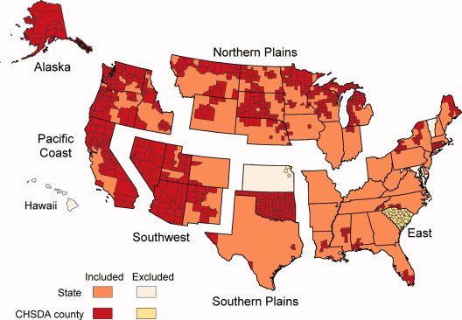
State and Contract Health Service Delivery Area (CHSDA) counties by IHS region

Slide 12
Cancer incidence rates, both sexes combined, CHSDA and all counties
Type of Cancer | AIAN | NHW | AIAN:NHW
CHSDA-All sites | 368.4 | 475.9 | 0.77
Kidney | 18.2 | 12.6 | 1.45
Stomach | 10.8 | 5.8 | 1.88
Cervix | 9.4 | 7.4 | 1.28
Liver | 9.0 | 4.3 | 2.11
Gallbladder | 3.3 | 0.9 | 3.59
All Co.-All sites | 275.5 | 479.0 | 0.58

Slide 13
Incidence rates for AIAN vs. NHW males by IHS region, 1999-2004
Type | AIAN | NHW | NP | AL | SP | PC | East | SW
All sit | 414.6 | 549.2 | 636.1 | 538.7 | 573.4 | 338.0 | 308.9 | 256.2
Prost | 105.6 | 154.4 | 174.6 | 78.3 | 156.7 | 83.2 | 83.9 | 65.7
Lung | 69.6 | 85.9 | 119.8 | 115.3 | 111.0 | 57.7 | 51.0 | 21.2
CRC | 52.6 | 59.8 | 88.9 | 98.5 | 70.3 | 44.0 | 31.1 | 25.7
Renal | 23.2 | 17.2 | 29.2 | 28.6 | 25.1 | 15.2 | 15.3 | 25.2
Blad | 16.5 | 41.5 | 26.8 | 23.0 | 25.0 | 14.1 | 22.8 | 5.7
NHL | 15.2 | 23.1 | 19.2 | 13.2 | 24.2 | 12.5 | 5.5 | 10.9
Stom | 14.7 | 8.5 | 18.7 | 34.6 | 10.5 | 12.2 | 7.9 | 15.3
Oral | 13.1 | 16.4 | 22.6 | 20.5 | 18.4 | 12.2 | 11.3 | 4.7

Slide 14
Incidence rates for AIAN vs. NHW females by IHS region, 1999-2004
Type | AIAN | NHW | NP | AL | SP | PC | East | SW
All sit | 337.6 | 424.0 | 471.1 | 500.7 | 440.9 | 295.1 | 272.0 | 218.3
Breas | 85.3 | 134.4 | 115.9 | 134.9 | 115.7 | 74.7 | 71.4 | 50.8
Lung | 48.5 | 58.6 | 93.8 | 75.4 | 69.9 | 48.0 | 43.5 | 10.4
CRC | 41.6 | 43.6 | 59.8 | 106.2 | 53.8 | 35.0 | 39.7 | 17.3
Uteru | 18.1 | 23.6 | 19.5 | 13.6 | 22.4 | 16.7 | 15.2 | 16.7
Renal | 14.2 | 8.7 | 19.3 | 12.0 | 18.1 | 10.2 | 14.0 | 12.4
NHL | 13.1 | 16.4 | 18.0 | 9.9 | 18.5 | 12.5 | 8.8 | 8.8
Ovary | 11.5 | 14.4 | 11.0 | 7.3 | 14.7 | 10.0 | 5.9 | 12.5
Pancr | 9.8 | 9.4 | 12.5 | 11.9 | 10.1 | 11.1 | 7.0 | 7.7

Slide 15
AIAN Total Mortality
NEJM 353;18 Nov 3 2005

Slide 16
Why do these inequities exist?

Slide 17
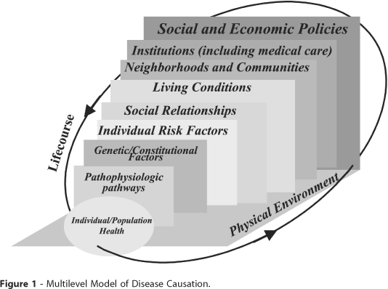
A multilevel model of disease causation
Kaplan GA, Upstream approaches to reducing socioeconomic inequalities in health, Rev Bras Epidemiol 2002; 5(Supl 1):18-27.

Slide 18
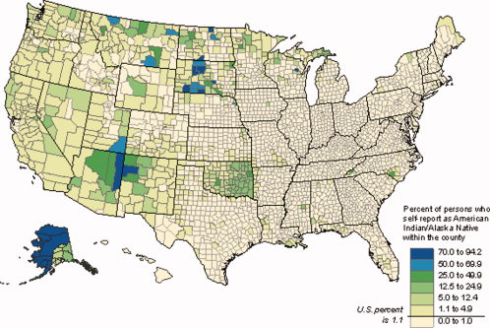
Percent of persons who self-report as AIAN within counties

Slide 19
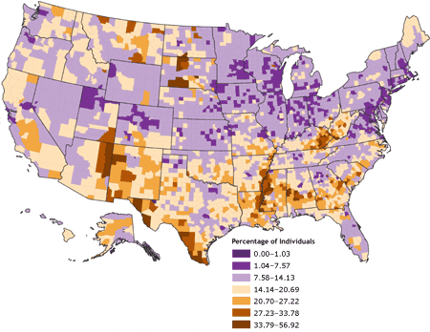
Percent of persons within counties living in poverty

Slide 20
Top 10 poorest counties in America, 2000 US Census
Buffalo Co., SD
Shannon Co., SD
Starr Co., TX
Ziebach Co., SD
Todd Co., SD
Sioux Co., ND
Corson Co., SD
Wade Hampton, AK
Maverick Co., TX
Apache Co., AZ
$5213
$6286
$7069
$7463
$7714
$7731
$8615
$8717
$8758
$8986
United States mean - $21,587
Notes:
20

Slide 21
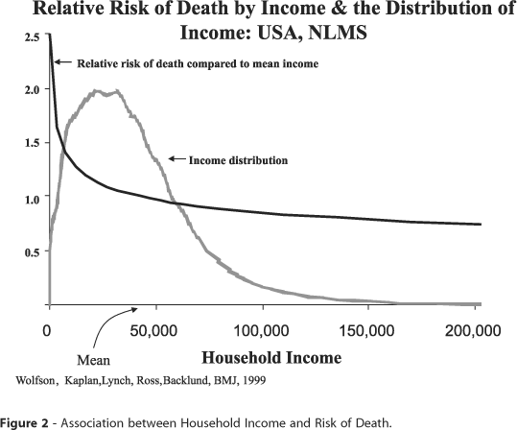
Association between household income and risk of death

Slide 22
AIAN Health Behaviors

Slide 23
Healthcare Expenditures
Access
NEJM 353;18 Nov 3 2005

Slide 24
What’s been/being done?
Varied BHCAIH Efforts
Notes:
24

Slide 25


Slide 26
Black Hills Center for American Indian Health
Community-based 501 (c)(3) organization
Founded in 1998
To conduct activities that will lead to the enhanced wellness of American Indian peoples, communities, and tribes
Research, Service, Education, and Philanthropy

Slide 27
Black Hills Center for American Indian Health
Research Portfolio
Currently home to 6 peer-reviewed health research grants and contracts totaling $9 million (historical: 32 and over $20 million)
Collaborative to Improve Native Cancer Outcomes (CINCO) CPHHD P50 – NIH/NCI
Native People for Cancer Control Community Networks Program – NIH/NCI
Native American Research Centers for Health: Lakota Center for Health Research – NIH/NIGMS/IHS

Slide 28
Black Hills Center for American Indian Health
Research Portfolio
Southwest Navajo Tobacco Education and Prevention Project (SNTEPP)– CDC/RWJ/ARNF/AZ
Lakota Oyate Wicozani Pi Kte RCT – NIH/NHLBI
The experience of chest pain among the Lakota pilot project – NIH/NCMHD

Slide 29
Black Hills Center for American Indian Health
Research Portfolio - Results
BHCAIH has consented more than 8,000 American Indians into its various studies in the past 8 years
Injected more than $5 million directly into impoverished Native communities
Directly or indirectly hired more than 40 tribal members to work on our varied projects
36 scientific publications and 4 book chapters

Slide 30
What’s been/being done?
Varied BHCAIH Efforts
SHS CVD Risk Prediction Model
Stop Atherosclerosis in Native Diabetics Study (SANDS)
Special Diabetes Program for Indians Competitive Grant Program
Notes:
30

Slide 31
What’s been/being done?
Community-based interventions to lower CVD risk among AIANs (NHLBI)
Economic Development
Casino gaming
Increasing # of interventions
Fitful advances in tribal sovereignty
Notes:
31

Slide 32
CONCLUSIONS
American Indians and Alaska Natives experience a number of health inequities
These inequities often have long-established histories
Social inequities have a profound impact on health status
It is likely that improvements in social condition, more than anything else, will begin to alleviate inequities in health

Slide 33
CONCLUSIONS
Tribal/community, clinical, and national leadership and governmental financial support are essential
Further research is needed to determine effective preventive interventions
Successful interventions need to be replicated and/or scaled up
Ongoing surveillance of behaviors and conditions is essential to gauge progress

Slide 34
CONTACT INFORMATION
Jeff Henderson
President and CEO
Black Hills Center for American Indian Health
701 St. Joseph St., Suite 204
Rapid City, SD 57701
(605) 348-6100
(605) 348-6990 fax
E-mail: jhenderson@bhcaih.org

