Slide 1

Building Stronger Communities for Better Health: Moving from Science to Policy and Practice
Brian D. Smedley, Ph.D.
Health Policy Institute
The Joint Center for Political and Economic Studies
www.jointcenter.org/hpi
Presented at the 17th Annual Summer Public Health Research Videoconference on Minority Health, June 7, 2011, www.minority.unc.edu/institute/2011/

Slide 2
Challenges:
Health inequality will get worse as a result of the economic downturn.
Despite the historic nature of the 2008 election, the United States is NOT “post-racial” – to the extent that this perception exists, political pressure for action will be diminished.
The “individual determinist” orientation remains predominant in the United States

Slide 3
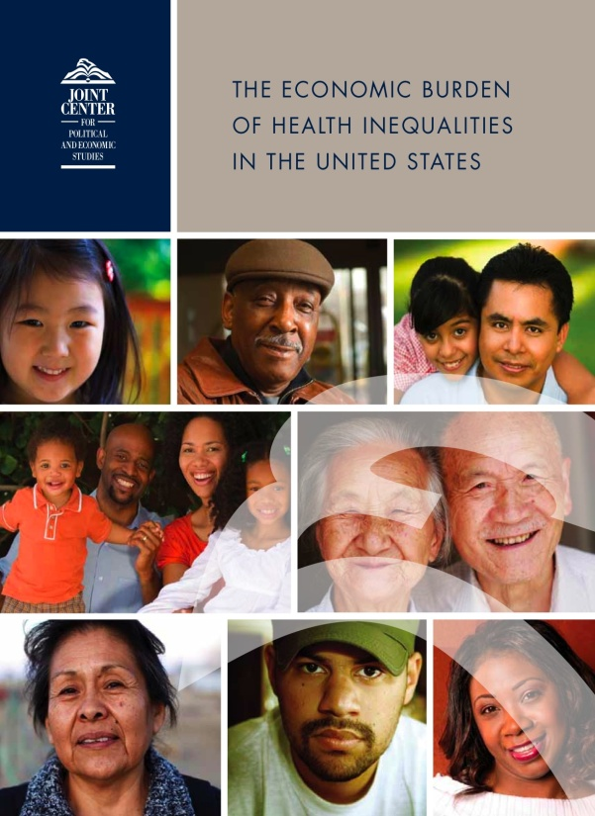
The Economic Burden of Health Inequalities in the United States (www.jointcenter.org/hpi)
Direct medical costs of health inequalities
Indirect costs of health inequalities
Costs of premature death

Slide 4
The Economic Burden of Health Inequalities in the United States
Between 2003 and 2006, 30.6% of direct medical care expenditures for African Americans, Asians, and Hispanics were excess costs due to health inequalities.
Eliminating health inequalities for minorities would have reduced direct medical care expenditures by $229.4 billion for the years 2003-2006.
Between 2003 and 2006 the combined costs of health inequalities and premature death were $1.24 trillion.

Slide 5
What Factors Contribute to Racial and Ethnic Health Disparities?
Socioeconomic position
Residential segregation and environmental living conditions
Occupational risks and exposures
Health risk and health-seeking behaviors
Differences in access to health care
Differences in health care quality
Structural inequality – including historic and contemporary racism and discrimination – influences all of the above

Slide 6
Neighborhood Factors Influence Health Through:
Direct effects on both physical and mental health
Indirect influences on behaviors that have health consequences
Health impacts resulting from the quality and availability of health care
Health impacts associated with the availability of opportunity structures (e.g., access to healthy food, safe spaces, capital, transportation)

Slide 7
The Role of Segregation

Slide 8
Racial Residential Segregation – Apartheid-era South Africa (1991) and the US (2001)
Source: Massey 2004; Iceland et al 2002; Glaeser and Vigitor 2001

Slide 9

The Share of Poor Families Living in High Poverty Neighborhoods is Declining . . .

Slide 10
. . . But Segregation is Deepening

Slide 11
Negative Effects of Segregation on Health and Human Development
Racial segregation concentrates poverty and excludes and isolates communities of color from the mainstream resources needed for success. African Americans are more likely to reside in poorer neighborhoods regardless of income level.
Segregation also restricts socio-economic opportunity by channeling non-whites into neighborhoods with poorer public schools, fewer employment opportunities, and smaller returns on real estate.

Slide 12
Negative Effects of Segregation on Health and Human Development (cont’d)
African Americans are five times less likely than whites to live in census tracts with supermarkets, and are more likely to live in communities with a high percentage of fast-food outlets, liquor stores and convenience stores
Black and Latino neighborhoods also have fewer parks and green spaces than white neighborhoods, and fewer safe places to walk, jog, bike or play, including fewer gyms, recreational centers and swimming pools

Slide 13
Negative Effects of Segregation on Health and Human Development (cont’d)
Low-income communities and communities of color are more likely to be exposed to environmental hazards. For example, 56% of residents in neighborhoods with commercial hazardous waste facilities are people of color even though they comprise less than 30% of the U.S. population
The “Poverty Tax:” Residents of poor communities pay more for the exact same consumer products than those in higher income neighborhoods­– more for auto loans, furniture, appliances, bank fees, and even groceries

Slide 14
Share of children who experience double jeopardy: Live in BOTH poor families and poor neighborhoods
Source: Acevedo-Garcia, Osypuk, McArdle & Williams, 2008
Note: Poor neighborhoods are those with poverty rates over 20%.
Source: 2000 Census.

Slide 15
Black/Hispanic Students Attend Schools with Dramatically Different Racial Compositions Than Those of White Students
(Percent of Students Attending Schools by Black/Hispanic Share of Enrollment: 2006-07)
Black/Hispanic Share of Enrollment
Source: National Center for Education Statistics, Common Core of Data, 2006-07.

Slide 16
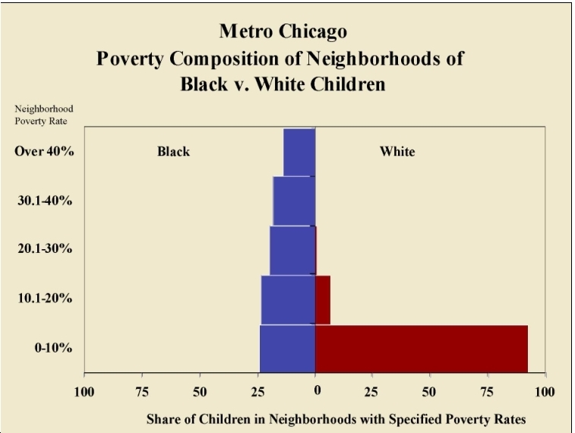

Slide 17
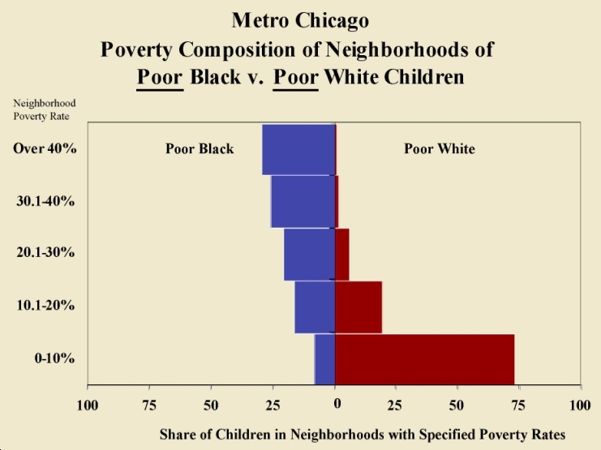

Slide 18
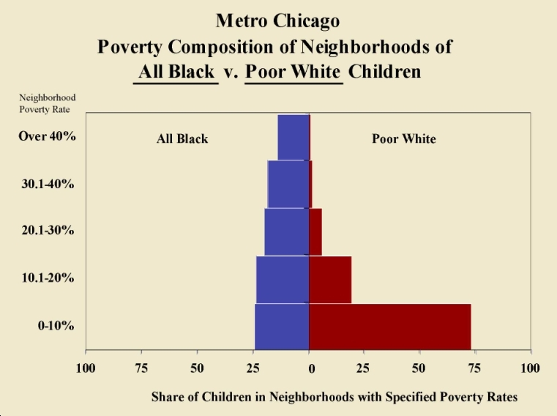

Slide 19
Science to Policy and Practice—What Does the Evidence Suggest?
A focus on prevention, particularly on the conditions in which people live, work, play, and study
Multiple strategies across sectors
Sustained investment and a long-term policy agenda

Slide 20
Science to Policy and Practice—What Does the Evidence Suggest?
Place-based Strategies: Investments in Communities
People-based Strategies: Increasing Housing Mobility Options

Slide 21
Create Healthier Communities:
Improve food and nutritional options through incentives for Farmer’s Markers and grocery stores, and regulation of fast food and liquor stores
Structure land use and zoning policy to reduce the concentration of health risks
Institute Health Impact Assessments to determine the public health consequences of any new housing, transportation, labor, education policies

Slide 22
Improve the Physical Environment of Communities:
Improve air quality (e.g., by relocating bus depots further from homes and schools)
Expand the availability of open space (e.g., encourage exercise- and pedestrian-friendly communities)
Address disproportionate environmental impacts (e.g., encourage Brownfields redevelopment)

Slide 23
Expand Opportunities for Quality Education:
Expand high-quality preschool programs
Create incentives to attract experienced, credentialed teachers to work in poor schools
Take steps to equalize school funding
Expand and improve curriculum, including better college prep coursework
Reduce financial barriers to higher education

Slide 24
Expanding Housing Mobility Options:
Moving To Opportunity (MTO)
U.S. Department of Housing and Urban Development (HUD) launched MTO demonstration in 1994 in five cities: Baltimore, Boston, Chicago, Los Angeles, and New York.
MTO targeted families living in some of the nation’s poorest, highest-crime communities and used housing subsidies to offer them a chance to move to lower-poverty neighborhoods.
Findings from the follow up Three-City Study of MTO, in 2004 and 2005, answer some questions but also highlight the complexity of the MTO experience and the limitations of a relocation-only strategy.
Away from concentrated poverty, would families fare better in terms of physical and mental health, risky sexual behavior and delinquency? Adolescent girls benefited from moving out of high poverty more than boys.

Slide 25
Other Obama Administration Initiatives
Promise Neighborhoods ($210 million) attempt to bring the innovative ideas of the Harlem Children’s Zone into communities across the country. By simultaneously focusing on the myriad needs of young children – education, health, mentorship, etc. – Promise Neighborhoods can break the cycle of inter-generational poverty and tap the potential of millions of young people.
Healthy Food Financing Initiative ($400 million) – would help tackle the dual scourges of joblessness and obesity in underserved communities by helping supermarket operators open new stores, new farmers markets take root, and corner store owners buy the refrigeration units they need to carry fresh food.
Choice Neighborhoods ($250 million) – would ensure that housing is linked to school reform, early childhood innovations, and supportive social services, tying housing developments to a range of services and supports leads to improved economic well-being for families.
Sustainable Communities Initiative ($150 million) – a joint effort by HUD, the Department of Transportation, and the EPA – is designed to "improve access to affordable housing more transportation options, and lower transportation costs while protecting the environment in communities nationwide."

Slide 26
Moving from Science to Practice – The Joint Center Place Matters Initiative
Objectives:
Build the capacity of local leaders to address the social and economic conditions that shape health;
Engage communities to increase their collective capacity to identify and advocate for community-based strategies to address health disparities;
Support and inform efforts to establish data-driven strategies and data-based outcomes to measure progress; and
Establish a national learning community of practice to accelerate applications of successful strategies

Slide 27
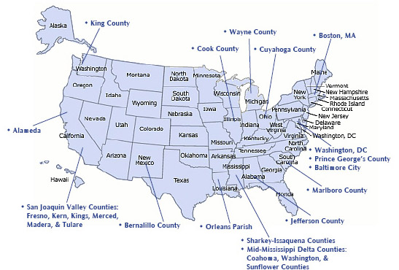
Moving from Science to Practice – The Joint Center Place Matters Initiative

Slide 28
Intersection of Health, Place & Equity
Health
facilities
Access to
Healthy
Food
Schools/
Child care
Health
Housing
Community
Safety/ violence
Environment
Equity
Parks/Open
Space playgrounds
Transportation
Traffic patterns
Work environments
Notes:
Outline the Issues
May be helpful to support with examples from recent news or statistics from catchment area (local, state, national area or foundation’s targeted populations). Some points for elaboration:
Schools – both youth education and higher education
Safety – on many levels, starting with youth safety in the home and at school; safe places for everyone to work, live and play; traffic safety; etc.
Transportation – safe and affordable options for commuting; ability to access needed resources
Pollution – the water we drink, the air we breathe, our food sources
Climate change – critical issue internationally
Access to resources – access to healthy foods, clothing, necessities for living
“These issues are complex and interrelated.” [click]
Obvious links between climate change, pollution, and sustainability [click]
Jobs, education and available resources are factors of the economy [click]
Health impacted by pollution, safety, ability to transport to get the resources, to get the exercise, to get to the doctor, etc.
Point out links between Environment, Economy & Health as well
This diagram does not reflect all of the linkages or all of the factors

Slide 29
Moving from Science to Practice – The Joint Center Place Matters Initiative
Progress to Date—Place Matters teams are:
Identifying key social determinants and health outcomes that must be addressed at community levels
Building multi-sector alliances
Engaging policymakers and other key stakeholders
Evaluating practices

Slide 30
“[I]nequities in health [and] avoidable health inequalities arise because of the circumstances in which people grow, live, work, and age, and the systems put in place to deal with illness. The conditions in which people live and die are, in turn, shaped by political, social, and economic forces.”
World Health Organization Commission on the Social Determinants of Health (2008)

