Slide 1
Diabetes among American Indians:
A Case Study in Moving from
Health Disparities to Health Equity
Ronny A. Bell, PhD, MS
Professor, Department of Epidemiology and Prevention, Division of Public Health Sciences
Co-Director, Maya Angelou Center for Health Equity
18th National Health Equity Research Webcast
University of North Carolina Gillings School of Global Public Health
June 5, 2012
www.minority.unc.edu/institute/2012/

Slide 2

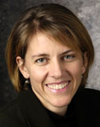
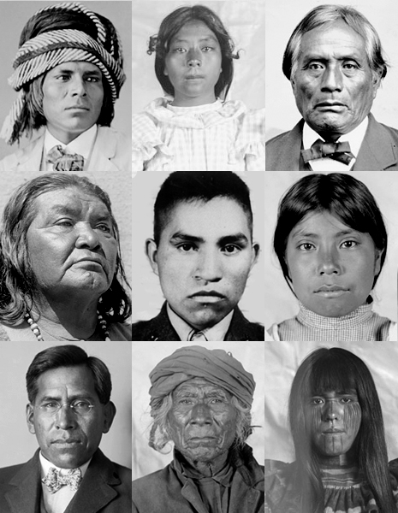
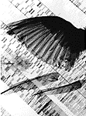

Diabetes AMONG American Indians

Slide 3
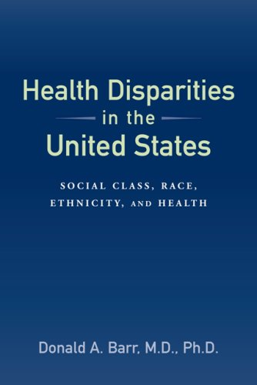
Health Disparities
"Health disparities are differences in the incidence, prevalence, mortality, and burden of diseases and other adverse health conditions that exist among specific population groups in the United States."
Source: National Institutes of Health

Slide 4

Diabetes Disparities – American Indians
American Indians are at least 2.2 times more likely to develop diabetes in their lifetime compared to non-Hispanic Whites
The diabetes death rate is 3 times higher for American Indians compared to the US general population
American Indians with diabetes are 3.5 times more likely to develop kidney failure compared to the general population
Source: Indian Health Service

Slide 5
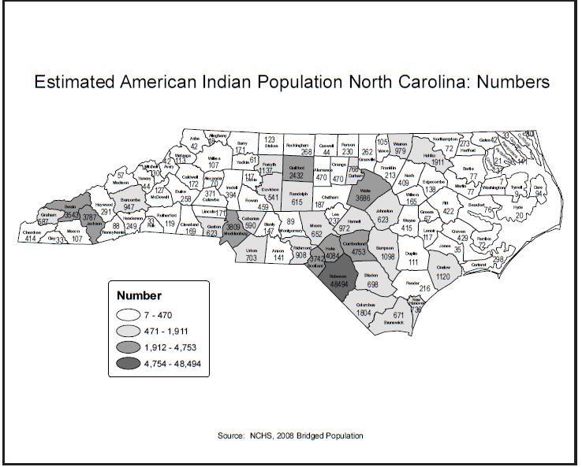

Slide 6
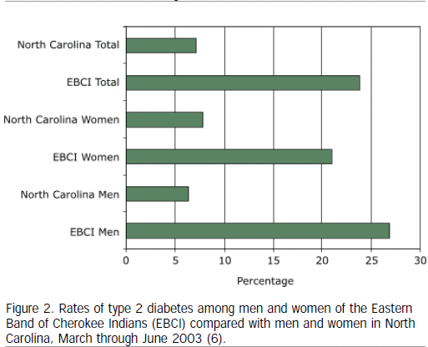
Source: Bachar et al, Preventing Chronic Disease, 2006

Slide 7
Prevalence of Diabetes in Youth Ages 10 - 19, by Race/Ethnicity and Clinical Diabetes Type
SEARCH for Diabetes in Youth Study

Slide 8

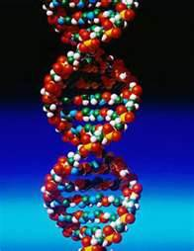
Diabetes Disparities Among American Indians Why?
The “Biomedical” Model
“Poor” Diet
Physical Inactivity
“Genes”
Inadequate access to and utilization of health care resources

Slide 9

Health Equity
“Health equity is the attainment of the highest level of health for all people.
Achieving health equity requires valuing everyone equally with focused and ongoing societal efforts to address avoidable inequalities, historical and contemporary injustices, and the elimination of health and healthcare disparities.”
Source: US Department of Health and Human Services, National Partnership for Action to End Health Disparities

Slide 10
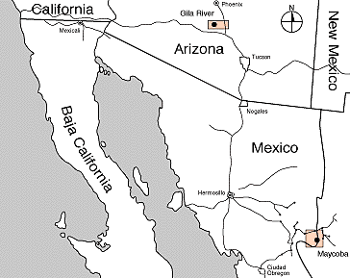
Diabetes Disparities Among American Indians – Why?
The “Health Equity” Model
Poverty
Inappropriately applied local, state and federal policies
Racism
Hopelessness/Fatalism
Historical Trauma

Slide 11
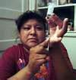

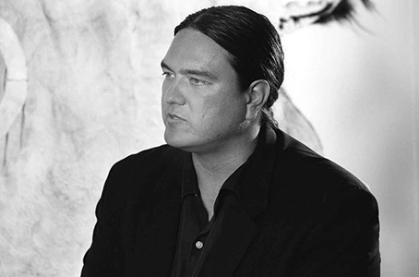
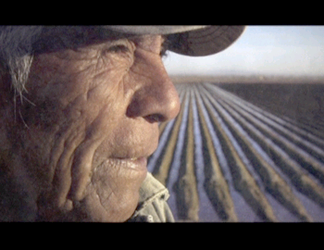
Diabetes Disparities Among American Indians “Bad Sugar”

Slide 12
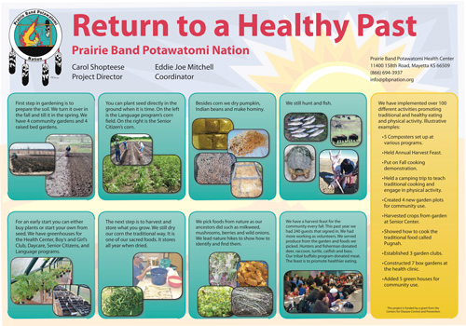
Diabetes Prevention and Control In
American Indian Communities
Education
Cultural Adaptation
Empowerment
Allocation of Resources
Holistic Orientation

Slide 13
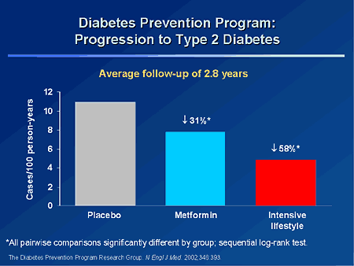

Slide 14

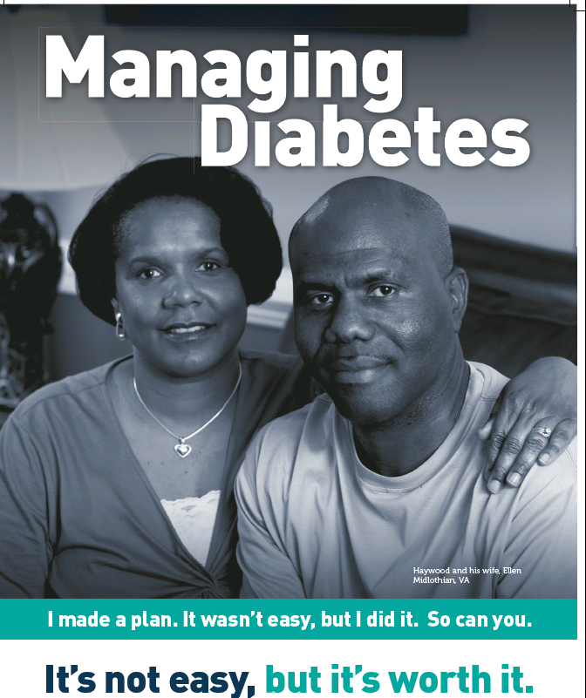
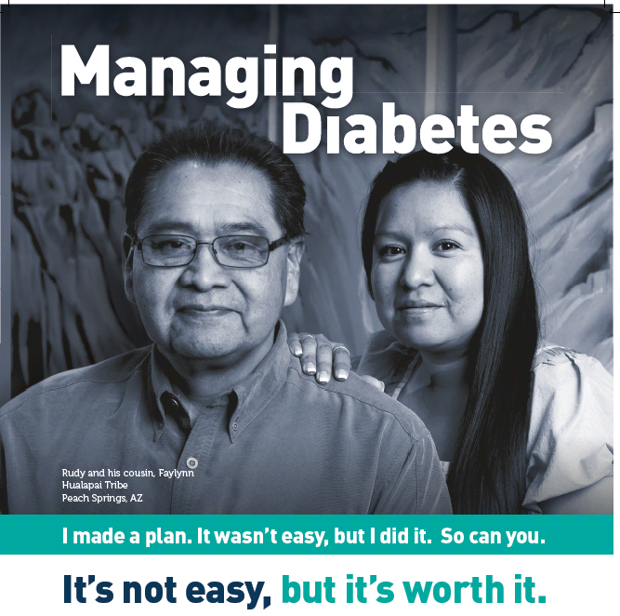
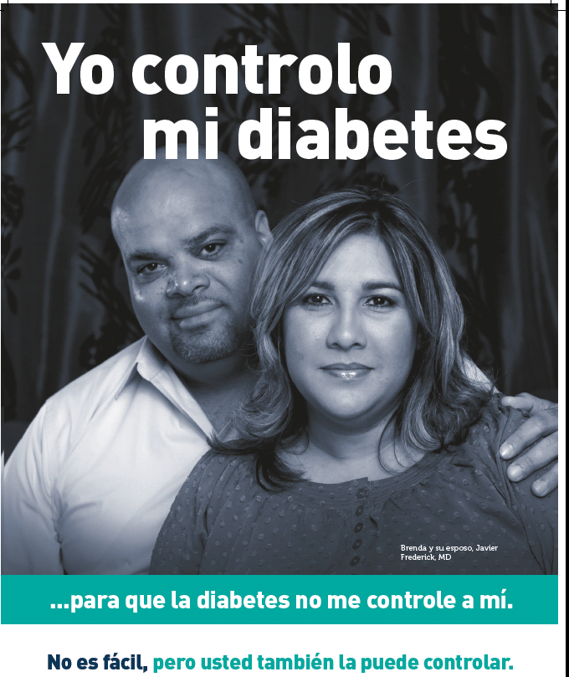

Slide 15
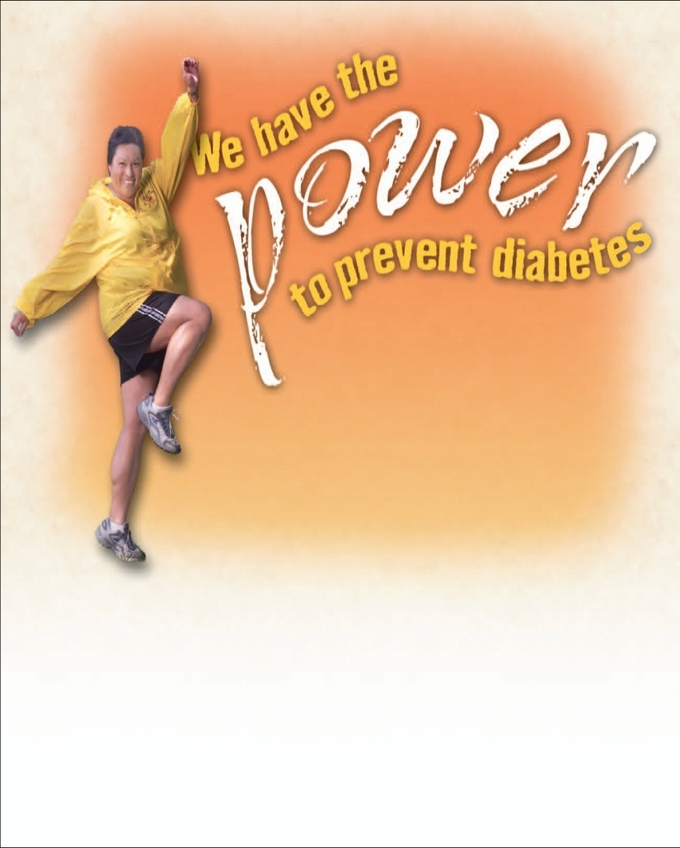
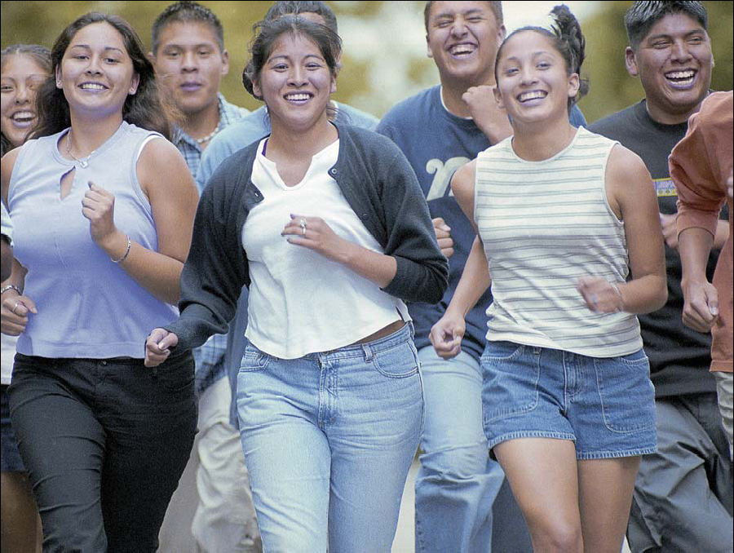
Diabetes Prevention in American Indian Communities
Power to Prevent Campaign
Move It! Campaign

Slide 16
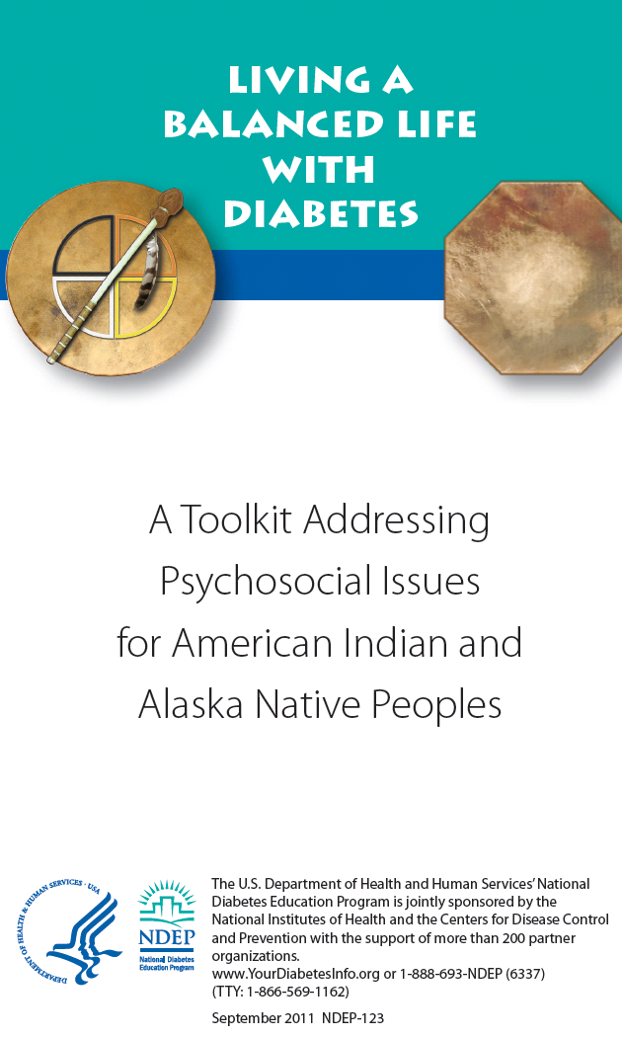

Slide 17
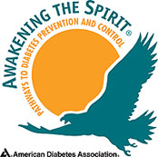


Cultural Approaches to Diabetes Prevention and Control

Slide 18
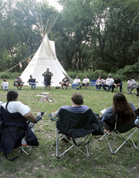

Cultural Approaches to Diabetes Prevention and Control
Diabetes Talking Circles

Slide 19
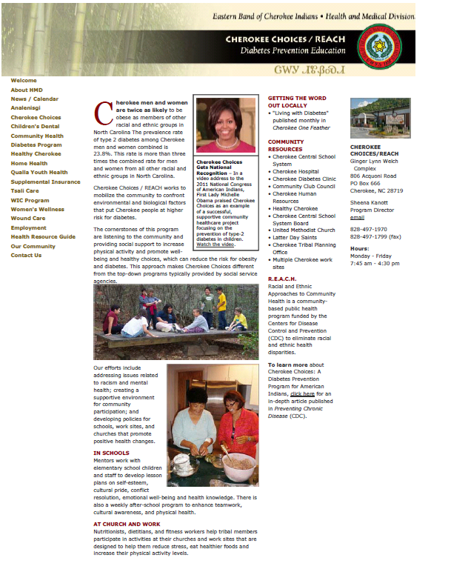

Slide 20
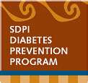
Changes in Indicators of Diabetes Control As a Result of the Special Diabetes Program for Indians (SDPI) and the Government Performance and Results Act
Control Indicator | Pre-SDPI (1995) | SDPI Era (2001)
A1c Control | 8.9% | 7.9%
Diastolic Blood Pressure | 79 mm Hg | 76 mm Hg
Total Cholesterol | 208 mg/dl | 193 mg/dl
Triglycerides | 257 mg/dl | 235 mg/dl
Source: Wilson et al, AJPH 2005

Slide 21
Summary
Diabetes disparities clearly exist for American Indians
The causes of these disparities are multi-faceted
The solutions to achieving health equity in diabetes for American Indians are also multi-faceted, and require a concerted effort to address this tragedy

Slide 22
For More Information:
Ronny A. Bell, PhD, MS rbell@wakehealth.edu
336-716-9736 www.wakehealth.edu/mache

