Slide 1
The Promise of Early Childhood Education:
Preventing Health and Learning Disparities
Portia Kennel
Senior Vice President, Ounce of Prevention Fund
June 4, 2013
19th National Health Equity Research Webcast
University of North Carolina at Chapel Hill
www.minority.unc.edu/institute/2013/

Slide 2
The State of Minority Children’s Health
Low-income children have higher rates of mortality and disability and are more likely to be in fair or poor health.
Black and Latino children are more likely to be in poor health than White children.
Children who are poor, of color or uninsured are more likely to lack access to appropriate health care.
Source: National Institute for Health Care Management, 2007

Slide 3
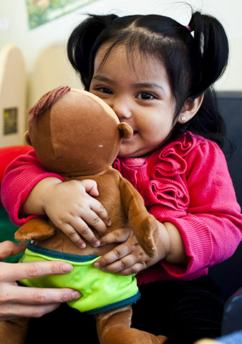
Adverse experiences and toxic stress in early childhood increase the likelihood for health risks, stress-related disease and learning disparities throughout a child’s life and into adulthood.

Slide 4

Early experiences during critical periods of development build the foundation for later learning and health.

Slide 5
The achievement gap starts well before Kindergarten
Disparities in early vocabulary development
Professional Parents
1200
Working Class Parents
600
Cumulative Vocabulary (Words)
Welfare
Parents
200
16 mos.
24 mos.
36 mos.
Child’s Age (Months)
Source: Hart & Risley (1995)

Slide 6

Early Childhood Education:
Front Line for Preventing Learning & Health Disparities
Rich learning environments linked to positive health outcomes throughout life
Comprehensive supports to families from prenatal to age five
Engage families in developing healthy behaviors for them and their children
Reduce stress-related roots of health disparities
Referrals and linkages to community resources for medical and dental homes, developmental screenings, well-child check ups and immunizations

Slide 7
Educare Learning Network Vision Statement
The Educare Learning Network will
demonstrate that research-based early
childhood education prevents the persistent
achievement gap for our nation’s most at-risk
young children. The Network’s evidence,
practice expertise, and dynamic partnerships
will help ensure that all children and families,
especially those at greatest risk, will have
access to effective early learning, and that the
first five years will be an integral part of the
nation’s education system.

Slide 8
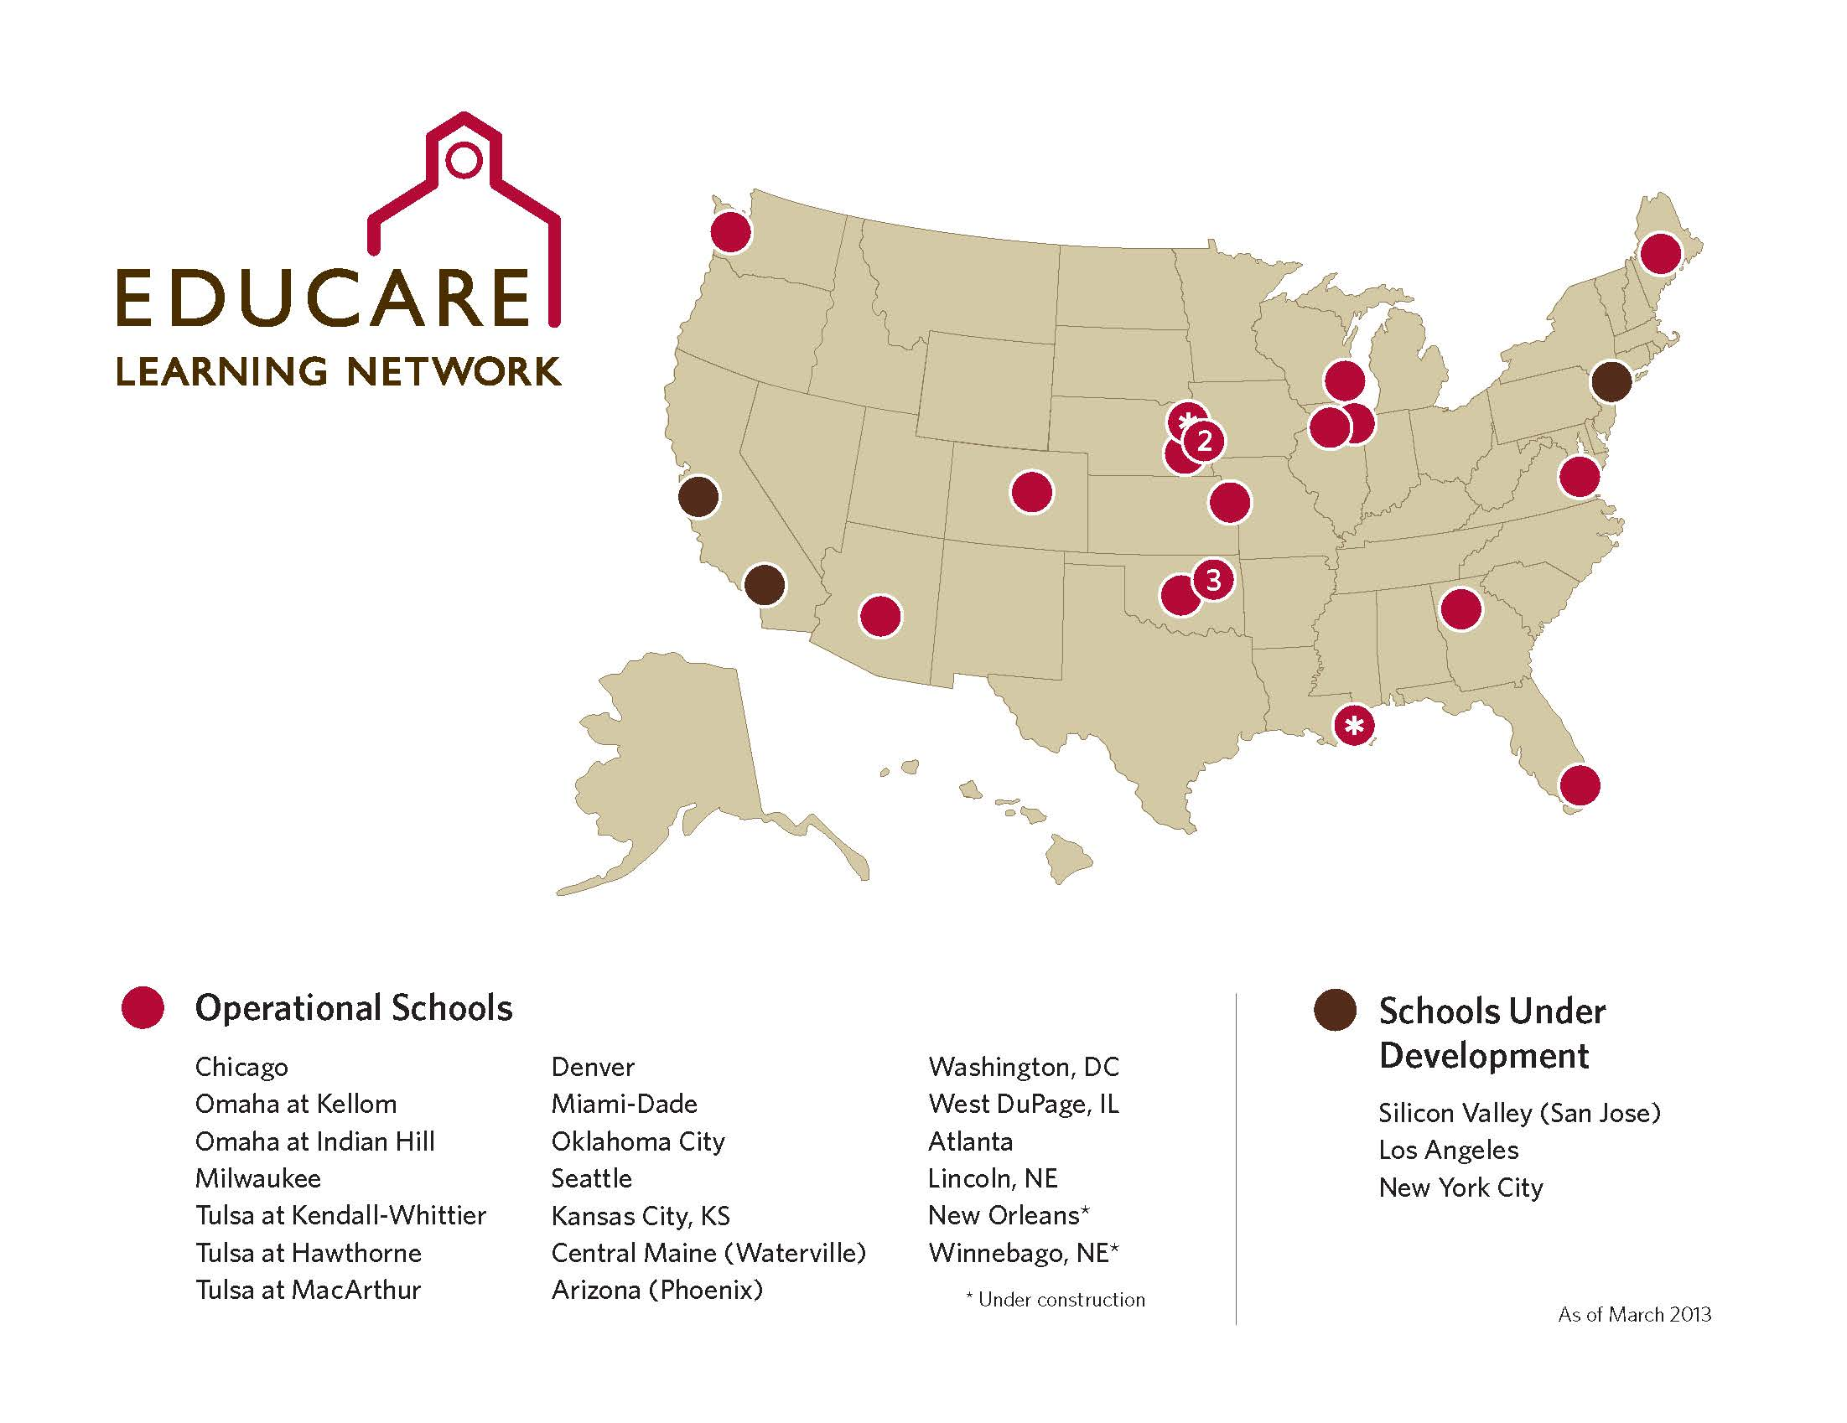

Slide 9



Educare is…
Partnership
Place
Program
Platform for Change

Slide 10
13 Core Features of the Educare Model
Provide full-day, full-year services
Use data collection and analysis to drive quality and ensure student success
Maintain Small Class Size & High Staff/Child Ratios
    3:8 for 0-3
    3:17 for 3-5
Maintain High Staff Qualifications & Intensive Staff Development
Provide Continuity of Care to help children develop secure relationships
On-site Family Support & Strong Parent Engagement
Implement Reflective Practice & Supervision
Interdisciplinary Work
Language & Literacy
Social and Emotional Development
Numeracy & Problem-Solving
Integrating the Arts
Start Early: Emphasize Prenatal Services

Slide 11

Framework for the Core Features
Data Utilization
Embedded Professional Development
High Quality Teaching Practices
Intensive Family Engagement
Dosage: Duration and Intensity

Slide 12
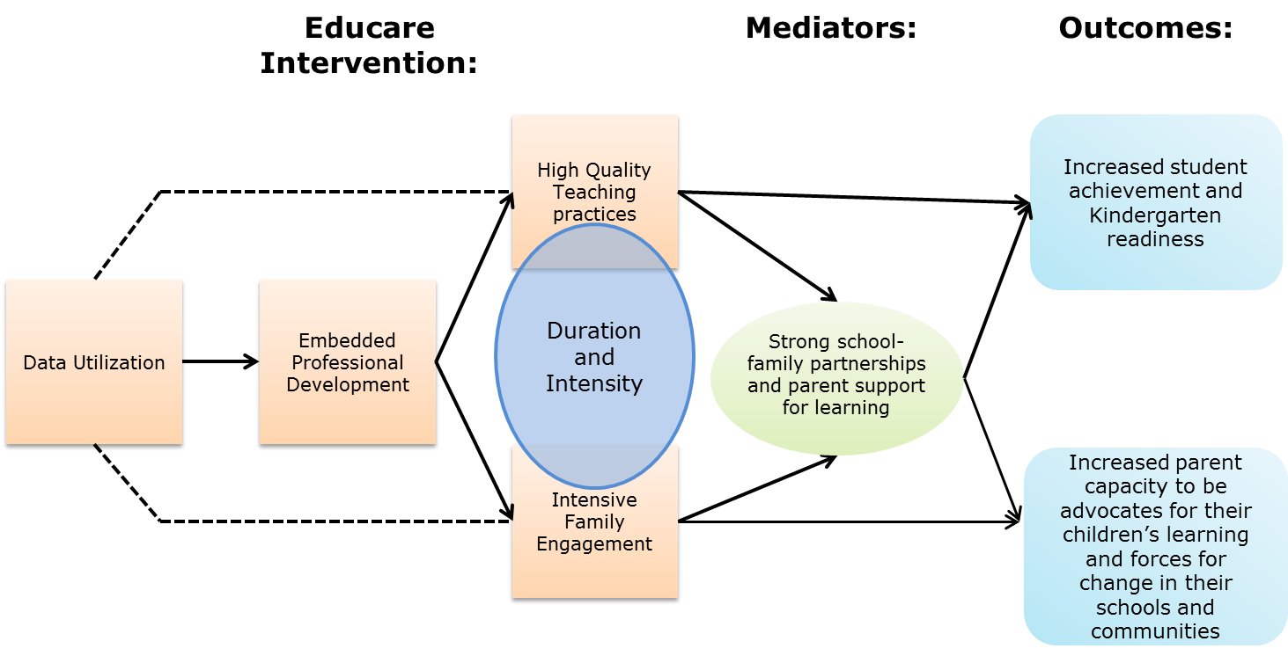
Educare Theory of Change

Slide 13
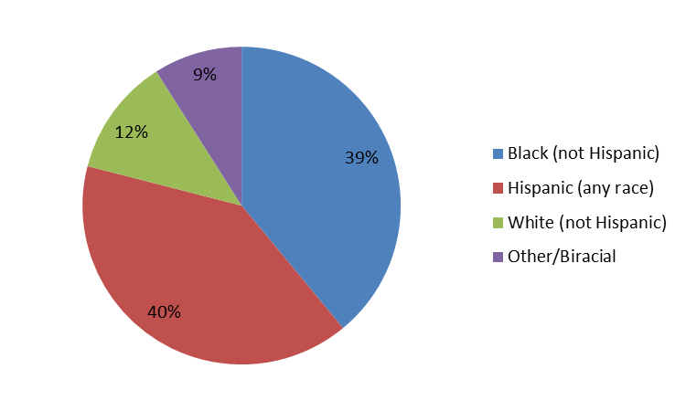
Educare Child Racial/Ethnic Demographics (2011–12)

Slide 14
Educare Child Demographic Characteristics (2011–12)
47% girls, 53% boys
97% of children were born in US
11% have a special need as identified by an IEP/IFSP
78% reported to have very good or excellent health

Slide 15
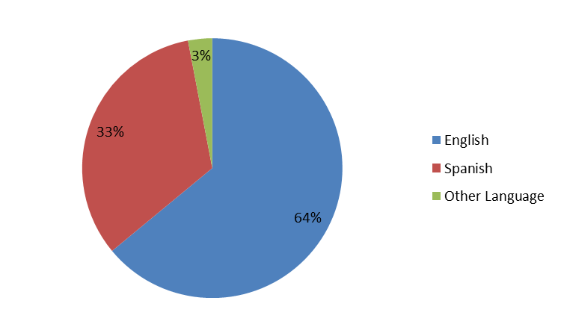
Educare Child Home Language (2011–12)

Slide 16
Educare Parent Demographic Characteristics (2011–12)
Similar to Head Start nationally (using FACES data for comparison)
Primary caregiver: 92% Mom; 3% Dad; 3% Grandma
20% of moms were teens when child was born
48% are a single parent
66% were born in the U.S.

Slide 17
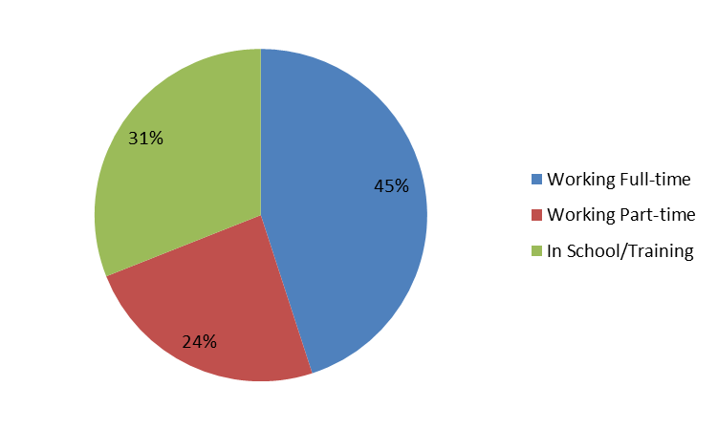
Educare Parent Employment Status (2011–12)

Slide 18
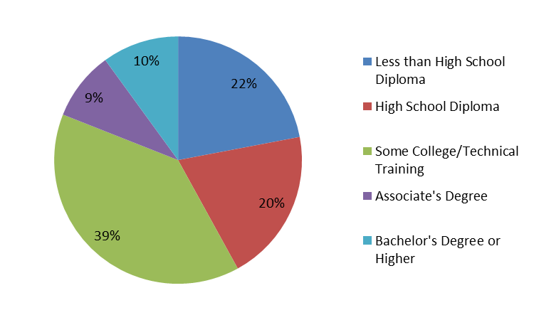
Educare Parent Educational Attainment (2011–12)

Slide 19
Serious Life Events & Risk Factors (2011–12)
Substantial change in income – 38.6%
Major change in living conditions – 31.9%
Change in primary caregiver’s work – 29.1%
Separate from partner – 22.5%
Family member incarcerated – 15.3%
Death of someone important in child’s life – 13.5%
Family member had serious illness – 12.5%
Family member victim of violent crime – 6.3%
Child was witness to domestic violence – 5.1%
Lived with someone with alcohol/drug problem – 4.9%
Parent screen positive for depression – 18%
Sometimes or often worry about food running out – 39%

Slide 20

How Educare Schools Promote Health & Learning
Head Start Standards
  Partnerships with community health providers
  Medical home
  Developmental screenings
  Immunizations
  Well-Child check ups
  Connections to WIC/SNAP supports
  Access to and provide child & family mental health services
  Screening, access and referral for disability services
Health clinics at Educare Schools in Arizona, Kansas City and Milwaukee
Parent classes on nutrition, healthy cooking and exercise
Parent-child activities focused on health & nutrition

Slide 21

Educare: Demonstrating Results
School Readiness
Language/Vocabulary
Social and Emotional Skills
Classroom Quality

Slide 22
School Readiness: Early Entry Matters Educare children emerge prepared for Kindergarten
National
Mean
=100
English Bracken scores of kindergarten-bound children,
by age of entry into Educare (all sites), 2007-11

Slide 23
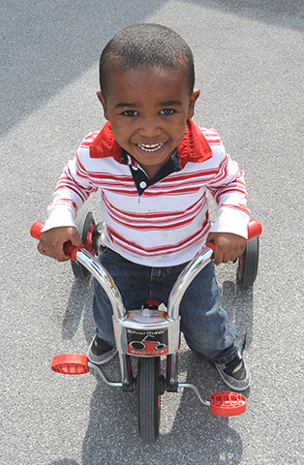
Long-term Health Outcomes of Early Childhood Intervention
Abecedarian Study
  Better health outcomes in adulthood
  Healthier lifestyle behaviors in adulthood

Slide 24

Call to Action
High quality early childhood programs can prevent learning disparities and promote better health outcomes in adulthood
Start early with prenatal care for mothers and high quality programs for children beginning at birth
Invest in innovative health and nutrition services for early childhood programs
Build and maintain community partnerships that support children’s health and learning
Increase coordination between early childhood and health care systems

Slide 25



pkennel@educarenetwork.org
www.ounceofprevention.org www.educareschools.org

Slide 26
Educare 13 Core Features

Slide 27

Full Day, Full Year
Birth to Five--Start Early
Dosage/Sustaining Gains
Meet the needs of families who are working or in school
Typical hours of operation:
7am-6pm
Importance of Early Entry

Slide 28

Data Utilization
Research-based strategies
Data driven practices
  Network level
  School level
  Individual children and families

Slide 29
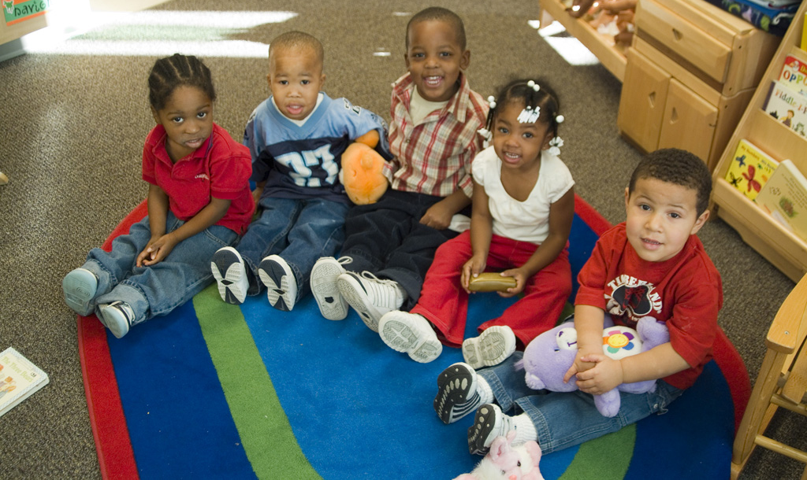
Maintain Small Class Size & High Staff/Child Ratios
Infant-toddler rooms -- 3 adults : 8 children
Preschool rooms -- 3 adults : 17 children

Slide 30
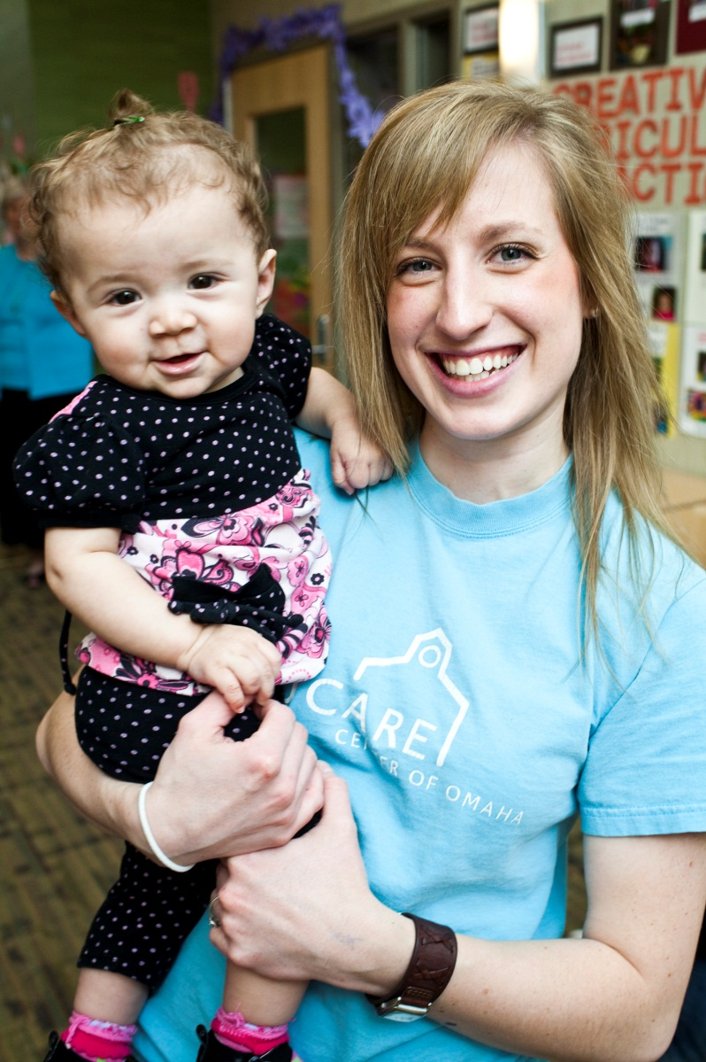
Maintain High Staff Qualifications & Intensive Staff Development
In each classroom:
    Teacher
    Assistant Teacher
    Teacher Aide
Family Support Supervisor & Family
Support Specialists
All staff have individual professional
development plans & is a priority for
the program
Variety of partnerships to enhance
PD offerings

Slide 31

Provide Continuity of Care to Help Children Develop Secure Relationships
Children remain with same
teaching team:
From entry until transition to 3-5
& from 3-5 until kindergarten
Same Age or Mixed Age
Primary Caregiving

Slide 32
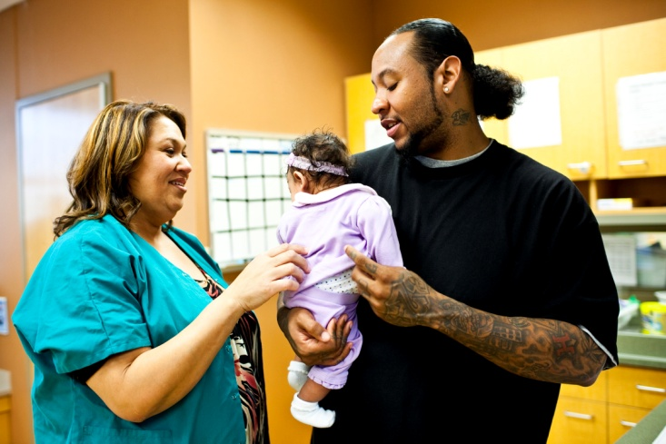
On-site Family Support & Strong Parent Engagement
Family support staff have a
specific & intentional role in
supporting 3 overarching
principles:
1. The parent-child relationship
2. The parent’s role in their child’s development, health, & learning
3. The parent’s role in their child’s school experiences

Slide 33
Reflective Practice & Supervision
Reflective Practice as an organizational model
Program design & management support the
integration of reflective practice & supervision throughout Educare
Supervisors have no more than 6 supervisees
Regular Individual and Group Reflective
Supervision

Slide 34
Interdisciplinary Work
Seeing the child in the context of
family through a collaborative process
Strategies for staff to understand the
importance of multiple perspectives
An interdisciplinary team conducts
Family/Child Reviews (FCRs) regularly
in order to discuss & understand each
child in context of family & community
Use of specialized, integrated
consultants

Slide 35
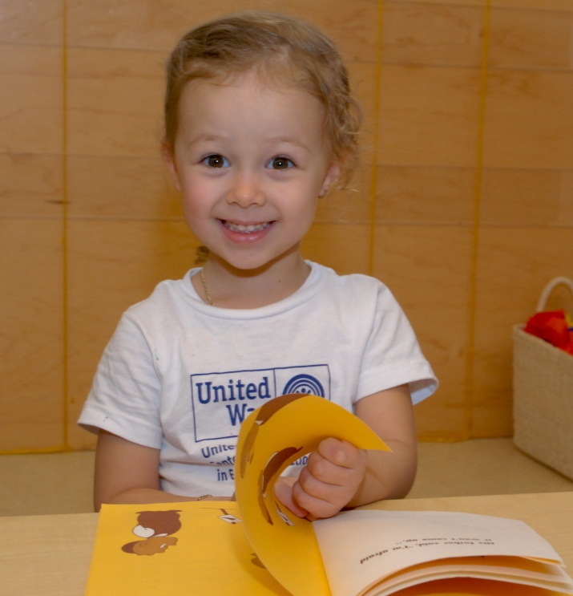
Language & Literacy
Focus on oral language development
Focus on children as readers and authors
Print-rich environment
Intentional use of the focused teaching cycle

Slide 36
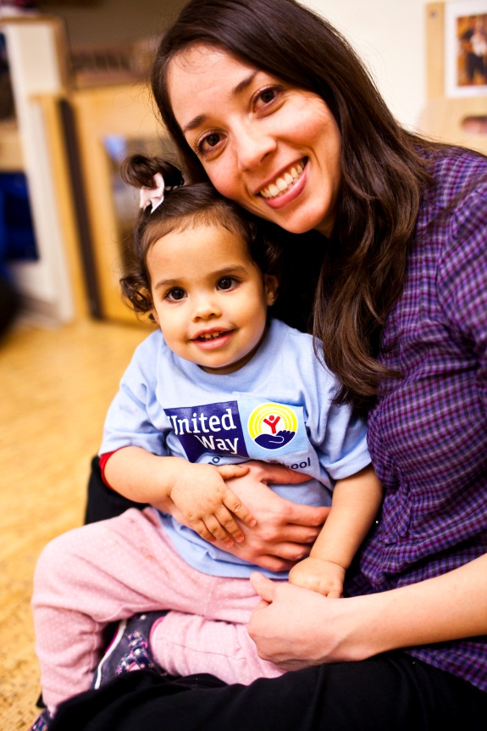
Social and Emotional Development
Focus on Relationships
Social, Emotional and Executive Function skills taught
Supporting Transitions into, within, and out of Educare
Proactive and positive child guidance
Integration of Mental Health Consultation

Slide 37

Foundational Math Skills
Focus on numeracy & problem-solving
Hands-on materials to promote the understanding of abstract math concepts
Intentional use of the focused teaching cycle

Slide 38
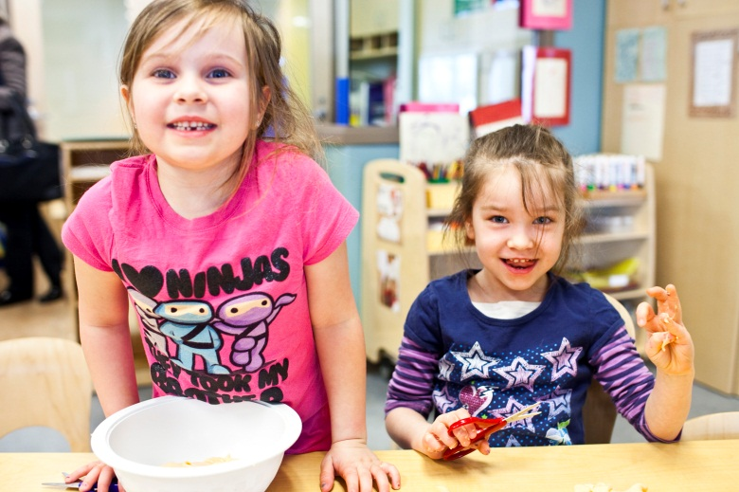
Integrate the Arts
Arts include: drama, dance, music, story-telling & visual arts
Art experiences included in all curricular areas to strengthen all domains of development & learning
Intentional use of the focused teaching cycle
Community artists’ performances & in-residence
Activities for parents, families, & staff

Slide 39
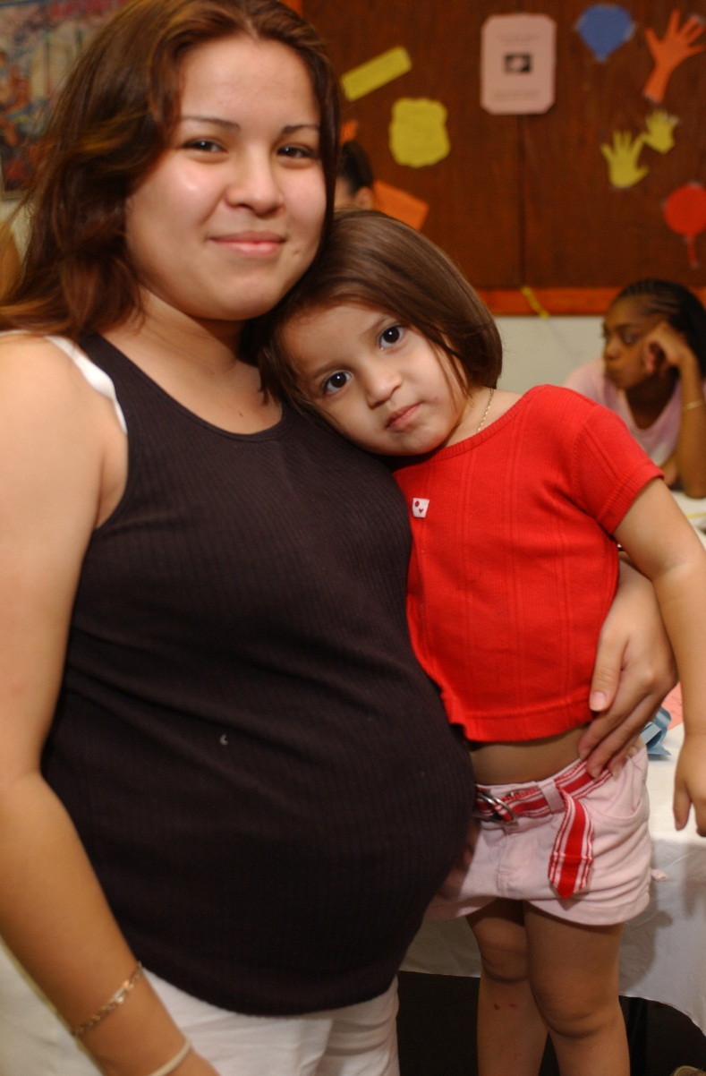
Emphasize Prenatal Services
Provide supportive, caring and educational experiences and services to pregnant women and newborns
Provide seamless transitions from prenatal to Educare program
Referrals through Community Collaborations

