Slide 1
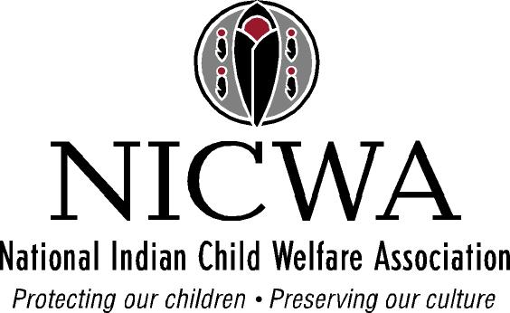
Achieving Health Equity for Native Children: The Role of Families, Community, and Culture
Sarah Kastelic, PhD
19th National Health Equity Research Webcast
Early Childhood Development: Investing in Our Children and Our Future
University of North Carolina at Chapel Hill
June 4, 2013

Slide 2
Agenda
Culture
Native Child Development
Health Disparities
Historical Trauma
Role of Families, Community and Culture in Achieving Health Equity

Slide 4
Culture
“…at its core, culture is far deeper and complex than the outward physical trappings or even language. It is at the level of worldview, values, patterns of interaction, and methods of problem solving that distinguishes it from other cultures.” (Deloria, 1979, p.151)

Slide 5
Native Child Development
“…different cultural worldviews and values forecast differences in developmental processes, challenges, and outcomes.” (Cross, 1997, p.2)

Slide 6
Native Child Development
Mainstream models of development are based on a cultural bias toward individuality
There is no existing Western theory regarding healthy interdependence
Developmental stages and the ultimate objective are different
Normal development geared toward healthy interdependence can be mistaken for pathological

Slide 7
Native Child Development
The goal of Native child development is “the emergence of healthy interdependence while maintaining individual autonomy.” (Cross, 1997, p. 8)

Slide 8
A Healthy Native Youth
Healthy relationships
Connecting with resources
Service
Safety
Coping capacities—emotional health
Focus and determination
Personal capacities
Personal qualities
Education
Employment
Cultural knowledge
Identity
Finances
Fitness
Health care
Healthy lifestyle
Housing
Balance
Connections to Native ancestry
Spiritual understanding and practices
Knowledge/skills in traditional cultural practices

Slide 9
Child Well-Being, 2008
 | National Average | White (Non-Hispanic) | Black/African American | Asian & Pacific Islander | American Indian & Alaska Native | Hispanic/ Latino
Infant Mortality Rate | 6.7 | 5.6 | 13.2 | 3.7 | 8.8 | 5.7
% of Children in Poverty | 18 | 11 | 34 | 12 | 31 | 28
Teen Death Rate | 62 | 58 | 83 | 33 | 87 | 58
Teen Birth Rate | 43 | 27 | 64 | 17 | 59 | 82
(Source: The Annie E. Casey Foundation (2010) 2010 Kids Count Data Book. Available at http://datacenter.kidscount.org/DataBook/2010/OnlineBooks/2010DataBook.pdf)

Slide 10
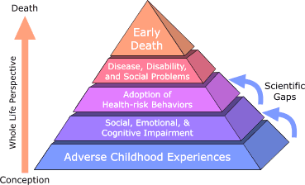
ACE Study Model
(Division of Adult and Community Health, National Center for Chronic Disease Prevention and Health Promotion, CDC, 2010)

Slide 11
What is an Adverse Childhood Experience (ACE)?
The experience of “significant abuse or household dysfunction during childhood”
Specific Indicators:
Recurrent physical abuse
Recurrent emotional abuse
Contact sexual abuse
An alcohol and/or drug abuser in the household
An incarcerated household member
Someone who is chronically depressed, mentally ill, institutionalized, or suicidal in the household
Mother is treated violently
One or no parents
Emotional or physical neglect
(Division of Adult and Community Health, National Center for Chronic Disease Prevention and Health Promotion, CDC, 2010)

Slide 12
ACE scores and health/well being
In the mainstream population, as an ACE score increases, the risk for the following health problems increases in a strong and graded fashion:
Alcoholism and alcohol abuse
Chronic obstructive pulmonary disease
Depression
Fetal death
Health-related quality of life
Illicit drug use
Ischemic heart disease
Liver disease
Risk for intimate partner violence
Multiple sexual partners
Sexually transmitted diseases
Smoking
Suicide attempts
Unintended pregnancies
Early initiation of smoking
Early initiation of sexual activity
Adolescent pregnancy
(Felitti et al., 1998)
For more information, or topic-specific studies, please see:
http://www.cdc.gov/ace/index.htm

Slide 13
Are ACE findings relevant to Native people?
ACEs among 7 Indian tribes were compared with participants in the Kaiser Permanente/CDC ACE study :
Natives have a significantly higher rate of ACEs/exposure to any trauma (86% vs. 52%)
Five times more Native people have been exposed to 4 or more categories of ACEs (33% vs. 6.2%) (Koss et al., 2003)

Slide 14
Historical Trauma
Assimilation
Relocation
Termination of tribal status
Adoption
Boarding schools
Language and traditions punished and discouraged
Checkerboard of treaties, laws, and decisions

Slide 15
ACE Study Model
Protective Childhood Experiences
(Division of Adult and Community Health, National Center for Chronic Disease Prevention and Health Promotion, CDC, 2010)

Slide 16
What is a Protective Childhood Experience (PCE)?
The experience of positive family life, participation in traditional practices, involvement with activities and interests, and engagement with spirituality.
Specific Indicators:
Close family relationships
Positive peer groups
Spiritual/religious connection
Learning a tribal language
Connection with tribal elders
Safe and strong community

Slide 17
Role of Families, Community, and Culture
“Resources vary from community to community as do strengths, challenges, and political climates. Each community needs to use its own knowledge of its assets and limitations, its culture and characteristics, its values and beliefs, to build policies and programs that are congruent with the community’s characteristics and meet the community’s needs.” (Thurman et al., 2012)

Slide 18
Role of Families, Community, and Culture
What’s working?
Positive Indian Parenting- a culturally-based parenting curriculum adapted and implemented in community
Positive Youth Development Approaches- key strategic interventions
Systems of Care- weaving together fractured services to more effectively serve children in a resource-challenged environment

Slide 19
Role of Families, Community, and Culture
“Colonization dismembered our people. Our job is re-membering.”
(Theda New Breast, Blackfeet Nation)

Slide 20
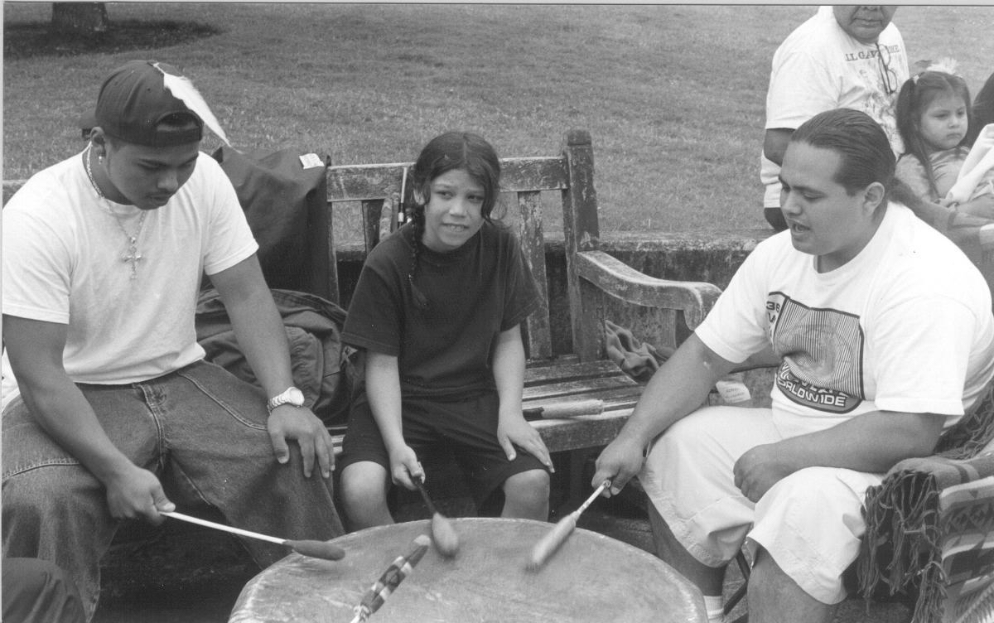
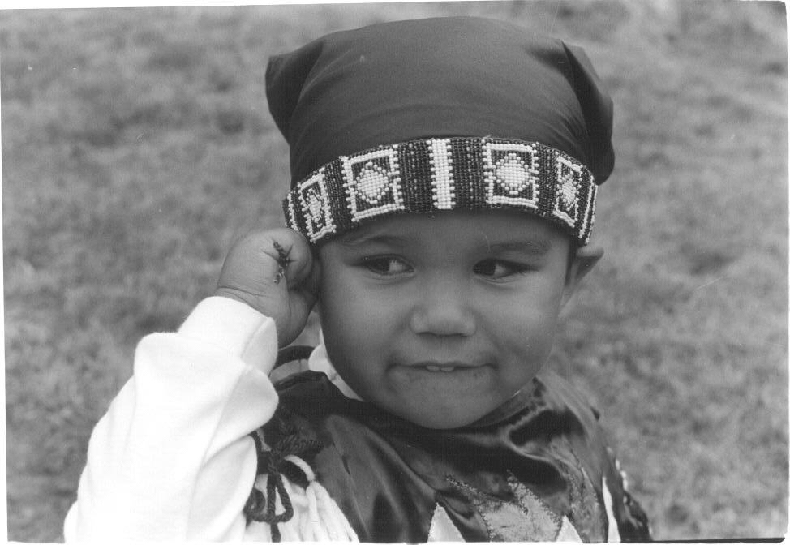
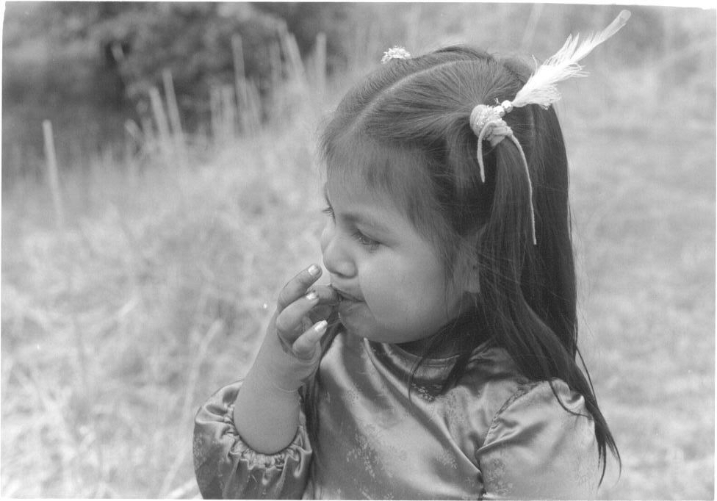
Let’s remember why we are really here today…
Healthy Native Children (and Adults)!

