Slide 1
Early Childhood Education:
Head Start's Role in Addressing Disparities
Yvette Sanchez Fuentes
Director, Office of Head Start
June 4, 2013
19th National Health Equity Research Webcast
University of North Carolina at Chapel Hill
www.minority.unc.edu/institute/2013/

Slide 2
Overview
  Early Childhood Education Disparities
  Health Disparities and Young Children
  Head Start
  What We Know About Head Start

Slide 3
Questions
What does a high quality early childhood program look like?
Does it look different for low-income children?

Slide 4
Early Childhood Programs^{1, 2}
Early childhood programs vary
Very few are designed to address the comprehensive needs of low-income families
Growing evidence of the early onset of achievement disparities between economically disadvantaged children and their more advantaged peers

Slide 5
Early Disparities^{1, 2}
Link to long-term negative educational and economic outcomes
Young children from families with incomes at 200 percent of poverty and below are significantly behind their more advantaged peers in cognitive development at age 2
By school entry children in low-income families are typically further behind their more advantaged peers

Slide 6
Changing Demographics¹
Changing demographic characteristics of families with young children in America
Increasing numbers of children entering kindergarten today are from homes where English is not the primary language

Slide 7
Health Disparities

Slide 8
Low-income Children²
More likely to go without all immunizations
Have less access to primary care
Maintain higher rates of emergency care usage
Miss school more often because of illness

Slide 9
Health Disparities ³⁻⁷
Uninsured, highest among American Indian and Hispanic children
Child poverty, highest among Black, American Indian and Hispanic children
Food insecurity, higher among households with children, black households, Hispanic households, low-income households below 185% of the poverty threshold

Slide 10
Health Disparities ³⁻⁷
Income and racial disparities exist in the number of children up-to-date on immunizations
Black and Hispanic children experience disparities in asthma outcomes

Slide 11
Head Start

Slide 12
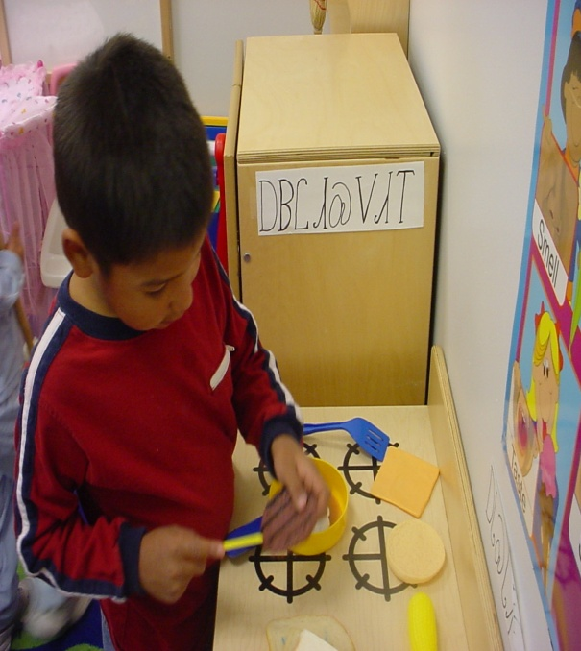
Head Start History
Project Head Start, launched as an eight-week summer program by the Office of Economic Opportunity in 1965, was designed to help break the cycle of poverty by providing preschool-aged children in low-income families a comprehensive program to meet their emotional, social, health, nutritional, and psychological needs.
Source: http://www.acf.hhs.gov/programs/hsb/about/hstory.htm

Slide 13
1965 Dr. Robert Cooke Memo
Defined a successful comprehensive program that included health
It highlighted the importance of improving a child’s physical health and physical abilities
Embraced activities designed to assess need and provide services

Slide 14

Purpose of Head Start and Early Head Start
To promote school readiness by enhancing the social and cognitive development of low-income children through the provision of health, educational, nutritional, social, and other services that are determined, based on family needs assessments, to be necessary.
Source: HEAD START ACT Sec. 636. [42 U.S.C. 9831]

Slide 15
Vision
Head Start will ensure that all children are healthy and ready for school
Children have an ongoing source of continuous, accessible, medical and dental care
Parents are fully engaged
Physical activity and daily health, hygiene and nutrition practices integrated in the classroom
Systems and policies are in place

Slide 16
Head Start Programs are…
Multi-generational and family centered, following the tenet that children develop in the context of their families and culture and that parents are respected as the primary educators and nurturers of their children.
Head Start services are responsive and appropriate to the developmental, ethnic, cultural, and linguistic heritage and experience of individual children and their families.
Source: Introduction: Head Start Program Performance Standards and other Regulations

Slide 17

Head Start serves…
Children ages 3-5 years old
Families with incomes below the poverty level or categorically eligible
Communities all across the United States, American Indian and migrants/ seasonal workers
Children with disabilities*
* Represent at least 10% of all Head Start enrollees

Slide 18
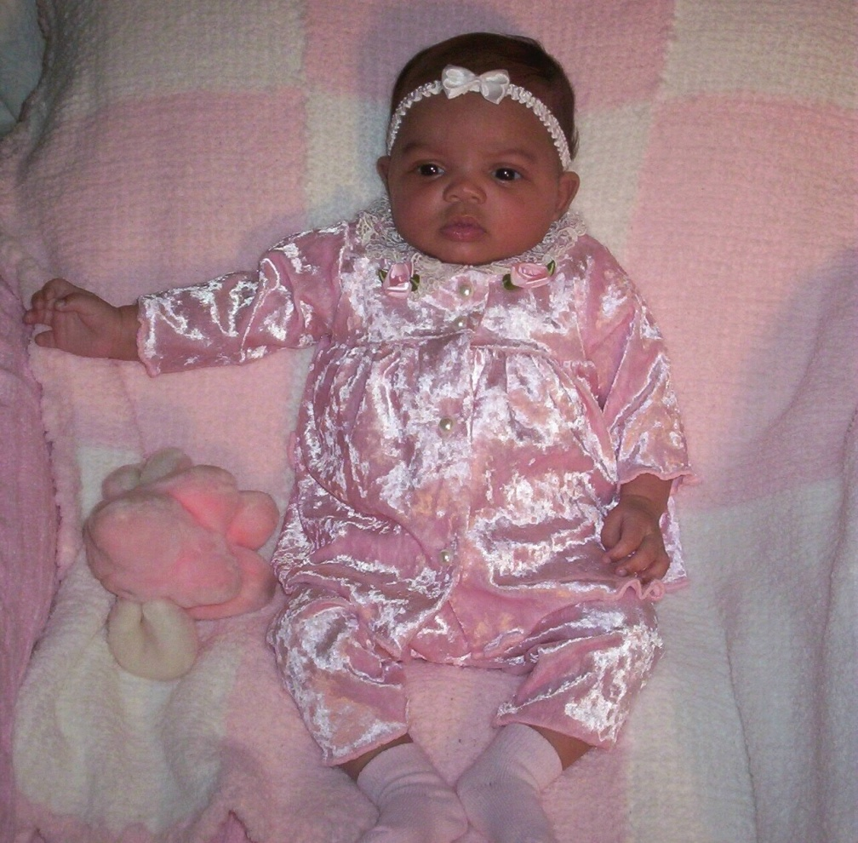
Early Head Start serves…
Children from birth to age 3 and pregnant women
1,015 programs nationwide
151,342 children enrolled in 2011-2012 program year
16,257 pregnant women enrolled during the same period
Source: 2011 – 2012 Head Start Program Information Report (PIR)

Slide 19

Migrant and Seasonal Head Start
Families migrate due to agricultural work
32,800 + children
Birth to age 5
38 states
Full-day/part-year
5-7 days/week
Transportation

Slide 20
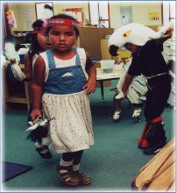
American Indians and Alaska Natives
152 federally recognized Tribal entities and Alaska Natives participate in Head Start
25,500 + children
26 states including Alaska

Slide 21
Children with Disabilities
At least 10 percent of Head Start enrollment opportunities will be for children with disabilities.
Today, the Head Start Act and the IDEA call for close collaboration between Head Start programs and the state and local agencies.
In 2011-2012, Head Start and Early Head Start provided services to over 136,700 young children with disabilities.

Slide 22
Trauma and Head Start Children and Families
FACES 2000 Report:
13% of parents indicated that they had been victims of domestic violence
10% of children were reported to witness domestic violence
E-PIRC Project (128 HS high-risk children and families):
44% of the children reported by parents to be experiencing trauma symptoms

Slide 23

Child Development and Health
  Child health and development
  Education and early childhood development
  Child health and safety
  Nutrition
  Mental health
  Disabilities

Slide 24
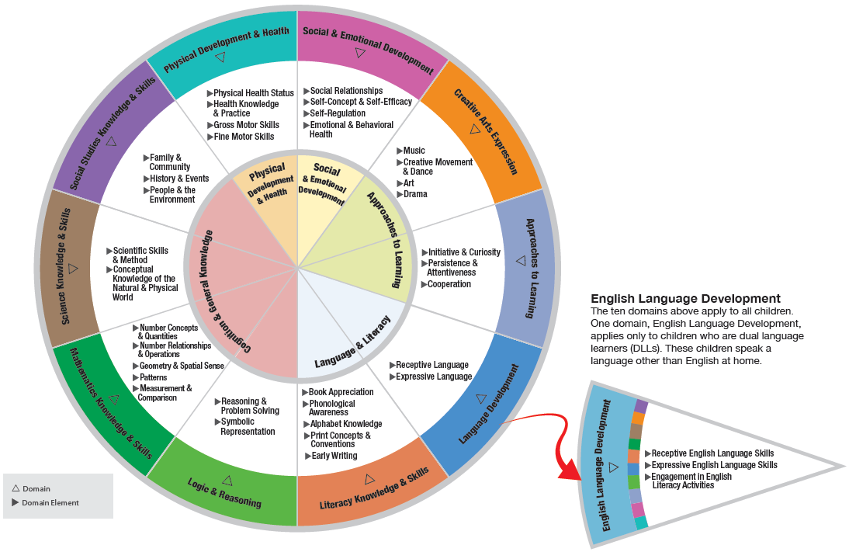
Physical Development and Health

Slide 25
Head Start Program Performance Standards
Includes standards for services for children from birth to age five, pregnant women, and their families.
There are eleven sections of the HSPPS, divided among three subparts:
  1) Early Childhood Development and Health Services;
  2) Family and Community Partnerships; and
  3) Program Design and Management.

Slide 26
Minimum Health Requirements
Determine a child’s ongoing source of continuous, accessible health care
Determine if a child is up‐to‐date
Track and case‐manage health care services
Obtain further diagnostic testing, examinations, and treatment

Slide 27
What We Know About
Head Start

Slide 28

FY 2012 Program Statistics
Head Start Grantees: 1,615
Head Start Classrooms: 57,480
Head Start Enrollment: 1,146,468
(total cumulative enrollment)
Paid Staff: 245,303
Volunteers: 1,315,733

Slide 29
Enrollment by Age in 2012
Source: 2011 – 2012 Head Start Program Information Report (PIR)

Slide 30
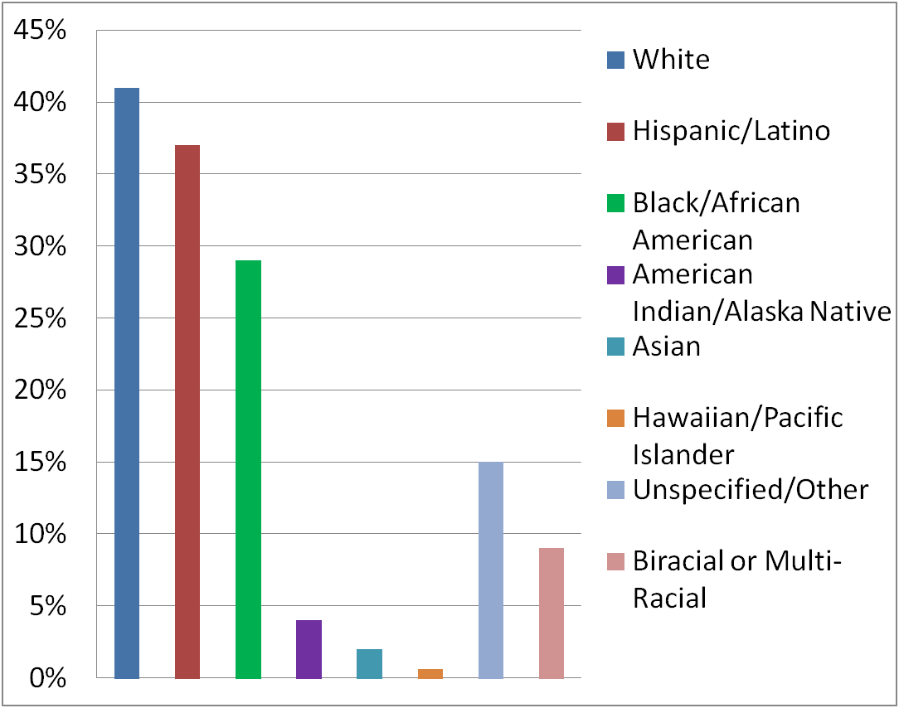
Head Start Demographics
Source: 2011 – 2012 Head Start Program Information Report (PIR)
.

Slide 31
Primary Languages Spoken*
English 70.3%
Spanish 25.1%
Native C. American/S. American 0.28%
Caribbean 0.31%
Middle Eastern and South Asian Language 0.83%
East Asian Languages .97%
Native N. American or Alaska Native Languages 0.08%
Pacific Island Languages 0.28%
European & Slavic Languages 0.60%
African Languages 0.57%
Other 0.14%
Unspecified 0.47%
* Includes children and pregnant women

Slide 32
Health Services
Preventive and primary health care 90.15%
Children receiving medical treatment 94.08%
Children with health insurance 96.40%
Children with a medical home 97.03%
Children with a dental home 91.04%
Preschool children completing professional dental exams 87.35%
Preschool children needing dental treatment 20.13%
Preschool children receiving dental treatment 80.96%
Source: 2011 – 2012 Head Start Program Information Report (PIR)

Slide 33
Head Start Health Services Research
1984 study - Head Start children were more likely to receive a medical exam (86% compared to 68%) and preventive health services such as lead screening (15% compared to 8%) than their non-Head Start peers
1995 study – Both white and African-American children were 8 to 11% more likely to be immunized if they participated in Head Start or another preschool program, as compared to no preschool program

Slide 34
Head Start Impact Study
Parent reported information; 3 and 4 year olds.
Largest impact for both age cohorts: children’s receipt of dental care.
Significant impact on children’s health insurance coverage for 4 year old cohort which continues through end of 1st grade; moderate for 3 year old cohort.
Suggestive evidence that providing access to Head Start at age 4 improves child’s health status in kindergarten; 3 year olds at end of school year only.

Slide 35
Programs Still Struggle
Programs have to continuously individualize for each child/family
Engaging parents
Securing treatment
Arranging and/or paying for treatment
Establishing and maintaining community partnerships
Staffing and professional development

Slide 36
Notes
Advisory Committee on Head Start Research and Evaluation, Final Report. ACF, 2012. Ahttp://www.acf.hhs.gov/sites/default/files/opre/eval_final.pdf
Providing Care for Immigrant, Migrant, and Border Children, COUNCIL ON COMMUNITY PEDIATRICS. Pediatrics; originally published online May 6, 2013; DOI: 10.1542/peds.2013-1099. http://pediatrics.aappublications.org/content/early/2013/04/30/peds.2013-1099
Alker J et al. Uninsured Children 2009-2011: Charting the Nation’s Progress, Georgetown University Health Policy Institute, Center for Children and Families, October 2012.
National Kids Count Program, The Annie E. Casey Foundation, KIDS COUNT Data Center. datacenter.kidscount.org. 2011.
Coleman-Jensen, Alisha, Mark Nord, Margaret Andrews, and Steven Carlson. Household Food Security in the United States in 2010. ERR-125, U.S. Dept. of Agriculture, Econ. Res. Serv. September 2011.
National Healthcare Disparities Report, 2011. April 2012. Agency for Healthcare Research and Quality.
The Coordinated Federal Action Plan to Reduce Racial and Ethnic Asthma Disparities, President's Task Force on Environmental Health Risks and Safety Risks to Children, 2012, CDC 2012. National Health Interview Survey Data 2010. Table 4-1. CDC, 2012. Health United States, 2011. Table 75. http://www.cdc.gov/nchs/data/hus/hus11.pdf

Slide 37
Thank You

