Slide 1
Development of Indigenous knowledges in Public Health: Epistememic diversity as an Essential Component of
Health Equity
32nd Annual Minority Health Conference
UNC Gillings School of Global Public Health
University of North Carolina, Chapel Hill
William T. Small Jr. Keynote Lecture, 2/25/11
Bonnie Duran DrPH
Director, Center for Indigenous Health Research Indigenous Wellness Research Institute www.iwri.org
Associate Professor, Department of Health Services School of Public Health, University of Washington

Slide 2
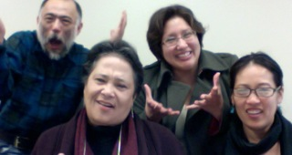
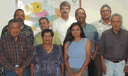
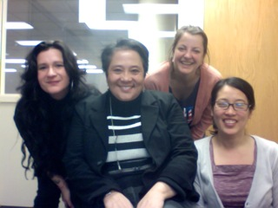
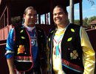

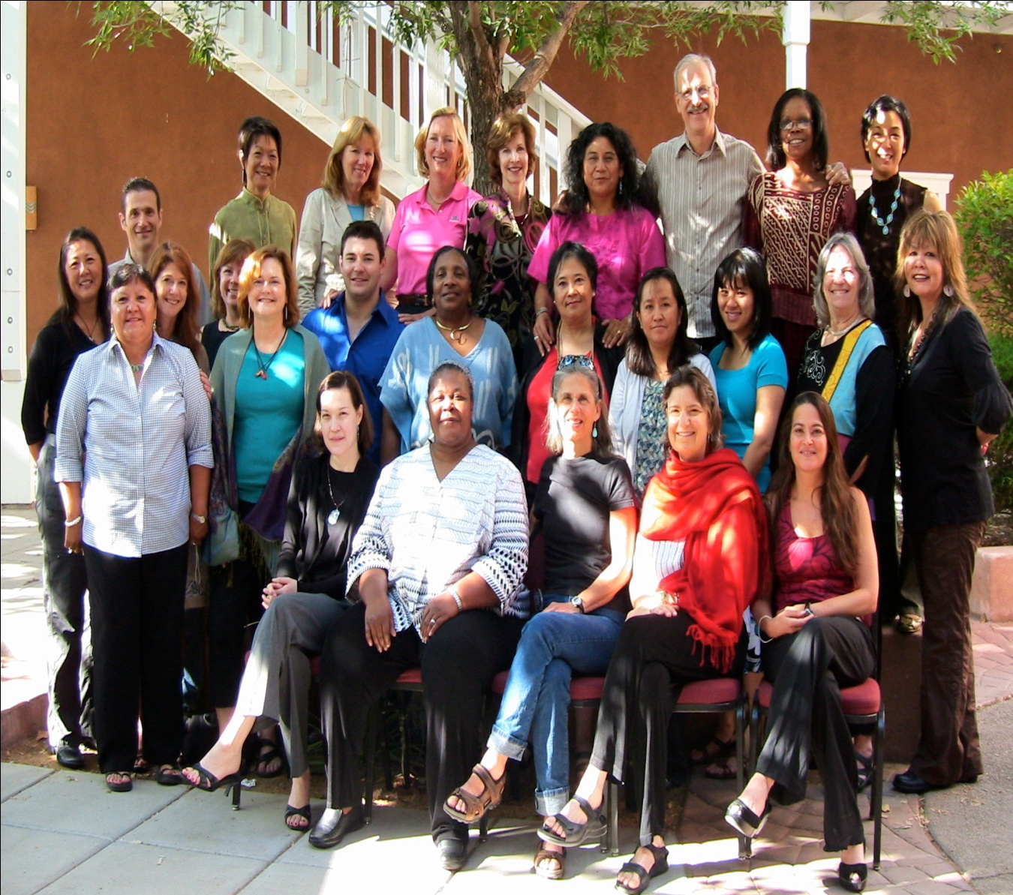
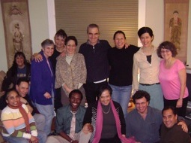
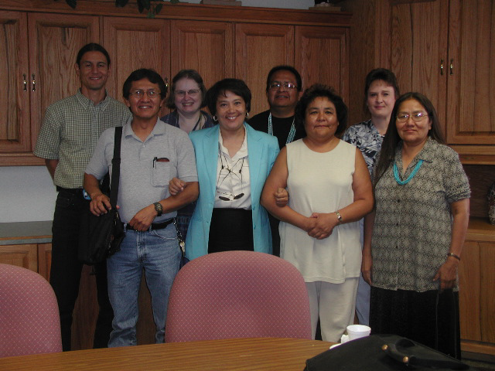
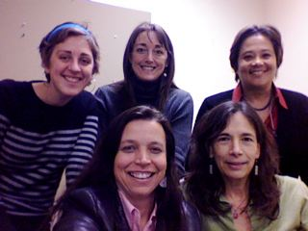
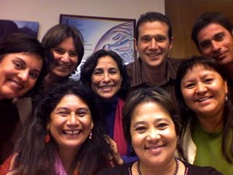
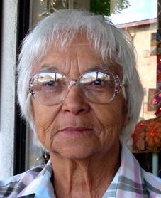
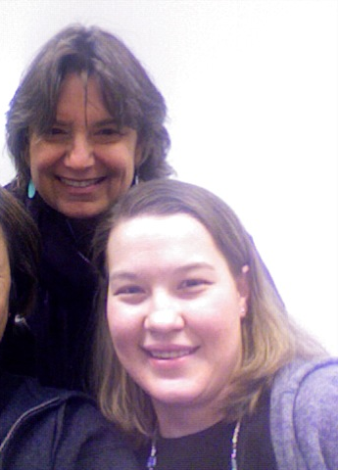
My Context
Madame Chair and the Navajo Nation HRRB
4CC Project
Notes:
Navajo Nation IRB-- Seattle, IWRI, Bridget SPH, Health Services Dept. New mexico-MPH, Center for native american health, Sangha, Sarah, Nina, decolonizing scholarship….Minkler, Wallack
Caleb and Jared Dunlap– Ojibewe twins, Jared will be entering Colombia and Caleb has been turned down by prestigous schools and is waiting to hear._____? I predict will be giving this lecture in 15 years…
Shout out to Shannon Fleg and the group at the Dominici center at UNM and the First ,

Slide 3
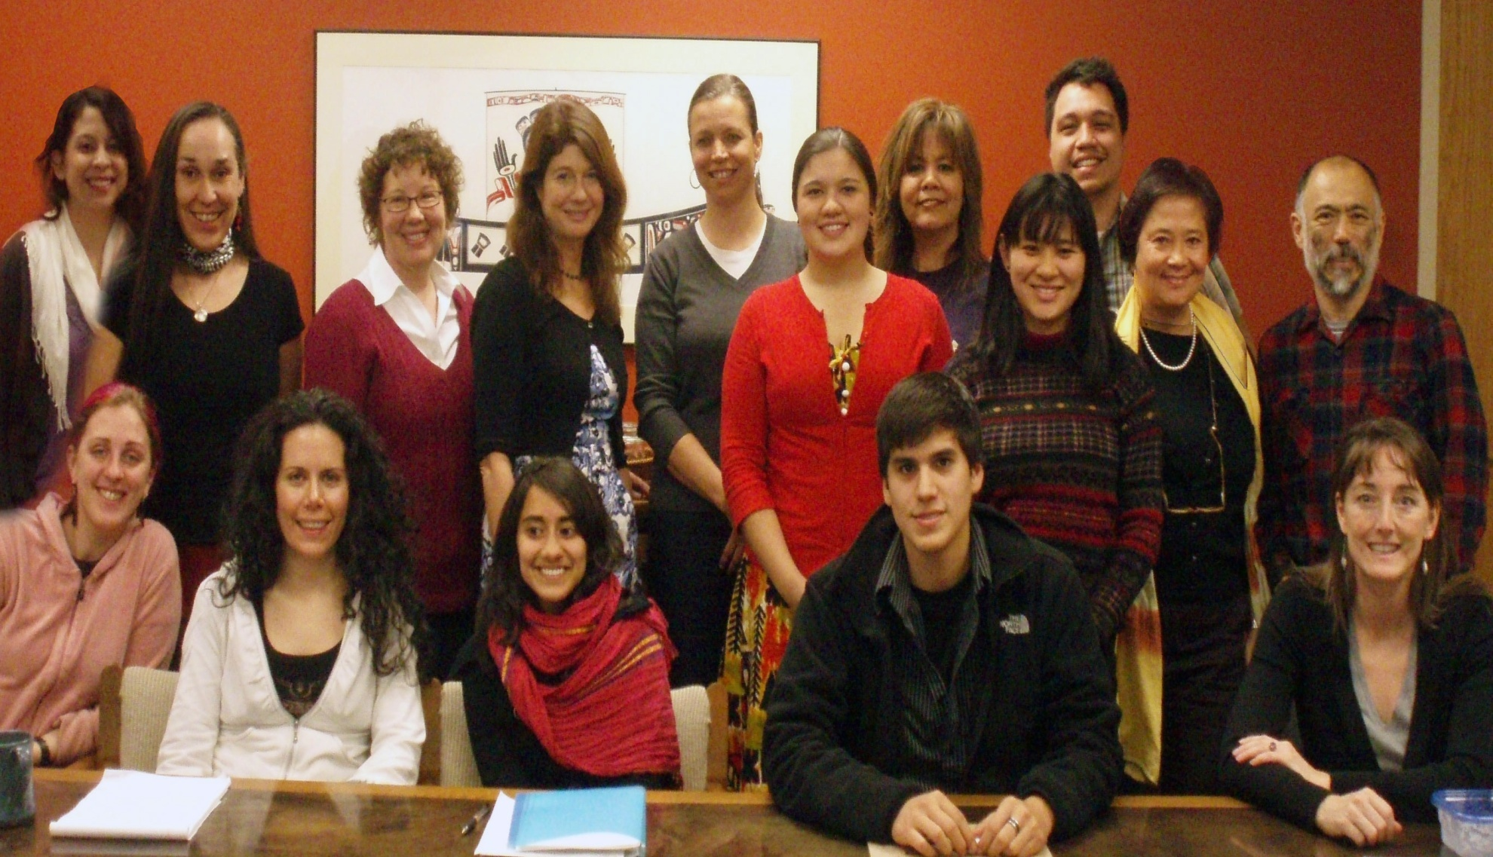
Indigenous Wellness Research Institute

Slide 4
Issues at Hand
Has western knowledge production itself contributed to health inequities?
Is there a power/knowledge episteme of public health that replicates colonial relationships?
Can Indigenous communities, other communities of color, public health advocates and allies use partnership opportunities and research spaces for indigenous knowledge development?

Slide 5
Presentation Ojectives
New western scholarship about pre-colonized America’s
Define Modernity/Coloniality Episteme
Examples of colonizing research
Decolonizing research and practice: CBPR and the space for indigenous knowledge development

Slide 6
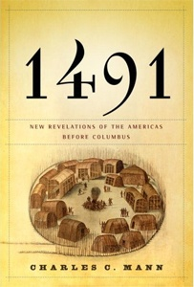
Emerging western scholarship about pre-contact America
In 1491 there were more people living in the Americas than in Europe.
Indigenous people in the America’s transformed their land so completely that Europeans arrived in a hemisphere already massively "landscaped" by human beings.

Slide 7
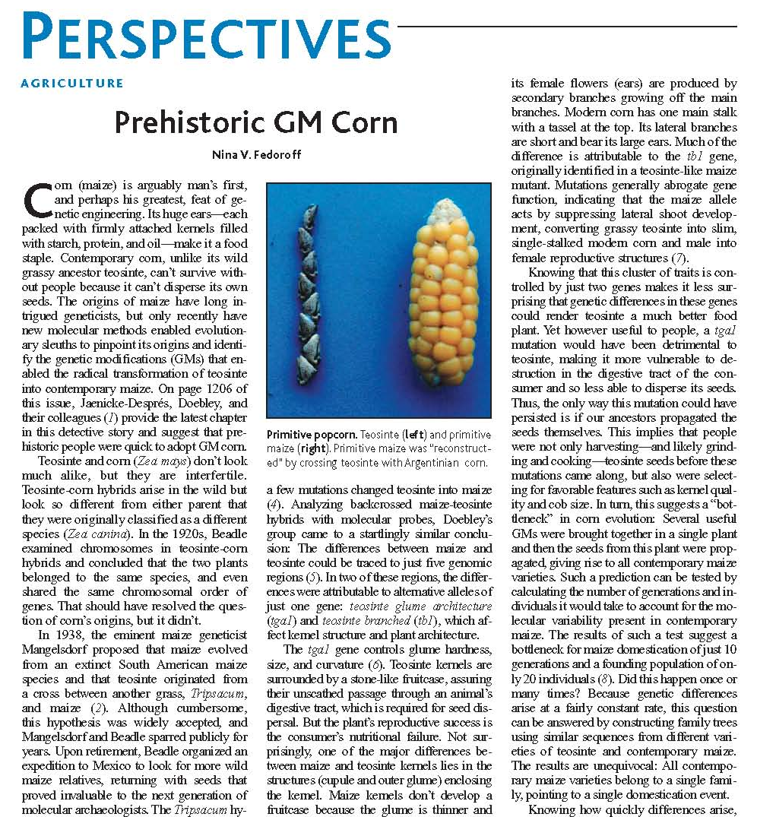
Emerging western scholarship about Indigenous knowledges
Pre-Columbian Indians in Mexico developed corn by a breeding process so sophisticated that a “Science” author described it as "man’s first, and perhaps the greatest, feat of genetic engineering."
AGRICULTURE Prehistoric GM Corn Nina V. FedoroffS Science 14 November 2003: 302 (5648), 1158-1159. [DOI:10.1126/science.1092042]

Slide 8
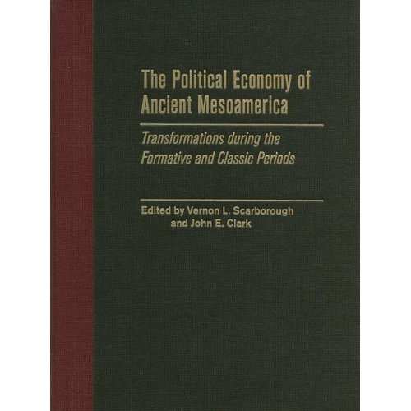
Emerging western scholarship about Indigenous knowledges
Tenochtitlan, the Aztec capital had a far greater in population than any contemporary European city, and unlike any capital in Europe at that time, had running water, beautiful botanical gardens, and immaculately clean streets.

Slide 9
“We all have been taught what the human species gained by the European invasion of the Americas. Now we have to consider what we, all of us, lost.”
Alfred W. Crosby, author of Ecological Imperialism and The Columbian Exchange, Professor Emeritus of Geography, American Studies and History, University of Texas

Slide 10
A Western Modernity/
Coloniality Episteme
Genealogy: 17th Century No. Europe Reformation thought, Enlightenment, French Revolution crystallized in 18th Century into “Modernity/Coloniality” and consolidated within the Industrial Revolution and motivated, in part, by colonization
Philosophically, emergence of the notion of “Man” as the foundation for all knowledge & order, separate from the natural and the divine
Culturally, Lifeworld is subsumed by forms of expert knowledge linked to capital and state administrative apparatuses (Foucault's disciplines)
Sociologically, rise of nation-state institution, knowledges for material reproduction
Indigenous and Subalterns studies scholars in the America’s, India, the Atlantic, Poststructuralists, Critical theorists..
Notes:
EMANCIPATION: The institutional framework \subjects all members of society to the same Freedoms and repressions,
[Immanent critique involves testing the claims of science that it makes for itself, without using any 'outside' sources -- it is a demonstration of the sort of self criticism that science needs to do]. Another tactic, more suitable in Anglo-Saxon circles is to confront science with its own history, as in Kuhn or Lakatos.
Habermas's aim was to criticise scientism. Briefly, operating with a notion of objects upon which one is not allowed to reflect, leads to an abstract focus on methodology.
Reflection in science is limited -- for example it is not common to think about the dynamics of the scientific community. This community and science itself tends to be objectivated. Discussions of method attempts to end whatever reflection takes place. This is achieved by:(a) Reductionism, of intentions or motives and into subjective relations, and of social relations themselves. Behaviourism and cybernetics accomplished this reduction (page 356). However, the study of 'paradigms'show how even the categories of these approaches depend on the subjective.(b) Displacement of the subjective by a 'theory language' (Feyerabend and Rorty are among the advocates of this). Perhaps a linguistic tradition rather than a behaviourist approach is better able to reconstruct the history of science and to be critical rather than objectivating, but, in Feyerabend at least, relativism and the proliferation of languages results. This leaves him unable to explain scientific progress, or indeed, unable to demarcate science from witchcraft.(c) The reduction of everything to physics, which claims to offer universal categories: in this sense, physics is both a theoretical and a metatheoretical discipline. [In other words, physics is claiming to be the proper and more fundamental theory of objects that are also studied by other theories or academic subjects. This kind of imperialism is also found in advocates of cybernetics or mathematics]. In fact, of course, it is only human language that meets this requirement). These are not new claims, and they affected both Kant and Darwin. Yet it is clear that [academic] subjects create their own objects ..

Slide 11
Characteristics of Coloniality/Modernity Episteme
Western knowledge contains a worldview that sees human development in terms of a master narrative requiring the congruence of other cultures.
Authority to determine fitness for world citizenship is based on Western knowledge that decides the criteria for what is reasonable and what is not reasonable.
Globalization: all world cultures and societies are reduced to being a manifestation of European history and culture.
Modern reason is emancipatory, but modernity’s “underside,” namely, the imputation of the superiority of European civilization, coupled with the assumption that Europe’s development must be followed unilaterally by every other culture
Notes:
At the risk of being essentialist….

Slide 12
Foundations of Epistemes*
Coloniality-Modernity
Rooted in rhetoric of salvation and progress
By necessity creates condemnatory logic, savage, primitive, marginalized
Post-Coloniality
Starts in Greece and Rome
Indigenous Episteme
Starts with a critique of the limits of Eurocentric knowledge hegemony of “science” as truth: Provincialism as Universalism
Shifts the geographies of reason
Language and concepts as only one vehicle to understand and express “reality”
Starts in Greece and Rome
Privileges “newness” in the archaeology/chronological history of european ideals
Epistemic disobedience as a set of projects that focus on the common effects of the experience of colonialism
Subjectivities created in language and history
* From at least a “post” perspective

Slide 13
Foucault’s Episteme as power
..defines episteme historically as the strategic apparatus which authorizes
  separating out from among all the statements which are possible
  those that will be acceptable in a field of scientificity, and
  which it is possible to say are true or false or “meaningless” *
Michel Foucault, Power/Knowledge (1980, p.197)
*My addition - borrowed from Sami Scholar Rauna Kuokkanen
Notes:
Goes a step further and traces episte in the discourses that produce and make it up… The episteme’s create knoweldges that serve a particular purpose..

Slide 14
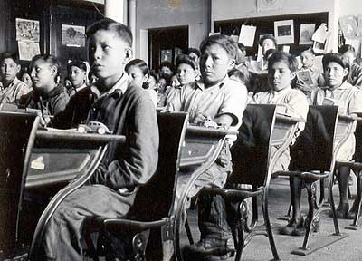
Western Knowledge Construction and Examples of Colonizing Research
Colonial Research Practice: Examples of Knowledge/Power Nexus

Slide 15
Indigenist Critique of Western Episteme’s
History is written
by people in power
Research
Controlled

Slide 16
Apparatus of Colonization
Colonization -
  Geographical incursion
  Ideological “stories” about race & skin color
  Socio-cultural dislocation
  External political control
  Provision of low-level social services
Governance of “frontier” by ‘central’ authority
Main governance institutions:
  Church
  Medicine/Public Health
  Education/Research
  Business/Industry
Both similar and different from larger global imperial projects
Kelm, M.-E. (1998). Colonizing bodies : aboriginal health and healing in British Columbia, 1900-50. Vancouver, BC: UBC Press.

Slide 17
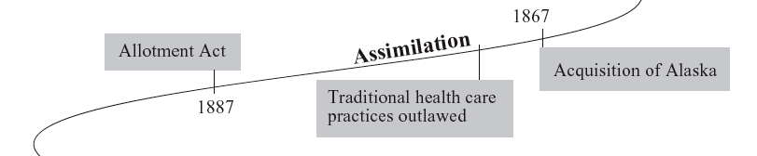
“Colonial Narratives ” & Federal Indian Policy
Assimilation and Allotment 1870-s - early 1900s
  1880’s Growth of BIA boarding schools
  1883 Some Traditional Medicine Outlawed
  1887 Allotment Act abolishes group title to Native land
Shelton, B. L. (2004). Legal and Historical Roots of Health Care for American Indian and Alaska Native in the United States. Menlo Park & Washington DC: The Henry J. Kaiser Family Foundation.

Slide 18
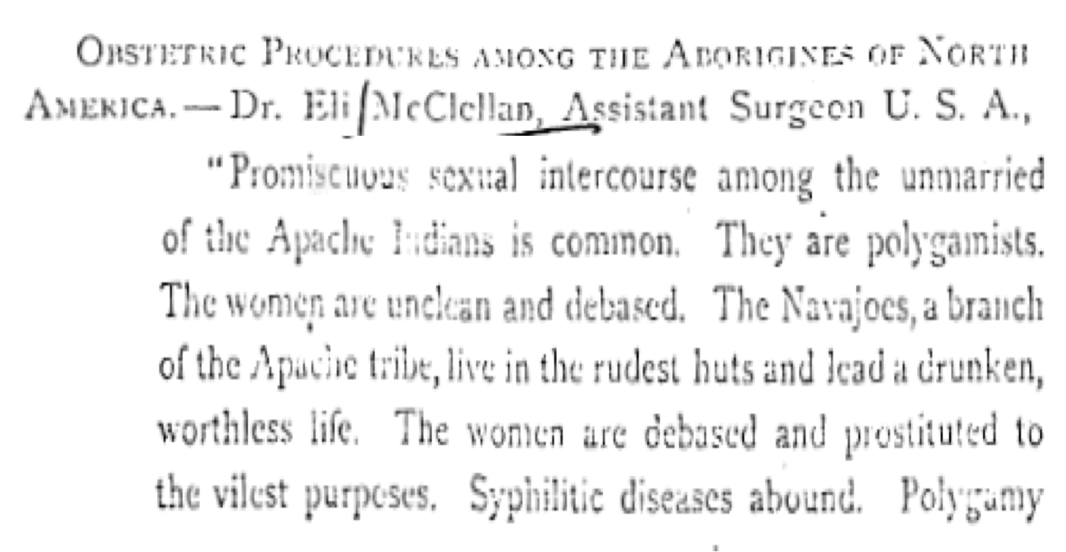
“Medical” Rationale for Assimilationist
Boarding Schools
“Promiscuous sexual intercourse among the unmarried of the Apache Indians is common. They are polygamist. The women are unclean and debased. The Navajos’ , a branch of the Apache tribe, line in the rudest huts and lead a drunken worthless life. The women are debased and prostituted to the vilest purposes. Syphilitic diseases abound….”
McClellan, E. (1873). Obstetric Procedures among the Aborigines of North America. Clinic of the Month, 99-106.

Slide 19
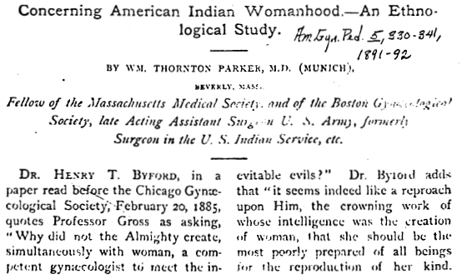
Rhetoric of salvation and progress
  “it seems ..a reproach upon Him...that she should be the most poorly prepared ..for the reproduction of her kind…”
Parker, T. (1891). Concerning American Indian Womanhood-An Ethnological Study. American Gynecology and Pediatrics, 5, 330-341.

Slide 20
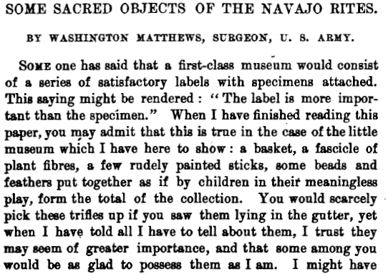
Medicine and Disciplinary Power
The basket drum
The drum stick
The Plumed wands
Kethawns
Sacrificial Cigarettes
Matthews, W. (1893). Some Sacred Objects of the Navajo Tribe. Archives of the International Folklore Association 1, 227-254.

Slide 21
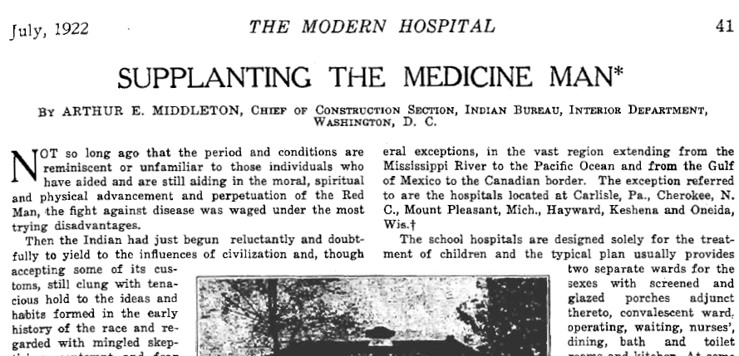
Subjugated Knowledge's

Slide 22
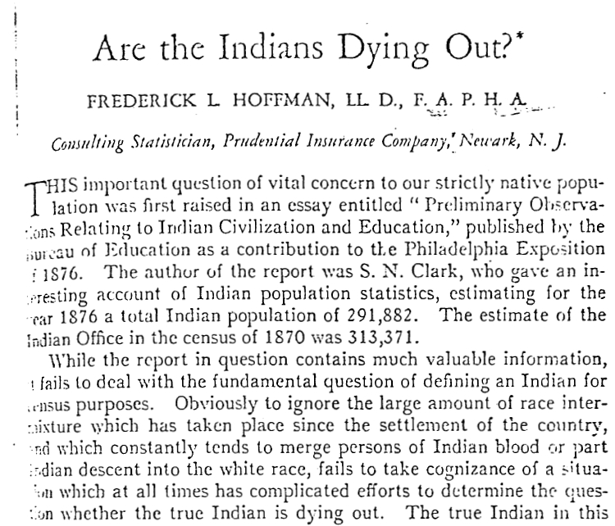
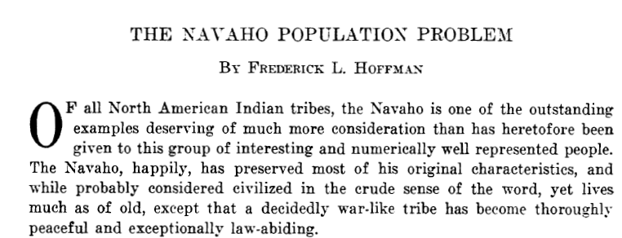
Surveillance and normalizing judgment work together to form “discipline”
…the greatest, most precise, productive, and comprehensive system of control of human beings will be built on the smallest and most precise of bases.
“…determine question of whether true Indian is dying out’.
Hoffman, F. (1928). The Navajo Population Problem. Proceedings of the twenty-third International Congress of Americanists 23, 620-633.
Hoffman, F. (1930). Are the Indians Dying Out? American Journal of Public Health, 20, 609-614.

Slide 23
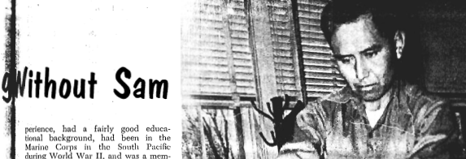
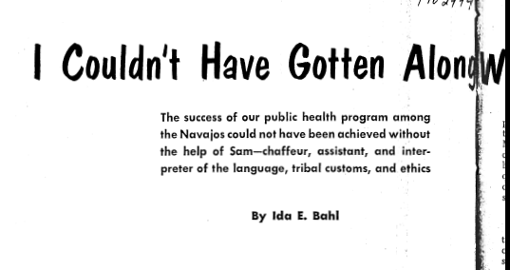
Knowledge, race and social position
  Interpreter, health educator, health systems navigator, medicine person…
                …driver
Nursing outlook,
June 1961

Slide 24
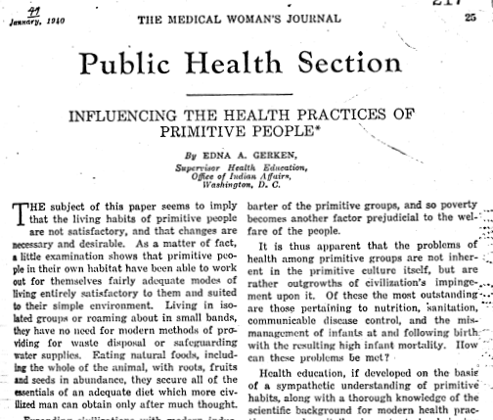
Colonial Episteme
Health research served as a “roadmap” for colonizers who utilized IHS to overcome difficulties of transportation and communication in more remote, previously inaccessible locations

Slide 25
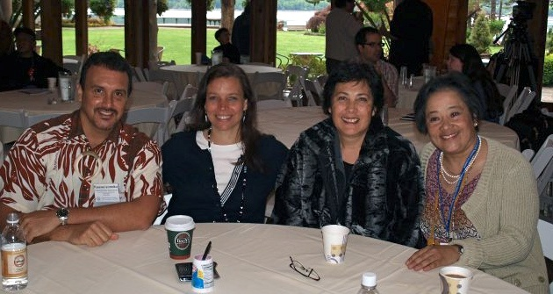
Decolonizing Research
DR is a purposeful approach to “transforming the institution of research, the deep underlying structures and taken-for-granted ways of organizing, conducting, and disseminating research knowledge”
DR enables indigenous communities to theorize their own lives connecting with past and future generations
Drawn from work of Smith, L.T. (2005). On Tricky Ground: Researching in the Age of Uncertainty. In Denzin & Lincoln (eds.). Handbook of Qualitative Research. Sage Publications

Slide 26
Indigenous Knowledges
Indigenous knowledge (IK) as ancient, communal, holistic, spiritual and systematic knowledge about every aspect of human existence
Local communities through accumulated IK gained from generation to generation, knew:
  Social order through culture-based sanctions and rewards for appropriate behavior
  Longevity through Indigenous Public Health
  Healthy physical environments through stewardship, ETC ETC ETC

Slide 27
Example of an Indigenous Episteme
“Logic of the gift” as a foundational epistemic convention grounded in valuing
Gifting functions as a system of social relations, forming alliances, solidarity
Gifting extends to giving and receiving in the natural and spiritual realms
Reconstructing indigenous Epistemes offers alternative paradigm for everyone, not just Natives..
Rauna Kuokkanen (2007) Reshaping the University: Responsibility, Indigenous Epistemes, and the Logic of the Gift. Vancouver, University of British Columbia Press
Notes:
An alternative to exchange, as against a market based society

Slide 28
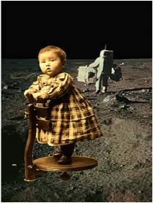
Evidence Based Public Health vs..
Evidence based Interventions may be a form of forced acculturation
Indigenous health promotion and treatment is often effective “cultural revitalization”

Slide 29
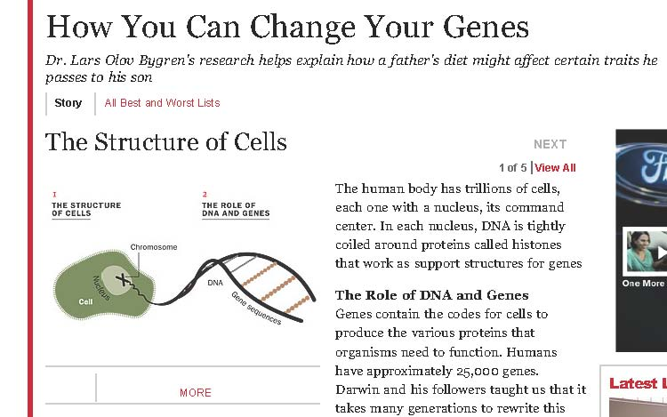
Indigenist Local Theory of Etiology
  cumulative vulnerability that colonization; i.e., epidemic disease, forced removal, warfare, and white cultural hegemony, have had on the physical manifestation of health among indigenous peoples.

Slide 30
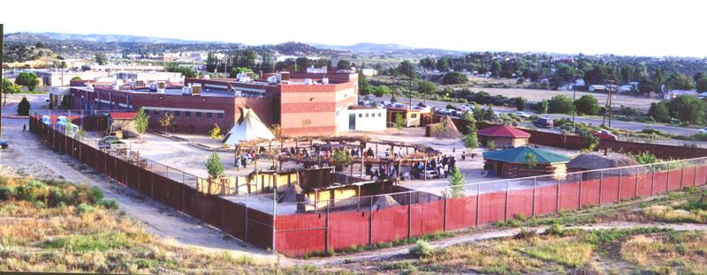
Indigenous and Hybrid Approaches

Slide 31
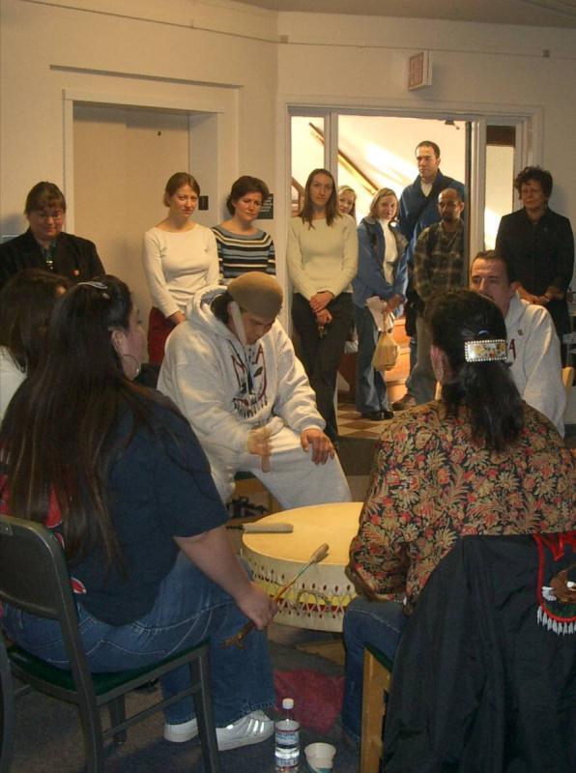
Base Interventions on Culture
Story telling
Sweat Lodge
Talking circle
Vision quest
Wiping of tears
Drumming
Smudging
Traditional Healers
Herbal remedies
Traditional activities

Slide 32
Center for Indigenous Health Research - IWRI
Decolonizing research and training
Partnerships with T/U/I
Indigenous Knowledge reclamation and production
Harness resources of UW and partners towards mission
Partners – MOU with
  American Indian Higher Education Consortium
  Northwest Indian College
  National Congress of American Indian Policy Research Center
  National Indian Health Board
  Affiliated Tribes of Northwest Indians

Slide 33
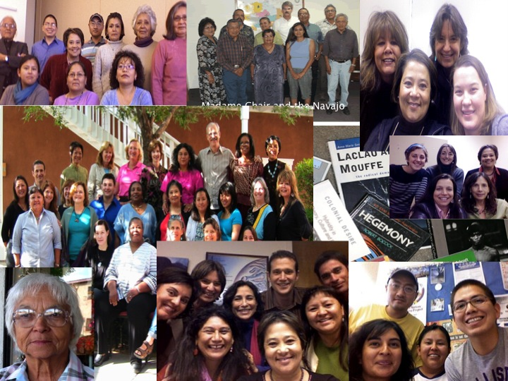
Genealogy of Partnerships
Center for Indigenous Health Research -- IWRI
Navajo Nation
NM Pueblo’s
AAIHB
NRG UW
NWIC
AIHEC
30 TCU
Notes:
Bill Freeman

Slide 34
Research for Change:
Cross-Site Multicultural
Community-Based
Participatory Research
Funding NIDA, OBSSR, NCRR, IHS

Slide 35
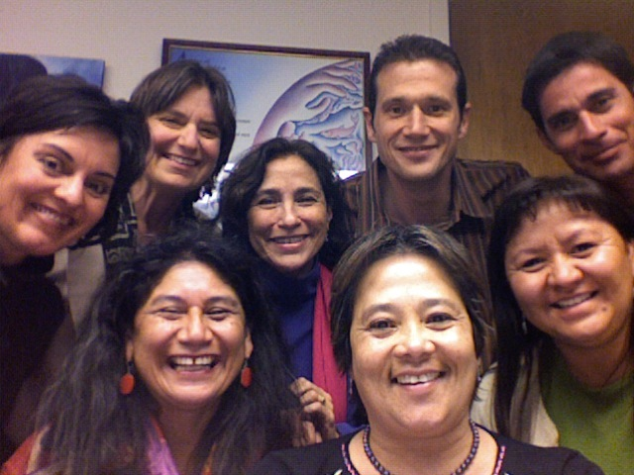
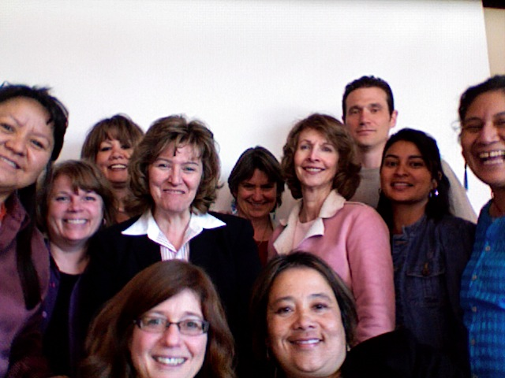
NCMHD Funded-- Evolution of National CBPR Team
UNM Team
UNM & UW Team

Slide 36
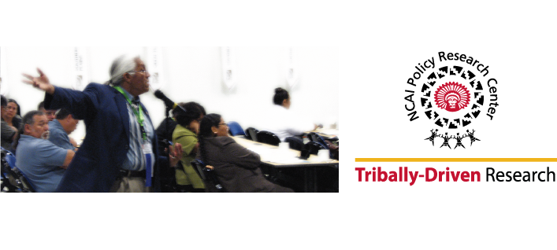
NCAI Policy Research Center
The NCAI Policy Research Center is a tribally-driven think tank that supports Native communities in shaping their own future by gathering credible data, building tribal research capacity, providing research support, and convening forums addressing critical policy questions.
As sovereign nations, tribes have a role in the research that is conducted in their communities and in regulating research which occurs on their land and with their citizens.
- Joe Garcia,
Former President, NCAI

Slide 37
NCAI Policy Research Center
Established in 2003 as a national tribal policy research center that would focus solely on issues facing tribal communities
Forum for forward-thinking, deliberate, proactive Indian policy discussions and the development of policy scenarios
Notes:
Our Center was established because of the wisdom of our leadership. As NCAI leadership reflected on the challenges they faced in making policy that benefits Indian people, and they realized they needed a new resource- a Center that would focus on anticipating the hot policy issues that would impact tribes, work with tribes to prioritize the opportunities, and develop the information and data that tribes would need to make informed policy decisions on behalf of their communities.
Our Center was established in 2003 as a national tribal policy research center that would focus only on issues facing tribal communities. Our focus is on forward-thinking, deliberate, proactive Indian policy development opportunities and the development of timely, credible information to equip tribal leaders to make good decisions for their communities.

Slide 38
PRC Values
Research in service to community
Direct implications for communities and improving their well-being
Community-driven agenda and all aspects of the work
Honor community and cultural contributions to the work
Partnership with communities and other organizations
Respect tribal sovereignty and ownership of data
Indigenous knowledge is as valid as academic knowledge
Research should build community capacity
Notes:
I also wanted to share with you a few of our core values. This will give you a sense of the philosophy of the Center and the way we do our work.
You will see from this slide and the next, that Native communities are at the heart of what we do. Research is not the destination, it is a vehicle to help tribal leaders guide their communities to the destination that they choose. Research for its own sake is not something that fits with the vision and mission of the Policy Research Center.

Slide 39
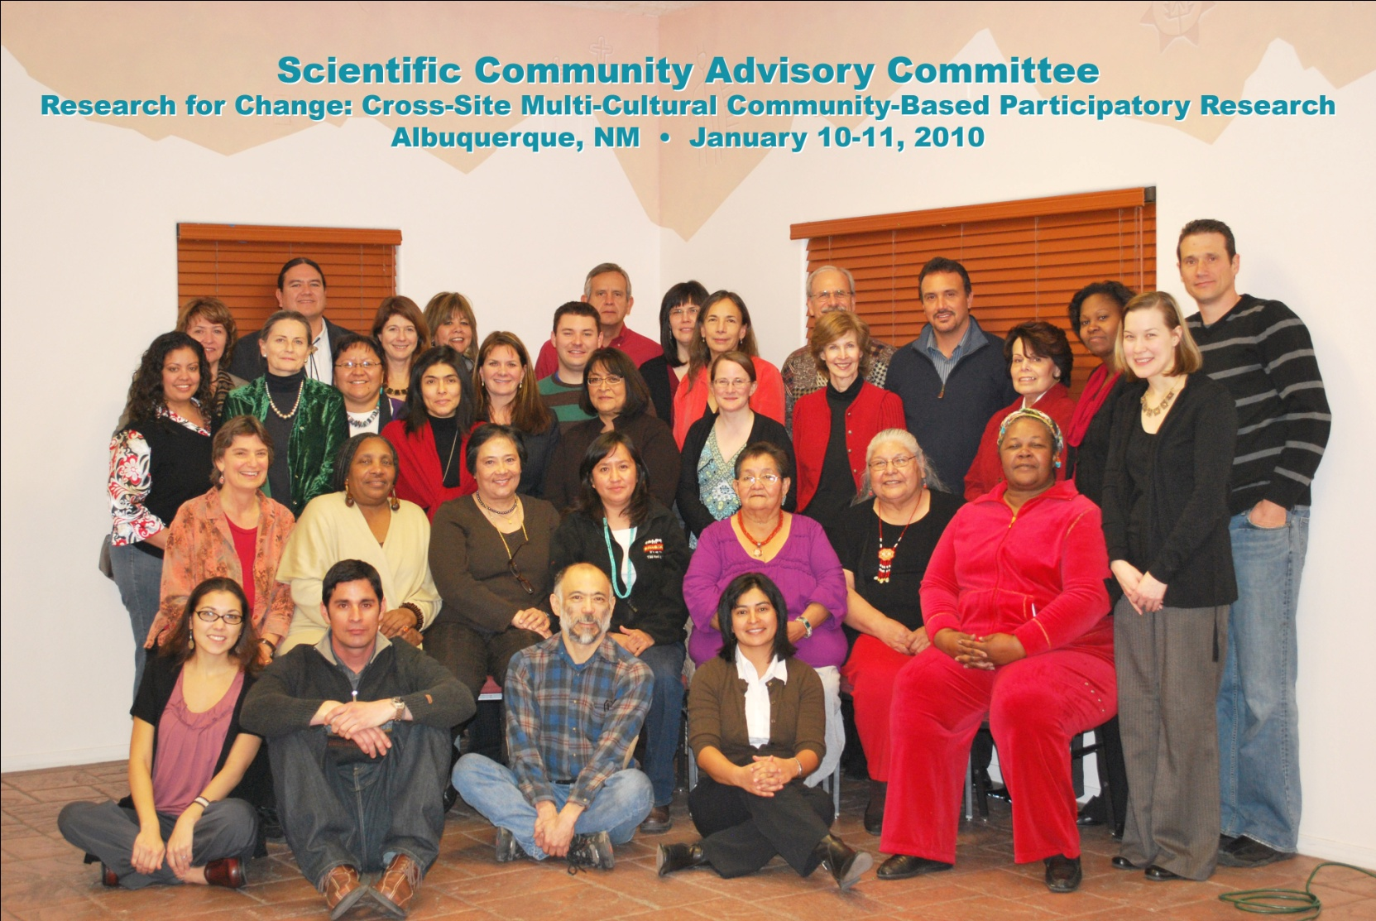
New CBPR Advisory Board

Slide 40
Native American Research
Centers for Health
Partnership between Indian Health Service & NIH
3 Goals-
  Reduce mistrust
  train “Expert Indians”, pipeline program
  conduct rigorous health disparities research
Tribal organization must be lead and maintain 30% of funds

Slide 41
Research for Improved Health: A National Study of Community-Academic Partnerships
1. Describe the variability of CBPR across dimensions in the model to identify differences and commonalities across partnerships
2. Describe and assess the impact of governance on CBPR processes and outcomes across AI/AN and other communities of color.

Slide 42
Research for Improved Health: A National Study of Community-Academic Partnerships
3. Examine the associations among group dynamic processes and three major CBPR outcomes:
  culturally-responsive and centered interventions;
  strengthened research infrastructure and other community capacities; and
  new health-enhancing policies and practices, under varying conditions and contexts.
4. Identify and disseminate best and promising practices, assessment tools, and future research needs

Slide 43
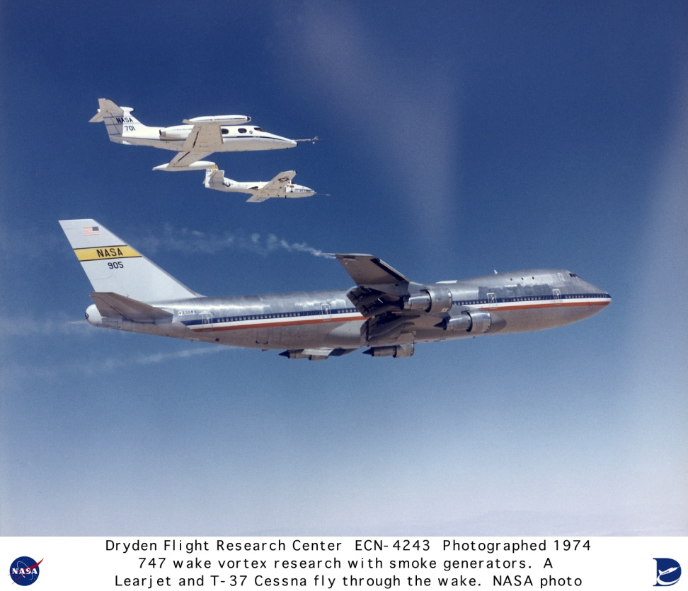
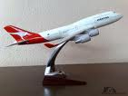
On Models
Models are “an idealized representation of reality that highlights some aspects and ignores others.”*
“Models of course are never true, but fortunately it is only necessary that
they be useful”**
* Pearl, J. (2000). Causality: Models, reasoning, and inference. Cambridge, England: Cambridge University Press.
** Box, G. E. P. (1979). Some problems of statistics and everyday life. Journal of the American Statistical Association, 74, 1–4

Slide 44
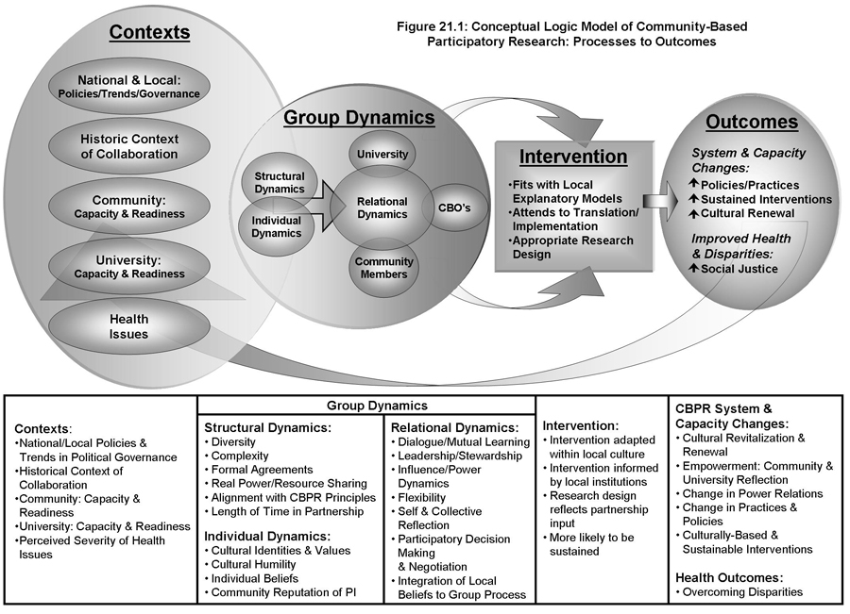

Slide 45
CBPR Very Preliminary Sample Characteristics
369+ Federally funded active in 2010
  Include NARCH
  Include PRC
  N= 427
Ethnicity
  AIAN 32
  API 15
  AA 72
  Latino 97
  White 7
  Multicultural 48
  None of the above 107
Vulnerable population
  n = 126 Children/Youth
  n = 61 Low-Income
  n = 14 People w/ Disability
  n = 27 Elderly
  n = 53 Rural
  n = 45 Migrant / Immigrant
  n = 56 Families
  n = 3 LGBTQ / MSM

Slide 46
Tribal Colleges and University
Alcohol and Drug Problems and Solutions Study
NIDA 5R01DA029001-02
Funding period: 2009 – 2013
Partner: American Indian Higher Education Consortium- 31 Tribal Colleges and Universities

Slide 47
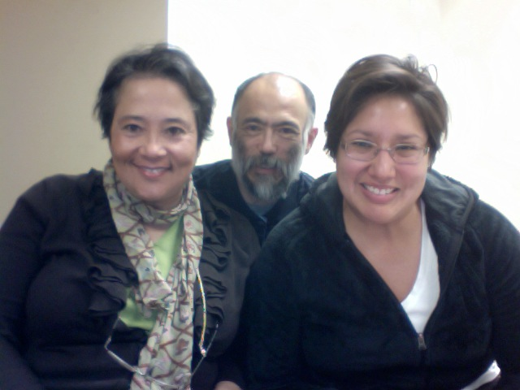
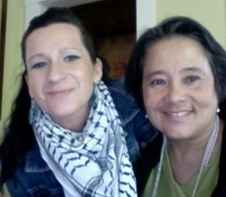
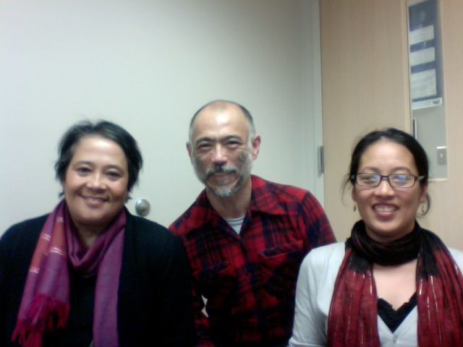
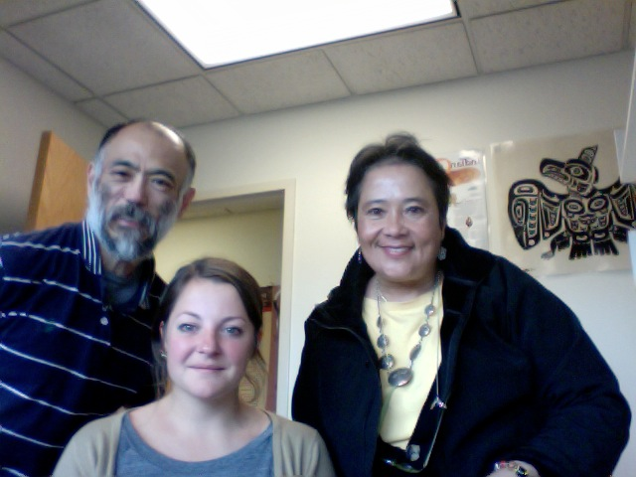
UW Team
Leo Egashira
Maya Magarati
Myra Parker
Ramona Beltran
Elana Mainer

Slide 48
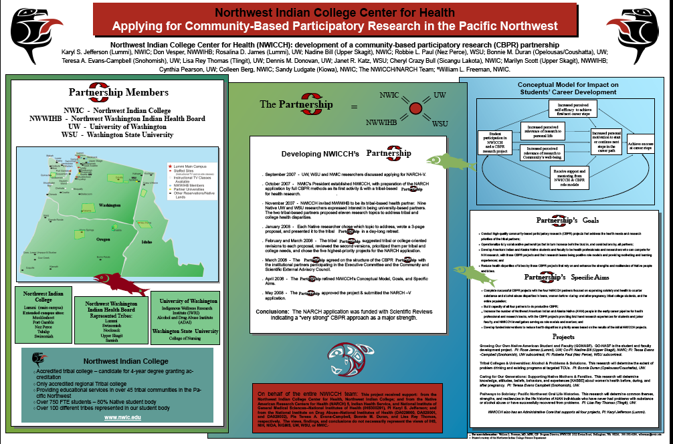

Slide 49
Study AIMS
Establish partnership and board (CBPR)
Compile and summarize literature
Key Stakeholders survey-needs and capacity
Qualitative review of culture-centered and evidence based interventions
Develop effective outreach and screening procedures

Slide 50

Decolonizing Strategies: Potential Approaches to Support Epistemic Diversity
In the Practice World
Adapted from:
The California Endowment
Rodney Hopson, Ph.D.

Slide 51
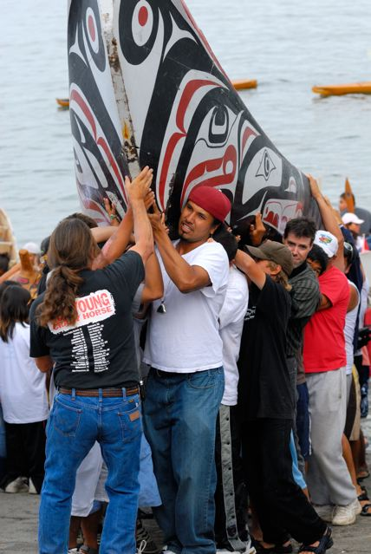
Reflect on your Social Location
The social location of the student/researcher matters (intersectionality)
  Gender
  Race
  Class
  Ethnicity
  Education
  Privilege/target
  Sexual orientation
  Etc… What else?
Hankivsky, O., & Cormier, R. (2009). Intersectionality: Moving Women’s Health Research and Policy Forward. Vancouver: Women’s Health Research Network.
This publication is also available online at www.whrn.ca.

Slide 52
Social change is a goal
2. Research plays a role in furthering social change and social justice
  Ability and duty to recognize asymmetric power relations and to
  challenge systems and mechanisms of inequity and injustice
  in hope of dismantling oppression
  Theoretical approaches: Indigenist, Queer, critical, feminist, cultural humility, anti-racist, postcolonial, etc… What else?

Slide 53
Reflect on ethnocentrism and cultural humility
3. Avoiding ethnocentrism means embracing multiple cultural perspectives
  shift between diverse perspectives
  Recognizes ethnocentric standards and ideas
HOW?
  Employ a team who can “translate” research from multiple cultural contexts

Slide 54
Valuing is culturally embedded
Culture is central to the research process
  worldview, values and norms impact the uses of, reactions to, and legitimacy of, any research
  multicultural validity - defining social problems
  norms will play out in the context of research instruments and protocols.

Slide 55
Decolonize and Indigenize
Culturally and ethnically diverse communities have contributions to make in redefining the research field
  standards, guidelines, methods and paradigms of the research field need to be rethought, and underserved and marginalized culturally diverse groups have an important role to play in this process

Slide 56
A Role of Academic Researchers
The role of the intellectual, according to Delueze, is not to awake consciousness but to weaken the power of hegemonic discourse and to create the space for competing discourses to be formulated and dispersed.

Slide 57
Roles of Ally Researchers in 2009
From this position, then…if you make it your task not only to learn what’s going on there through language, through specific programs of study…through historical critique of your position as the investigating person. When you take the position of not doing your homework, I will not criticize because of the accident of my birth, the historical accident, that is a pernicious position.
Gayatri Spivak. Postcolonial critic

Slide 58
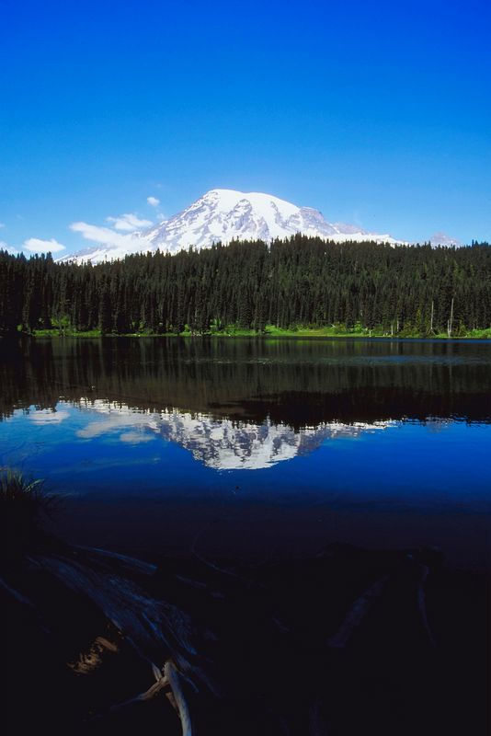
“Our research work must promote Expert Indians instead of Indian Experts”
Beverly Pigman
Quote from Navajo Nation IRB Chair, Ms. Beverly Pigman (June 27, 2006)
May all beings be happy.

