Slide 1
The evolution of academic public health in North Carolina
Victor J. Schoenbach, https://go.unc.edu/vjs
October 4, 2016
EPID890, Seminar for MSPH Students
UNC Department of Epidemiology
(audio recording available at )

Slide 2
Social Epidemiology @ UNC

Slide 3
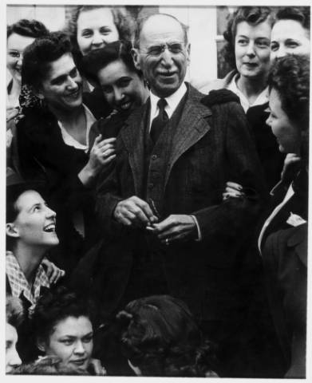
Social epidemiology @ UNC – Rosenau
Milton J. Rosenau, MD
1869 – born in Philadelphia
1889 – MD from University of Pennsylvania
1892-1893 – Hygienic Institute, Berlin
1900 – Pathological Institute (Vienna) and Pasteur Institute (Paris)
1890-1892 – assistant surgeon with U.S. Marine Hospital Service (forerunner of US PHS)
1895-1898 – quarantine officer at San Francisco
1898 – quarantine officer in Cuba
1899 – director, Hygienic Laboratory (nucleus of NIH)
1909 – professor of preventive medicine, Harvard Medical School
1913 – established first school of public health in the US
1936 – established Division of Public Health at UNC SOM
Notes:
“Also in 1913 Rosenau published his most important work, Preventive Medicine and Hygiene, which in its tenth edition remains the standard text on the subject. With his long teaching career and his influential textbook, Rosenau was so instrumental in educating health workers in the advances of microbiology and immunology that he was regarded as the father of preventive medicine in the United States.”
http://ncpedia.org/biography/rosenau-milton-joseph
“During 1899-1909, he directed the MHS Hygienic Laboratory, transforming a one-person operation into a bustling institution with divisions in bacteriology, chemistry, pathology, pharmacology, zoology, and biology. Rosenau conducted his most important medical research during his 10 years at the Hygienic Laboratory, publishing many articles and books, including The Milk Question (1912) and Preventive Medicine and Hygiene (1913), which quickly became the most influential textbook on the subject.
“From early in his career, campaigns to reduce milkborne diseases occupied Rosenau's attention. As he stated in his textbook, ‘Next to water purification, pasteurization is the most important single preventive measure in the field of sanitation.’ A Public Health Service study in 1909 reported that 500 outbreaks of milkborne diseases had occurred during 1880-1907. By 1900, increasing numbers of children drank pasteurized milk, but raw milk remained the norm partly because the high-temperature process then in use imparted a "cooked milk" taste. In 1906, Rosenau established that low temperature, slow pasteurization (140 F [60 C] for 20 minutes) killed pathogens without spoiling the taste, thus eliminating a key obstacle to public acceptance of pasteurized milk. However, securing a safe milk supply nationwide took another generation. By 1936, pasteurized, certified milk was the standard in most large cities, although over half of all milk in the United States was still consumed raw.”
Also, https://www.cdc.gov/mmwr/preview/mmwrhtml/mm4840b1.htm

Slide 4
Social epidemiology @ UNC – Rosenau 2
Milton J. Rosenau, MD
Milton Rosenau was the first dean and the entire epidemiology faculty.*
“Probably, short of construction blasts, nothing has ever rocked the …[MacNider Building] as did the unaccustomed applause from the auditorium the day Rosenau closed the course in epidemiology in December 1945. On, on and on it thundered and rolled. Overcome at last. Dr. Rosenau turned to the stairs at the front of the room and slowly, quietly started down the long two flights to his office. And still the applause followed him every step of the way and could be heard by the staff on the ground floor. Only then, with damp eyes, did the class depart.” Robert Korstad, Dreaming of a Time: The School of Public Health, The University of North Carolina at Chapel Hill, 1939-1989. UNC School of Public Health, 1990 p53.
* Many courses were taught by people on loan from other agencies, especially the NC Department of Health.

Slide 5
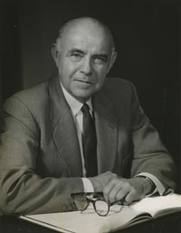
Social epidemiology @ UNC - McGavran
Edward G. McGavran
– Dean and Epidemiology faculty
1902 – born in Pachmari, State of Madhya Pradesh, Central Provinces, India, the son of missionaries
1924 – Butler University, Indianapolis
1928 – Graduated from Harvard Medical School
1929-1933 – private practice of medicine
1934 – Directed Kellogg Foundation project in “field training programs designed as requisite for approved professional status for public health workers”
Notes:
See Edward G. McGavran: Guardian of the Body Politic. Harriet H. Barr, Frances H. Barrie. UNC School of Public Health, 1979:
“During his medical education at Harvard, Dr. McGavran was assigned to Dr. Milton J. Rosenau’s reorganized curriculum, available through a new departmental division identified as the Department of Preventive Medicine and Hygiene. By 1925 the program had been condensed to one basic and one shorter course in epidemiology and was accompanied by an opportunity for conducting extensive research. Dr. Rosenau, a keen detector of student potential, was ever on the alert to encourage the most talented to consider graduate work in public health. The professor recommended as preparatory experience three years in private practice of medicine. In his opinion, practice in a rural area was especially /13/ beneficial in learning everything possible about the problems of a practicing physician.”
McGavran practiced medicine in Sidell, Illinois from 1929-1933. Frequently medical fees were paid with edibles from fields, barns and gardens. “This period provided Dr. McGavran the private practice experience which Rosenau had recommended as a prerequisite for successful public health leadership.” p14.

Slide 6
Social epidemiology @ UNC – McGavran 2
Edward G. McGavran
– Dean and Epidemiology faculty
1935 – MPH, Harvard School of Public Health
Public health officer, …, health commissioner of St. Louis County, MO
1946-1947 – Head, Department of Public Health and Preventive Medicine, Univ of Kansas Medical School
1947- 1963 – Dean and epidemiology faculty, UNC School of Public Health
Notes:
Edward G. McGavran: Guardian of the Body Politic. Harriet H. Barr, Frances H. Barrie. UNC School of Public Health, 1979:
“During his tenure with the Kellogg Foundation in Michigan, Dr. McGavran chose two communities as sites for a study and evaluation of tuberculosis programs. When the report was completed, the findings indicated that the community with the best services had the least improvement in tuberculosis rates. Upon closer examination of the evidence, it became apparent that improved economic conditions in the second community had a greater impact on the reduction of the incidence of tuberculosis than the health services provided. Dr. McGavran constantly reminded public health workers of their responsibility to promote social changes which affect health inasmuch as the greatest impact on health status in a community may be achieved by better housing or better jobs.” p14

Slide 7
Social epidemiology @ UNC – McGavran 3
Dean McGavran writes in the Department of Epidemiology’s 1953-1954 annual report: "… this department, which should be the strongest in the School of Public Health, is actually the weakest. … The primary need of the Department of Epidemiology, which is one of the basic disciplines of public health, is for a full-time person in this Department. The Dean as Professor of Epidemiology can devote less than 1/10 of his time to departmental teaching and work.”
http://www.unc.edu/~vschoenb/EPIDhistory/EPIDhx-CarlShyPhotopiesFromSPHannualReports/
Notes:
Edward G. McGavran: Guardian of the Body Politic. Harriet H. Barr, Frances H. Barrie. UNC School of Public Health, 1979:
“During his tenure with the Kellogg Foundation in Michigan, Dr. McGavran chose two communities as sites for a study and evaluation of tuberculosis programs. When the report was completed, the findings indicated that the community with the best services had the least improvement in tuberculosis rates. Upon closer examination of the evidence, it became apparent that improved economic conditions in the second community had a greater impact on the reduction of the incidence of tuberculosis than the health services provided. Dr. McGavran constantly reminded public health workers of their responsibility to promote social changes which affect health inasmuch as the greatest impact on health status in a community may be achieved by better housing or better jobs.” p14

Slide 8
Social epidemiology @ UNC – McGavran 3
1954 – Dean McGavran obtains Public Health Service funds to start a Chronic Disease Section and hires John Cassel to teach about cancer and other chronic diseases and to conduct epidemiologic research [Dreaming of a Time, p91].
1955 – “Dr. John Cassel, who recently arrived in this country from the Union of South Africa, has taken over the duties of Associate Professor in the Department of Epidemiology.” [The Body Politic, 1 (1), April 1955, p3 – the only mention of Epidemiology in this issue]
Notes:
Edward G. McGavran: Guardian of the Body Politic. Harriet H. Barr, Frances H. Barrie. UNC School of Public Health, 1979:
“During his tenure with the Kellogg Foundation in Michigan, Dr. McGavran chose two communities as sites for a study and evaluation of tuberculosis programs. When the report was completed, the findings indicated that the community with the best services had the least improvement in tuberculosis rates. Upon closer examination of the evidence, it became apparent that improved economic conditions in the second community had a greater impact on the reduction of the incidence of tuberculosis than the health services provided. Dr. McGavran constantly reminded public health workers of their responsibility to promote social changes which affect health inasmuch as the greatest impact on health status in a community may be achieved by better housing or better jobs.” p14

Slide 9
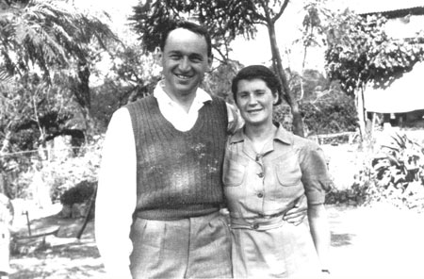
Social epidemiology @ UNC - Kark
Sidney Kark – first full-time EPID chair
1911 - born in Johannesburg, South Africa, to which his family had emigrated from Lithuania in the 1880s
1936 - Graduated from Witwatersrand University Medical School in 1936
1940 - led the Pholela health center in rural Natal Province, South Africa, with his wife Emily, also a physician
1946 – directed the newly created Institute of Family and Community Health (IFCH) to train personnel for the large network of health centers on the Pholela model
1958-59 – first full-time chair of the UNC Department of Epidemiology
http://www.ncbi.nlm.nih.gov/pmc/articles/PMC3221478/

Slide 10
Epidemiology @ UNC - Funding
Epidemiology funding in 1958-1959:
NIH training grants from Heart Institute ($16,500)
NIH training grant from Cancer Institute ($14,500),
Epidemiology training grant from US PHS ($25,000)
State funds ($13,000).

Slide 11
Epidemiology @ UNC - Graduates
May 1959 graduates
108 total graduates from the School.
Among them:
Epidemiology 1
Parasitology 7
(The Body Politic Vol. V, May, 1959)

Slide 12
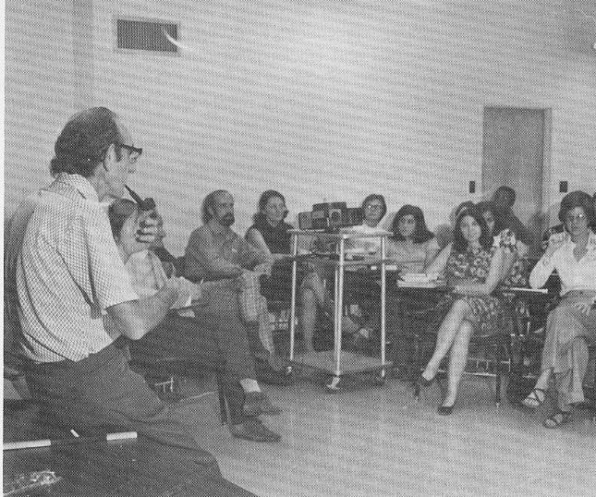
Social epidemiology @ UNC - Cassel
John C. Cassel – first permanent EPID chair
1921 - born in Johannesburg
1947 – MD from Witwatersrand
Joined the staff of the Durban IFCH and received training at two of its health centers
Appointed medical officer in charge of the Pholela center, until 1953
Came to UNC for MPH in public health administration
July 1, 1959 – becomes Epidemiology chair

Slide 13


Social epidemiology @ UNC – new faculty
Ralph C. Patrick, Jr.
PhD in Anthropology from Harvard University
Assistant Professor, Department of Sociology and Anthropology, Washington University, St. Louis Missouri,
1958 – appointed Associate Professor, UNC Department of Epidemiology by Sidney Kark
Herman Alfred (“Al”) Tyroler
1924 – born in Brooklyn, NY
1947 – MD from NYU College of Medicine
1951-1953 – 1st Lt. to Captain, USAF Medical Corps
1953-1958 – Medical Consultant and Director of Research, Occupational Health Services, Asheville NC
1958-1960 – Research Director, Health Research Foundation, Asheville, NC
1960 – Associate Professor, UNC Department of Epidemiology
C. David Jenkins
1960 – PhD in Psychology from UNC

Slide 14
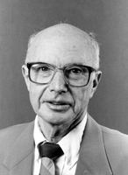
Social epidemiology @ UNC - Kaplan
Berton H. Kaplan, Ph.D.
1951 – B.S. in Business Administration from Virginia Polytechnic Institute
1952 – M.S. in Personnel Administration from UNC
U.S. Air Force. First Lt., Base Information and Education Officer; Base Adjutant to the Base Commander
1954-55 – Studied Social Anthropology at University of Edinburgh
1956 – Research Assistant to John Cassel
1956-1959 – Fellowships with Harvey L. Smith
1959-1968 – Preceptor in Departments of Psychiatry and Sociology, UNC
1962 – PhD in Sociology from UNC
1960-1966 – Instructor and Assistant Professor, Department of Mental Health, UNC
1966 – Appointed Senior Associate, Department of Anthropology, UNC
1967 – Appointed Associate Professor, Department of Epidemiology (Full, 1972)
1974-1980 – Director, NIH Training Program on Psychosocial Factors in Mental Health and Disease

Slide 15
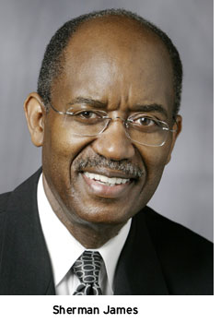
Social epidemiology @ UNC - James
Sherman A. James, Ph.D.
1964 – BA from Talladega College, Talladega, Alabama
1964-1969 – USAF, 2nd lieutenant to Captain
1973 – PhD in Social Psychology from Washington University, St. Louis
1973 – Appointed Assistant Professor, UNC Department of Epidemiology (Associate 1980, Full 1985)
1986-1987 – Visiting Professor of Preventive Medicine, School of Medicine, Federal University of Bahia
Sherman describes his recruitment to Chapel Hill in an interview with Bill Jenkins: https://youtu.be/vCSEAaT6kxw (6 min. excerpt) (Complete interview [30 min]: https://www.youtube.com/watch?v=1qALNhukprg)

Slide 16
Equity

Slide 17
Equity (social justice)
What is health equity / social justice?
Diversity among people leads to different judgments.
Contrasting philosophies – 1) people deserve what they can get versus
2) everyone should have what they need. The former philosophy has strategic advantages because it requires less cooperation and less enforcement. The latter philosophy may produce more harmony.
Judgments about equity reflect power.
The impact of those judgments depends upon power.
Influencing actions requires more power than does influencing words.
Equity requires modest differentials in power and resources.

Slide 18
UNC conferences/webcasts
Archived: Political power, policy, and health equity, 22nd National Health Equity Research Webcast
Mildred Thompson, Senior Director and Director of the PolicyLink Center for Health Equity and Place
Malia Villegas, Director, National Congress of American Indians Policy Research Center
Lydia Camarillo, Vice-President, Southwest Voter Registration Education Project (SVREP)
Moderator: Thomas Ross, President Emeritus, The University of North Carolina, Professor of Public Law and Government, UNC; Terry Sanford Distinguished Fellow, Duke Sanford School of Public Policy
Coming February 24: Systems of Power; Recalling our Past, Restructuring our Future, 38th Annual Minority Health Conference
(Many more at www.minority.unc.edu/resources/webcasts/)

Slide 19
What has epidemiology taught us about health equity?
Immediate essentials for health are air, water, food, clothing, shelter, and protection against living material that may harm us (via hygiene, sanitation, disinfection, immunization, insect control, animal control, police protection).
Broader essentials are some degree of personal autonomy, access to resources and services, knowledge and information (education).

Slide 20
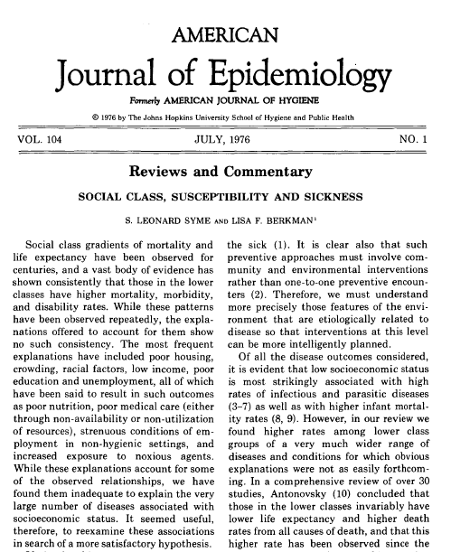
Epidemiology: It’s healthier to be well off
“Social class gradients of mortality and life expectancy have been observed for centuries …” (Syme and Berkman, 1976)
Preponderance of health problems occur to people with limited resources.
Power begets resources; resources beget power.
When we discover how to prevent illness, those with the knowledge and resources get the best chance to do so.

Slide 21
Economics

Slide 22
Economics and equity
In 21st century US, continuing from 20th century, income and especially wealth are key determinants of individuals’ and groups’ power and access to resources.
Income and wealth are very unequally distributed, and bring associated differences in health care, support, knowledge, choices, opportunities, influence, control, decision-making, autonomy.
Disparities tend to persist and grow, because those who have more can (1) accumulate more readily; (2) invest more in their families, friends, and associates; (3) disproportionately influence the rules of the game.
These influences are not absolute, since there are some conflicts and contradictions. There are various sources of power that compete with economic power. Consider the fate of millionaires in Russia. Also, political movements are not entirely under the control of money. But in U.S. democracy, money has considerable access to power.

Slide 23
Economics as a fundamental framework
Every process needs resources, so every agent and every organization needs resources. Competition – and cooperation – are inherent in society (and in biology)
Resources are needed for current consumption and for investment to increase future capabilities and productivity.
Resources can be garnered by force/taxation, by exchange, by gift, etc.
Profit-making enterprises have the most direct access to resources, especially in democracies. Consumers “willingly” provide revenue. Government programs need agreement on revenue, which means political support and compliant taxpayers. Both government and, especially business, have found ways to entice people to give over money (e.g., Powerball, reward cards).

Slide 24
Evolution

Slide 25
Evolution
Market capitalism emulates evolution, the process through which we emerged and remain.
Evolution – what exists has, for the most part, survived from yesterday.
Strategies, reason, values, etc. – all stand or fall based on whether they survive over extended periods (or can arise anew).
Adaptability, reproduction, inheritance, diversity, growth are key – environments change; agents compete; need redundancy and portfolios to cover all contingencies.
Cooperation can increase success.
But cooperation requires trust – which also opens door to cheating. So need sanctions, “fairness”, “justice”.
Emergence – another E-word! Life and society are emergent phenomena.

Slide 26
Enlightenment

Slide 27
Enlightenment
Business as usual probably won’t work indefinitely; the environment dictates the need for a more enlightened approach to human living.
We cannot afford to waste so much wealth – wasteful/harmful consumption, excessive competition, poor judgment/mismanagement, corruption, poor governance, military excesses.
What can epidemiology contribute? Epidemiology is transdisciplinary, integrates across all fields, is purposeful, goal directed, practically-oriented, wholistic, uses a systems thinking approach.
Epidemiology should devote more attention to studying how the nervous system works – thinking, noncognitive processes, biological influences, feedbacks, environmental, including behavioral environmental influences, behavioral economics, decision-making (many examples at https://sakai.unc.edu/access/content/user/vschoenb/Public%20Library/Decision-making/).
What influences consciousness, breadth of awareness, generosity?
Notes:
See also notes at See notes at www.unc.edu/epid600/modules/130roleOfEPID/ and www.unc.edu/epid600/modules/130roleOfEPID/morethoughts.htm

Slide 28
Example: Children can predict election results?
University students rating candidates’ competence from photos had 72% probability of choosing the one elected.
Children choosing a captain for an imaginary boat trip had 71% probability of choosing the photo of the candidate elected.
(Predicting Elections: Child's Play! Science 27 Feb 2009;323:1183. http://science.sciencemag.org/content/323/5918/1183)
Notes:
"… individuals automatically infer characteristics of social targets based on facial appearances (6). Voters acting rationally, however, should change these initial classifications as they receive information about the target individual's values, performance, political affiliation and the like. Unfortunately, voters are anchored in first impressions and do not appropriately correct initial inferences; additional information on the candidates does not change choices by much (5)."
"We recruited adults and children in Switzerland to rate pairs of faces (the winner and runner-up) from the run-off stages of the 2002 French parliamentary election (10). In experiment 1 (N=684 adults), results of a logistic regression showed that the probability of predicting an election result correctly on the basis of ratings of competence was 0.72. Ratings of compenetnce also predicted margin of victory (standardized beta=0.32, P<0.001).
"Using the same materials in experiment 2, 841 individuals – of whom 81 were children aged 5-13 years (mean age=10.31, SD=1.81) – participated in a game involving a computer-simulated trip from Troy to Ithaca. Thereafter participants chose from two faces the captain of their boat (Fig. 1A). For the children, results from a logistic regression showed that probability of predicting an election result correctly on the basis of choice of captain was 0.71. The results did not differ when including the other particiopants (N=160, mean age=30.49, SD=16.32); prediction accuracy did not depend on age (fig. S1)."
(John Antonakis and Olaf Dalgas. Predicting elections: child’s play! Science 27 Feb 2009;323:1183) www.sciencemag.org/cgi/data/323/5918/1183/DC1/1

Slide 29
Example: Blue or Red? Exploring the Effect of Color on Cognitive Task Performances
Red (versus blue) induces an avoidance (versus approach) motivation & enhances performance on a detail-oriented task
Blue enhances performance on creative task
Effects occur outside of consciousness
Activation of alternative motivations mediates
[Ravi Mehta and Rui (Juliet) Zhu, Science 27 Feb 2009;323:1226-1229, http://science.sciencemag.org/content/sci/323/5918/1226.full.pdf?sid=c68a2457-3d07-4a97-9912-b8a73ab69376]
Notes:
Ravi Mehta and Rui Zhu studied the effect of color on thinking: “From a series of six studies, using various tasks covering a number of different domains, we demonstrate that red (versus blue) can activate an avoidance (versus approach) motivation and subsequently can enhance performance on detail-oriented (versus creative) cognitive tasks. This research thus offers a reconciliation of the conflicting results reported in the extant literature and advances current research on the effect of color on cognition and behavior [e.g., (3)]. More important, our findings offer a wide range of implications for daily human life. What wall color do we pick for an educational facility? What color enhances persuasion in a consumption context? What color enhances creativity in a new product design process? Results from this research suggest that, depending on the nature of the task, different colors might be beneficial. If the task on hand requires people's vigilant attention (e.g., memorizing important information or understanding the side effects of a new drug), then red (or another color that activates an avoidance motivation) might be particularly appropriate. However, if the task calls for creativity and imagination (e.g., designing an art shop, or a new product idea brainstorming session), then blue (or another color that activates an approach motivation) would be more beneficial.”
(Blue or Red? Exploring the Effect of Color on Cognitive Task Performances
Ravi Mehta and Rui (Juliet) Zhu. Science 27 Feb 2009:1226-1229.)
http://www.sciencemag.org/cgi/content/full/323/5918/1226

Slide 30
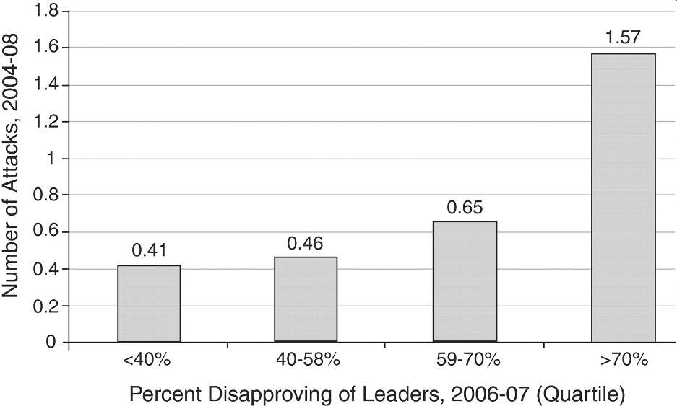
Example: Attitudes and international terrorism
In 143 pairs of countries, controlling for other relevant variables, we “found a greater incidence of international terrorism when people of one country disapprove of the leadership of another country.”
Fig. 1 Attitudes and international terrorist attacks. Shown are the numbers of attacks per pair of countries by public disapproval of foreign leaders. Calculations were made by the authors from Gallup World Poll data and NCTC WITS data.
Alan B. Krueger and Jitka Malecková. Attitudes and Action: Public Opinion and the Occurrence of International Terrorism.
Science 18 Sept 2009: 1534-1536. http://science.sciencemag.org/content/sci/325/5947/1534.full.pdf?sid=68e58e2d-b1b8-4096-8f4c-0e52caa20c0a
Notes:
“

Slide 31
Example: Neuropeptide oxytocin regulates parochial altruism in intergroup conflict among humans
Parochial altruism – individual self-sacrifice to
1) Benefit their group (“in-group love”) and
2) Derogate competing out-groups (“out-group aggression”).
Computer-mediated, double-blind, placebo-controlled, intranasal administration of oxytocin
Oxytocin increases in-group trust, in-group love, out-group hate, and defensive out-group aggression
(Carsten K. W. De Dreu et al., Science 11 Jun 2010;328:1408-1411)
Notes:
http://www.sciencemag.org/content/328/5984/1408.abstract

Slide 32
Examples: Emotions are contagious
Experimental evidence of massive-scale emotional contagion through social networks. PNAS 2014 (“We provide experimental evidence that emotional contagion occurs without direct interaction between people (exposure to a friend expressing an emotion is sufficient), and in the complete absence of nonverbal cues.”) (LINK)
Facebook Manipulated 689,003 Users' Emotions for Science. Kashmir Hill, Forbes, 2014 (“Facebook’s data scientists manipulated the News Feeds of 689,003 users, removing either all of the positive posts or all of the negative posts to see how it affected their moods.”) (LINK)
Notes:
We can illustrate the relation among incidence, prevalence, and duration with a simple example. Suppose there is a remote community with 101,000 people and one hospital. The hospital has a census of 1,000 patients, all from this community. Each week 500 people from the community are admitted to the hospital, and because the hospital and community are in a steady state, there are also 500 discharges each week. In this special situation, the prevalence odds of hospitalization will equal the incidence rate of hospitalization times the average duration of hospitalization:
prevalence odds = incidence rate X average duration
The prevalence odds are the prevalence divided by one minus the prevalence [p/(1-p)], which for a small prevalence is essentially the same as the prevalence (which is why many textbooks give the formula as prevalence = incidence x duration.

Slide 33
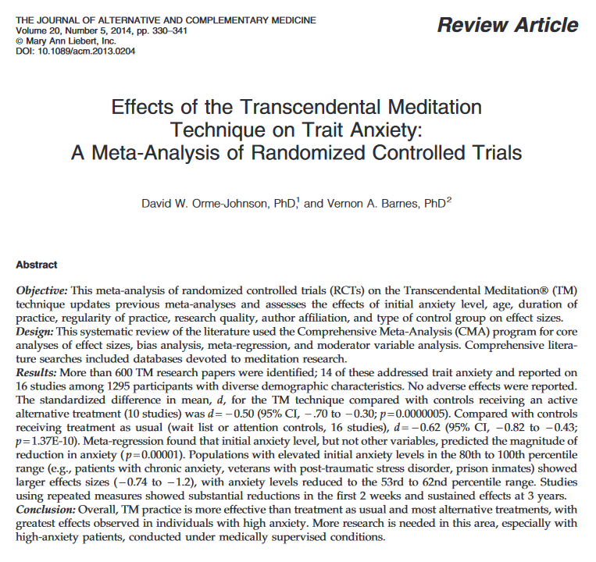
Results: “… 16 studies among 1295 participants with diverse demographic characteristics. … The standardized difference in mean, d, for the TM technique compared with controls receiving an active alternative treatment (10 studies) was
d=-0.50 (95% CI,-.70 to -0.30;…). Compared with controls receiving treatment as usual (wait list or attention controls, 16 studies), d=-0.62 (95% CI, -0.82 to -0.43; …).… Populations with elevated initial anxiety levels in the 80th to 100th percentile range (e.g., patients with chronic anxiety, veterans with post-traumatic stress disorder, prison inmates) showed larger effects sizes (-0.74 to -1.2), with anxiety levels reduced to the 53rd to 62nd percentile range.
David W. Orme-Johnson and Vernon A. Barnes. Effects of the Transcendental Meditation Technique on Trait Anxiety: A Meta-Analysis of Randomized Controlled Trials. The Journal of Alternative and Complementary Medicine 2014;20(5):330-341.
http://online.liebertpub.com/doi/pdf/10.1089/acm.2013.0204
Notes:
David W. Orme-Johnson and Vernon A. Barnes. Effects of the Transcendental Meditation Technique on Trait Anxiety: A Meta-Analysis of Randomized Controlled Trials. The Journal of Alternative and Complementary Medicine 2014;20(5):330-341.
http://online.liebertpub.com/doi/pdf/10.1089/acm.2013.0204

Slide 34

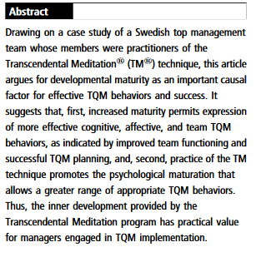
Jane Schmidt-Wilk. TQM and the Transcendental Meditation program in a Swedish top management team, The TQM Magazine 2003;15(4):219 - 229
http://www.emeraldinsight.com/doi/pdfplus/10.1108/09544780310486137
Notes:
Jane Schmidt-Wilk. TQM and the Transcendental Meditation program in a Swedish top management team, The TQM Magazine 2003;15(4):219 - 229
http://www.emeraldinsight.com/doi/pdfplus/10.1108/09544780310486137

Slide 35
Thank you!
Please visit my “virtual library” at http://go.unc.edu/sjae
and my other pages at
http://go.unc.edu/vjs

