Slide 1
Cardiovascular Epidemiology Program at UNC: A Brief Historical Perspective
Wayne Rosamond, PhD, MS
Professor
Department of Epidemiology
Gillings School of Global Public Health
University of North Carolina at Chapel Hill

Slide 2
Fall class 1936, Division of Public Health, UNC

Slide 3
Milton Rosenau, Dean, School of Public Health, UNC 1946

Slide 4
Beginning of chronic disease epidemiology at UNC
Edward McGavran, SPH Dean, 1953 Annual Report
“…the result of this (growing administrative responsibilities of Deans Rosenau and McGavran) is that this department (Epidemiology), which should be the strongest in the School of Public Health, is actually the weakest”,
To address this need the Chronic Disease Section created in 1954, led by John Cassel
John Cassel, 1954

Slide 5
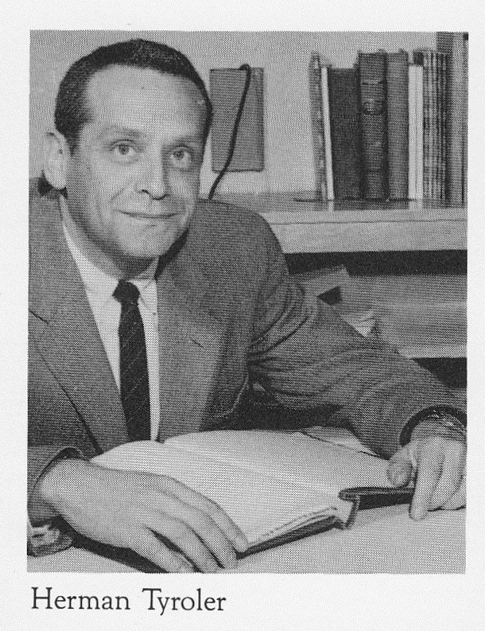
Department of Epidemiology Faculty, 1960

Slide 6
Al Tyroler (1924-2007)
1947 M.D. degree New York University
1960-1995 Professor UNC Department of Epidemiology

Slide 7
CHD and the social and physical environment, 1963

Slide 8
Early Days
Evans County Heart Study (1958-1995)
Examine incidence of CVD across entire population of Evans Co. GA
Prospective cohort design (n=3102)
Only study to compare difference in CVD incidence between black and whites
One of only two to study entire population of a community
Results
CHD higher in whites
Risk factors act the same in blacks and whites
Importance of HDL cholesterol
Temporal increase of CHD risk in blacks toward that of whites.
McDonough J, et al. CVD field study in Evans Co. GA. Public Health Reports. 1963; 78(12): 1051-1059.
Cassel J. Evans county cardiovascular study. Arch Intern Med. 1971; 128 (6): 883-992)
Notes:
Begun by Curtis Hames, MD. A family doc from Glaxton GA…notices CHD rare in blacks…wondered why?
No statistical tests in initial papers….data not from a sample of some universe but was the universe.
95% of all residents 40yr + enrolled in study.

Slide 9
Evans County Cardiovascular Study, 1959

Slide 10
Evans County Heart Study. 1965
Curtis Hames
Al Tyroler

Slide 11
Early days
Lipid research clinic coronary primary prevention trials (LRC-CPPT) (1973)
Data coordinating center at UNC Biostatistics
Widely considered definitive test of cholesterol lowering hypothesis
“2 for 1” idea…2 percent lowering of risk for 1 percent lowering of LDL
Prevalence study (10 US, 2 Soviet, 1 Israeli populations)
Geographic differences,
Follow up supported HDL-CHD relationship
Multigenerational family study of lipid dysregulation
LRC-CPPT committee. LRC Prevalence Study. Circulation. 1979;60:427-439
LRC-CCPT committee. LRC Prevention Trial. JAMA. 1984; 251:351-364.

Slide 12
UNC CV Epidemiology Program (circa 1972)
Gerardo Heiss and Al Tyroler

Slide 13
Lipid Research Clinics, 1973-1983

Slide 14
The Daily Tar Heel, 1985: ARIC Study in the news
“ Gerardo Heiss, UNC associate professor…said the research should determine if the decline in heart disease related deaths is due to fewer cases or better treatment of patients...(and) provide new information about...factors...that may lead to atherosclerosis...”

Slide 15
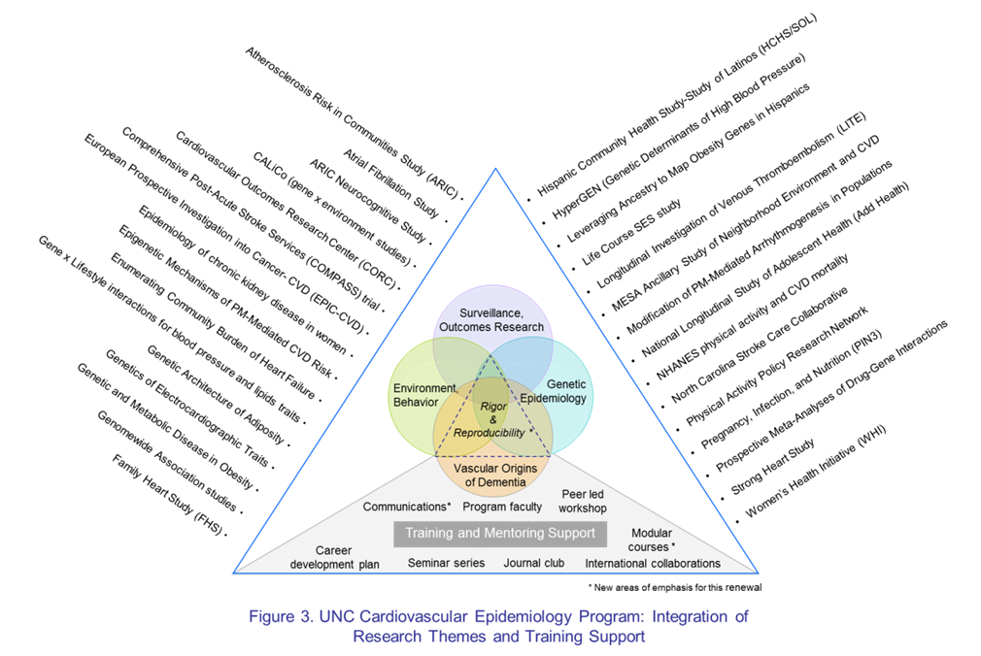
UNC Cardiovascular Epidemiology Program- Research Themes and Training Support 2016

Slide 16
CV Epidemiology trainees 2006

Slide 17
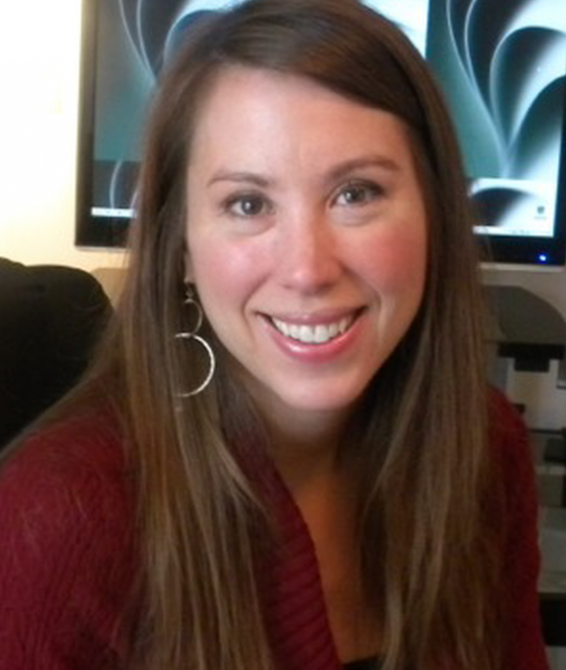
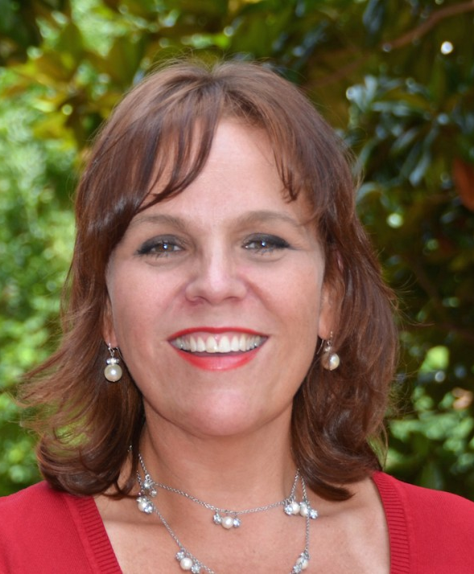
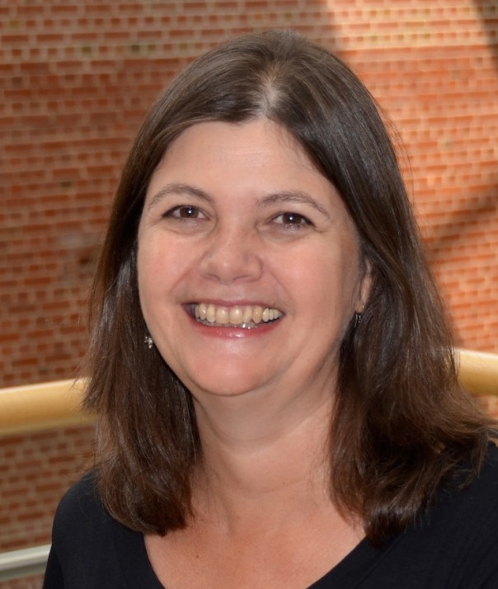
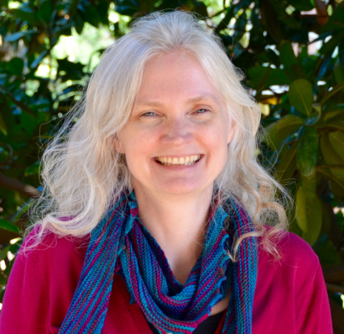
UNC Cardiovascular Epidemiology Program Faculty
2016
(clockwise from left): L. Loehr, K. Evenson, G. Heiss, W. Rosamond, K. North, C. Avery, A. Kucharska-Newton, N. Franceschini, E. Whitsel, K. Young, M. Graf

Slide 18
Department of Epidemiology 2016
Ranked 4th among administrating departments/entities in grant funding ($26.5 million)
Lineberger Cancer Center
Carolina Population Center
Institute for Global Health and Infectious Diseases
Ranked 1st among all UNC Departments
30% ($8 million) from CV Epidemiology program

Slide 19
Cardiovascular Epidemiology Faculty & Staff
Program Area Faculty
Christy Avery
Sara Jones Berkeley
Ganga Bey
Kelly Evenson
Nora Franceschini
Misa Graff
Heather Highland
Kristin Young
Shakia Hardy
Anna Kucharska-Newton
Laura Loehr
Kari North
Wayne Rosamond
Eric Whitsel
Michelle Meyer (Emergency Medicine)
Priya Palta (Neurology)
Ming Ding (Medicine)
Staff
Nancy Culberson
Terry Hudgins
Anna Johnson
Betsi Thompson
Amber Robb
James Stewart
Yujie Wang
Molly Wen
Gloria Gu
Jinyu (Jennifer) Chen
James Russell Pike
Alex Munson
Katherine Kartheiser
Jenna Barbee
Notes:
New slide from Wayne Rosamond inserted by Victor Schoenbach, 11/18/2024

Slide 20
Thank You!
Questions

