Slide 1




Gerardo
Heiss
1942-2022

Slide 2
Gerardo
Heiss
1942-2022

Slide 3
Gerardo
Heiss
1942-2022

Slide 4
Gerardo
Heiss
1942-2022

Slide 5
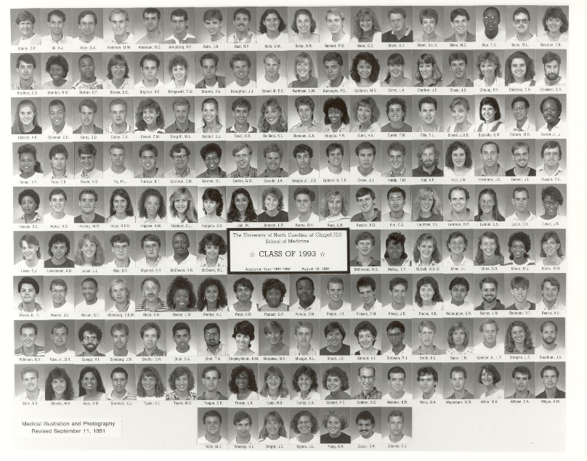
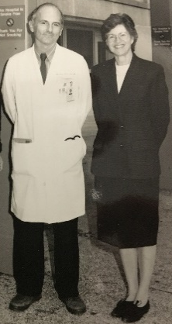
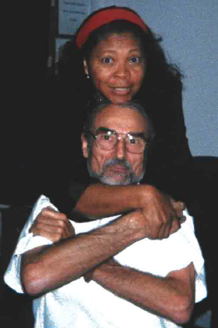
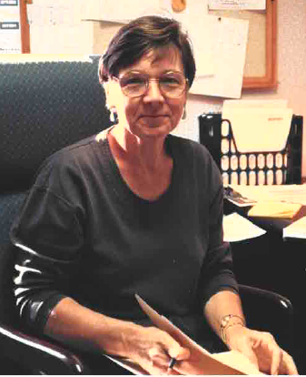
Gerardo
Heiss
1942-2022

Slide 6
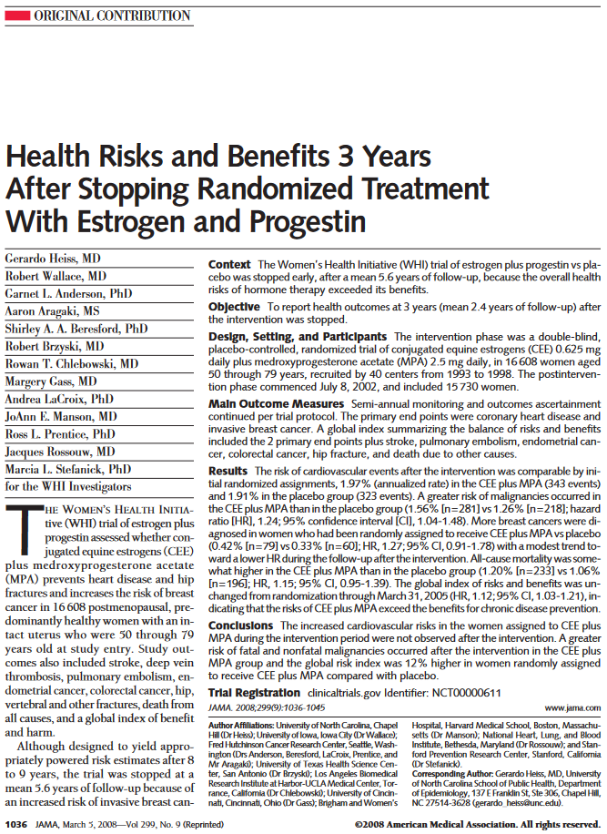
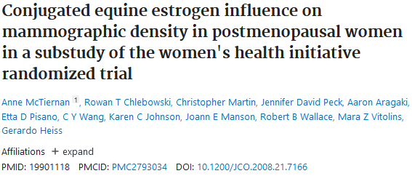
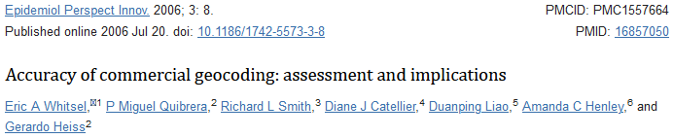
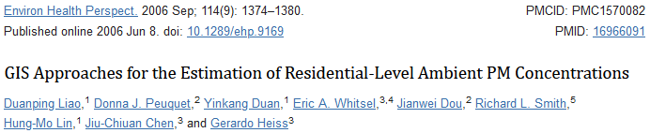
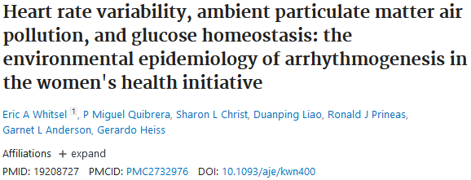
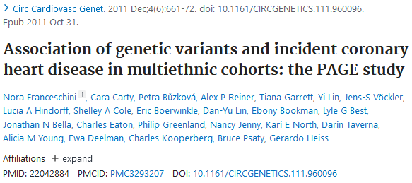
Gerardo
Heiss
1942-2022

Slide 7
Gerardo
Heiss
1942-2022
The Gerardo Heiss Memorial
Cardiovascular Epidemiology Scholarship
Endowment Fund
(fund 444861)

