Slide 1
Telling the story of the UNC Department of Epidemiology’s history
(I wasn’t interested in history until I realized it was my future)
Victor J. Schoenbach, https://go.unc.edu/vjs
Judith Winkler, https://www.linkedin.com/in/judithwinkler/
November 19, 2024
Gerardo Heiss Cardiovascular Disease Seminar
UNC Department of Epidemiology
(https://go.unc.edu/EPIDhistory
Notes:
The UNC Department of Epidemiology: Our First 40 Years, 1936-1976. (2018).
J. Winkler and V. J. Schoenbach. Chapel Hill, N.C.: The UNC Gillings
School of Global Public Health. Available at:
sph.unc.edu/files/2018/02/UNC_EPID_History_2018.pdf – Dead link!

Slide 2

Vic’s disclosures
I am more of an archivist than a historian, and I’m not trained or accredited as either; I’m probably just a hoarder!
When my wife learned about attention deficit disorder, she gave me an ADD diagnosis – but no treatment.
I doubt there’s anything I can tell you that hasn’t been said better by someone else.
I’m secretly hoping that AI comes to my rescue

Slide 3
Outline
Gerardo Heiss, W.R. Kenan, Jr. Distinguished Professor
How the world has changed; why history is important
UNC’s Department of Epidemiology is a remarkable community, whose history deserves to be celebrated.
How Judith Winkler wrote the History of the Department of Epidemiology
Sources of historical data
Many people have contributed to preserving our history but it remains a challenge.

Slide 4
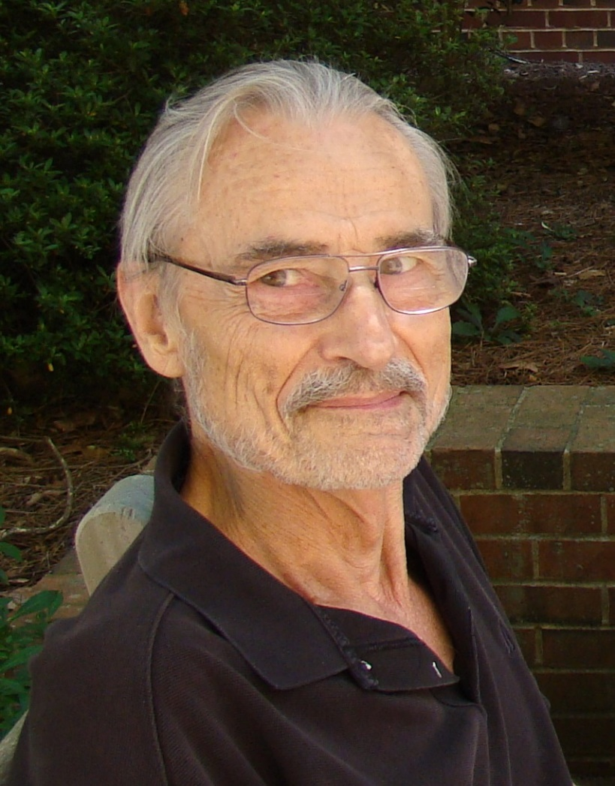
Gerardo Heiss, MD, MSc, PhD., FAHA
W.R. Kenan, Jr. Distinguished Professor
Speaking in the Gerardo Heiss Cardiovascular Epidemiology Seminar today is both an honor and a special occasion for me.
Although I have attended – and recorded – several Cardiovascular Epidemiology Seminars over the decades, the only one which I had a role in preparing was Gerardo’s presenting the history of the Evans County Study of Cardiovascular Disease (link)

Slide 5
Gerardo Heiss, MD, MSc, PhD., FAHA
W.R. Kenan, Jr. Distinguished Professor
Gerardo was a remarkable synthesis of detailed knowledge and understanding from the molecular to the environmental, penetrating analysis, broad awareness, thoughtfulness, collaboration, and accomplishment.
At the same time he was incredibly courteous, gracious, and supportive.

Slide 6
Gerardo Heiss, MD, MSc, PhD., FAHA
W.R. Kenan, Jr. Distinguished Professor
His contributions to the world, the nation, the University, School, and Department were huge. So many students, postdoctoral fellows, and colleagues benefited from his insights and wisdom, patience and high expectations, kindness and responsiveness, and attention to detail along with the big picture.

Slide 7
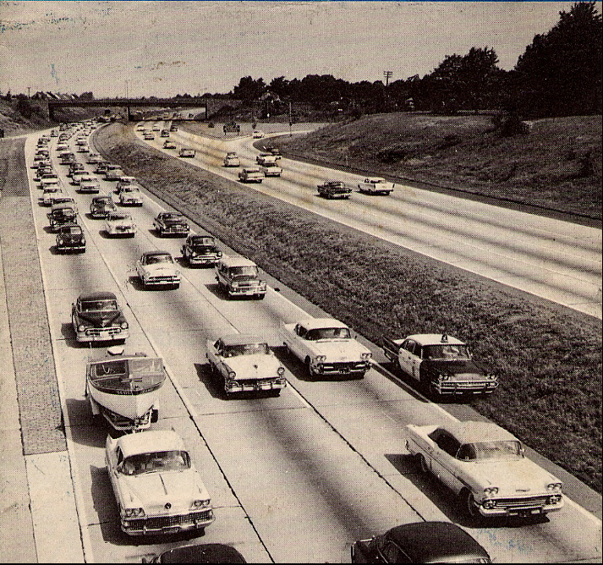
How the world has changed!
The world has changed phenomenally over the millennia. Even during my relatively short lifetime there have been dramatic changes in daily life, work, culture, demography, transportation, communications, manufacturing, agriculture, consumption, marketing, government, culture, . . ., Technology, and epidemiology.

Slide 8
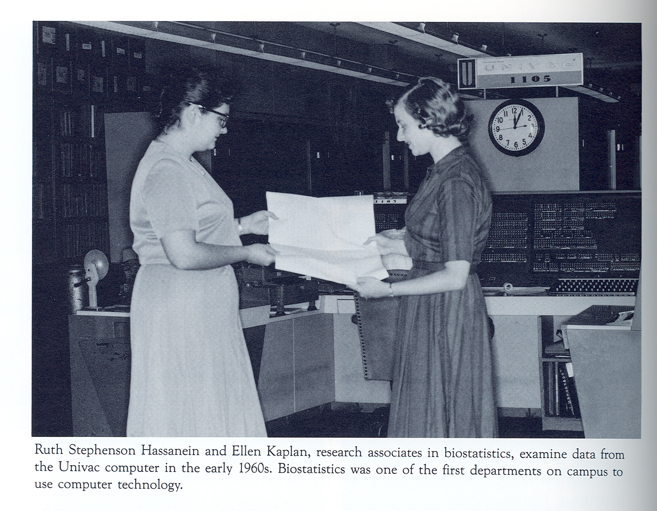
Notes:
In 1959, the UNC Computation Center began operating with a Univac 1105 computer. In March 1960, Bill Friday presided over dedicating the Computation Center (https://trilug.org/pipermail/trilug/Week-of-Mon-20100301/060923.html) In this photograph, from Robert Korstad’s Dreaming of a Time, Epidemiology faculty member Bert Kaplan’s wife Ellen was one of the early computer users in the School.

Slide 9
What use is history?
Knowledge of history broadens awareness, providing perspective and context
Studying history is a form of observational epidemiology, with occasional natural experiments.
Earlier versions of ourselves have influenced who we are today; earlier versions of organizations and institutions have influenced their current forms and procedures.
Learning the lessons of the past may help us to do better going forward – but no guarantees.

Slide 10
UNC’s Department of Epidemiology is a remarkable community

Slide 11
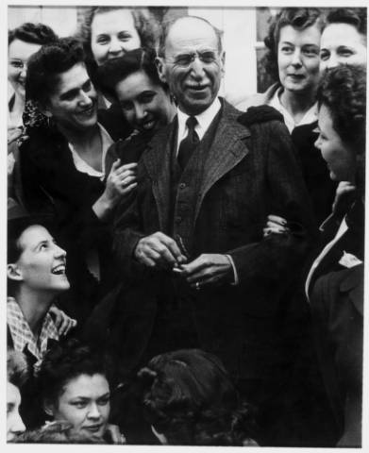
Epidemiology @ UNC – Milton J. Rosenau, MD
Milton J. Rosenau, MD
1869 – born in Philadelphia
1889 – MD from University of Pennsylvania
1892-1893 – Hygienic Institute, Berlin
1900 – Pathological Institute (Vienna) and Pasteur Institute (Paris)
1890-1892 – assistant surgeon with U.S. Marine Hospital Service (forerunner of US PHS)
1895-1898 – quarantine officer at San Francisco
1898 – quarantine officer in Cuba
1899 – director, Hygienic Laboratory (nucleus of NIH)
1909 – professor of preventive medicine, Harvard Medical School
1913 – established first school of public health in the US
1936 – established Division of Public Health at UNC SOM
Notes:
“Also in 1913 Rosenau published his most important work, Preventive Medicine and Hygiene, which in its tenth edition remains the standard text on the subject. With his long teaching career and his influential textbook, Rosenau was so instrumental in educating health workers in the advances of microbiology and immunology that he was regarded as the father of preventive medicine in the United States.”
http://ncpedia.org/biography/rosenau-milton-joseph
“During 1899-1909, he directed the MHS Hygienic Laboratory, transforming a one-person operation into a bustling institution with divisions in bacteriology, chemistry, pathology, pharmacology, zoology, and biology. Rosenau conducted his most important medical research during his 10 years at the Hygienic Laboratory, publishing many articles and books, including The Milk Question (1912) and Preventive Medicine and Hygiene (1913), which quickly became the most influential textbook on the subject.
“From early in his career, campaigns to reduce milkborne diseases occupied Rosenau's attention. As he stated in his textbook, ‘Next to water purification, pasteurization is the most important single preventive measure in the field of sanitation.’ A Public Health Service study in 1909 reported that 500 outbreaks of milkborne diseases had occurred during 1880-1907. By 1900, increasing numbers of children drank pasteurized milk, but raw milk remained the norm partly because the high-temperature process then in use imparted a "cooked milk" taste. In 1906, Rosenau established that low temperature, slow pasteurization (140 F [60 C] for 20 minutes) killed pathogens without spoiling the taste, thus eliminating a key obstacle to public acceptance of pasteurized milk. However, securing a safe milk supply nationwide took another generation. By 1936, pasteurized, certified milk was the standard in most large cities, although over half of all milk in the United States was still consumed raw.”
Also, https://www.cdc.gov/mmwr/preview/mmwrhtml/mm4840b1.htm

Slide 12
Epidemiology @ UNC – Rosenau 2
Milton J. Rosenau, MD
Milton Rosenau was the first dean and the entire epidemiology faculty.*
* Many courses were taught by people on loan from other agencies, especially the NC Department of Health.

Slide 13
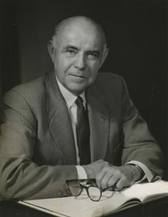
Epidemiology @ UNC – Edward G. McGavran
Edward G. McGavran
– Dean and Epidemiology faculty
1902 – born in Pachmari, State of Madhya Pradesh, Central Provinces, India, the son of missionaries
1924 – Butler University, Indianapolis
1928 – Graduated from Harvard Medical School
1929-1933 – private practice of medicine
1934 – Directed Kellogg Foundation project in “field training programs designed as requisite for approved professional status for public health workers”
Notes:
See Edward G. McGavran: Guardian of the Body Politic. Harriet H. Barr, Frances H. Barrie. UNC School of Public Health, 1979:
“During his medical education at Harvard, Dr. McGavran was assigned to Dr. Milton J. Rosenau’s reorganized curriculum, available through a new departmental division identified as the Department of Preventive Medicine and Hygiene. By 1925 the program had been condensed to one basic and one shorter course in epidemiology and was accompanied by an opportunity for conducting extensive research. Dr. Rosenau, a keen detector of student potential, was ever on the alert to encourage the most talented to consider graduate work in public health. The professor recommended as preparatory experience three years in private practice of medicine. In his opinion, practice in a rural area was especially /13/ beneficial in learning everything possible about the problems of a practicing physician.”
McGavran practiced medicine in Sidell, Illinois from 1929-1933. Frequently medical fees were paid with edibles from fields, barns and gardens. “This period provided Dr. McGavran the private practice experience which Rosenau had recommended as a prerequisite for successful public health leadership.” p14.

Slide 14
Epidemiology @ UNC – McGavran 2
Edward G. McGavran
– Dean and Epidemiology faculty
1935 – MPH, Harvard School of Public Health
Public health officer, …, health commissioner of St. Louis County, MO
1946-1947 – Head, Department of Public Health and Preventive Medicine, Univ of Kansas Medical School
1947- 1963 – Dean and epidemiology faculty, UNC School of Public Health
Notes:
Edward G. McGavran: Guardian of the Body Politic. Harriet H. Barr, Frances H. Barrie. UNC School of Public Health, 1979:
“During his tenure with the Kellogg Foundation in Michigan, Dr. McGavran chose two communities as sites for a study and evaluation of tuberculosis programs. When the report was completed, the findings indicated that the community with the best services had the least improvement in tuberculosis rates. Upon closer examination of the evidence, it became apparent that improved economic conditions in the second community had a greater impact on the reduction of the incidence of tuberculosis than the health services provided. Dr. McGavran constantly reminded public health workers of their responsibility to promote social changes which affect health inasmuch as the greatest impact on health status in a community may be achieved by better housing or better jobs.” p14

Slide 15
Epidemiology @ UNC – McGavran 3
Dean McGavran writes in the Department of Epidemiology’s 1952-1953 annual report: "The primary need of the Department of Epidemiology, which is one of the basic disciplines of public health, is for a full-time person in this Department. The Dean as Professor of Epidemiology can devote less than 1/10 of his time to departmental teaching and work.… The result is that this department, which should be the strongest in the School of Public Health, is actually the weakest.”
https://www.epidemiolog.net/sjae/publib/orgs/UNCCH/UNCSPH/EPID/Annual%20reports/1950s/EPID-AnnualReport-1952-1953.pdf
Notes:
Edward G. McGavran: Guardian of the Body Politic. Harriet H. Barr, Frances H. Barrie. UNC School of Public Health, 1979:
“During his tenure with the Kellogg Foundation in Michigan, Dr. McGavran chose two communities as sites for a study and evaluation of tuberculosis programs. When the report was completed, the findings indicated that the community with the best services had the least improvement in tuberculosis rates. Upon closer examination of the evidence, it became apparent that improved economic conditions in the second community had a greater impact on the reduction of the incidence of tuberculosis than the health services provided. Dr. McGavran constantly reminded public health workers of their responsibility to promote social changes which affect health inasmuch as the greatest impact on health status in a community may be achieved by better housing or better jobs.” p14

Slide 16
Epidemiology @ UNC – McGavran 3
1954 – Dean McGavran obtains Public Health Service funds to start a Chronic Disease Section and hires John Cassel to teach about cancer and other chronic diseases and to conduct epidemiologic research [Dreaming of a Time, p91].
1955 – “Dr. John Cassel, who recently arrived in this country from the Union of South Africa, has taken over the duties of Associate Professor in the Department of Epidemiology.” [The Body Politic, 1 (1), April 1955, p3 – the only mention of Epidemiology in this issue]
Notes:
Edward G. McGavran: Guardian of the Body Politic. Harriet H. Barr, Frances H. Barrie. UNC School of Public Health, 1979:
“During his tenure with the Kellogg Foundation in Michigan, Dr. McGavran chose two communities as sites for a study and evaluation of tuberculosis programs. When the report was completed, the findings indicated that the community with the best services had the least improvement in tuberculosis rates. Upon closer examination of the evidence, it became apparent that improved economic conditions in the second community had a greater impact on the reduction of the incidence of tuberculosis than the health services provided. Dr. McGavran constantly reminded public health workers of their responsibility to promote social changes which affect health inasmuch as the greatest impact on health status in a community may be achieved by better housing or better jobs.” p14

Slide 17
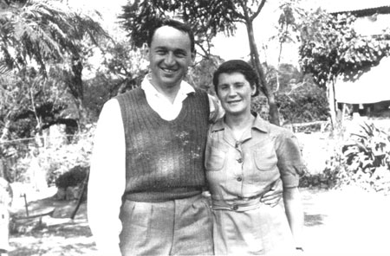
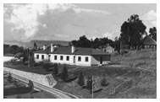
Epidemiology @ UNC - Kark
Sidney Kark – first full-time EPID chair
1911 - born in Johannesburg, South Africa, to which his family had emigrated from Lithuania in the 1880s
1936 - Graduated from Witwatersrand University Medical School in 1936
1940 - led the Pholela health center in rural Natal Province, South Africa, with his wife Emily, also a physician
1946 – directed the newly created Institute of Family and Community Health (IFCH) to train personnel for the large network of health centers on the Pholela model
1958-59 – first full-time chair of the UNC Department of Epidemiology
http://www.ncbi.nlm.nih.gov/pmc/articles/PMC3221478/
https://apps.nlm.nih.gov/againsttheodds/exhibit/community_health/model_world.cfm
Notes:
Photos from https://apps.nlm.nih.gov/againsttheodds/exhibit/community_health/model_world.cfm

Slide 18
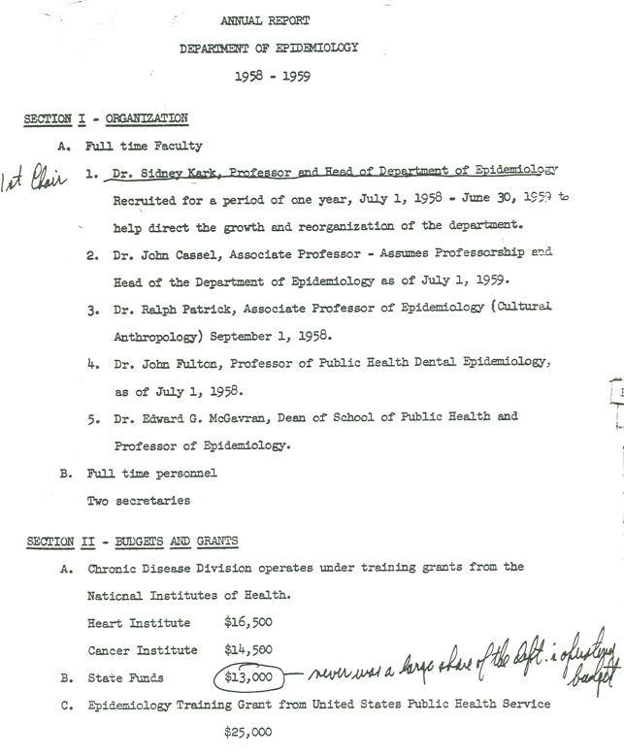
Epidemiology @ UNC - Funding
Epidemiology funding in 1958-1959:
NIH training grants from Heart Institute ($16,500)
NIH training grant from Cancer Institute ($14,500),
Epidemiology training grant from US PHS ($25,000)
State funds ($13,000).

Slide 19
Epidemiology @ UNC - Graduates
May 1959 graduates
108 total graduates from the School.
Among them:
Epidemiology 1
Parasitology 7
(The Body Politic Vol. V, May, 1959)

Slide 20
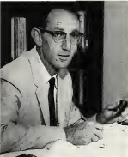
Epidemiology @ UNC – John C. Cassel
John C. Cassel – first permanent EPID chair
1921 - born in Johannesburg
1947 – MD from Witwatersrand
Joined the staff of the Durban IFCH and received training at two of its health centers
Appointed medical officer in charge of the Pholela center, until 1953
Came to UNC for MPH in public health administration
July 1, 1959 – becomes Epidemiology chair
Notes:
Photo from Robert Korstad, Dreaming of a Time, p116

Slide 21
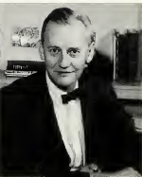
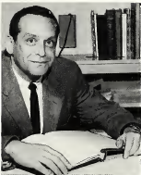
Epidemiology @ UNC – new faculty < 1960
Ralph C. Patrick, Jr.
PhD in Anthropology from Harvard University
Assistant Professor, Department of Sociology and Anthropology, Washington University, St. Louis Missouri,
1958 – appointed Associate Professor, UNC Department of Epidemiology by Sidney Kark
Herman Alfred (“Al”) Tyroler
1924 – born in Brooklyn, NY
1947 – MD from NYU College of Medicine
1951-1953 – 1st Lt. to Captain, USAF Medical Corps
1953-1958 – Medical Consultant and Director of Research, Occupational Health Services, Asheville NC
1958-1960 – Research Director, Health Research Foundation, Asheville, NC
1960 – Associate Professor, UNC Department of Epidemiology
Notes:
Photos from Robert Korstad, Dreaming of a Time, p116

Slide 22
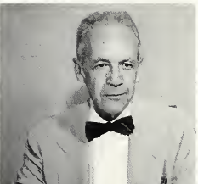
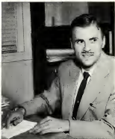
Epidemiology @ UNC – new faculty < 1960
John T. Fulton, D.D.S.
Graduate studies in public health, mental hygiene, and public administration
Joined the Epidemiology faculty in 1958 as a professor of public health dental epidemiology
C. David Jenkins, Ph.D.
1960 – Ph.D., University of North Carolina at Chapel Hill. Major: Psychology
1959 research associate, 1960 assistant professor
Left for the University of Texas, Galveston; after retiring returned to UNC and taught a course on social epidemiology
Notes:
Photo from Robert Korstad, Dreaming of a Time, p116

Slide 23
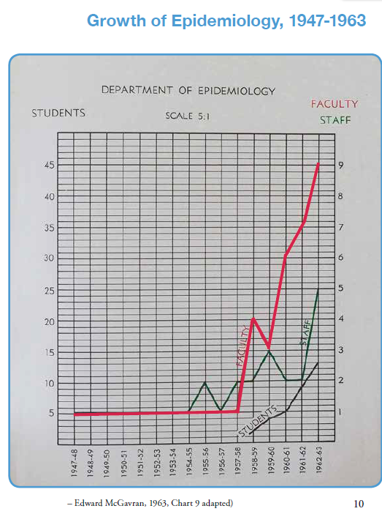
Faculty
Staff
Students

Slide 24
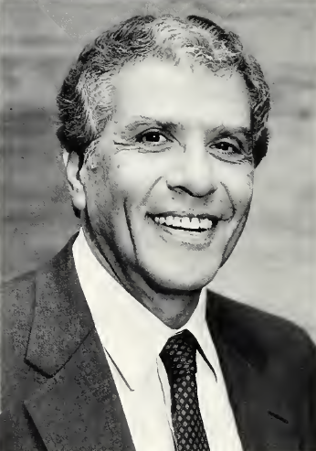
Epidemiology @ UNC – Michel Ibrahim
Michel A. Ibrahim, Ph.D.
An early EPID student - 1961 MPH, 1964 PhD
Grew up in a Christian family in Cairo, Egypt
Graduated from a British-style medical school in Egypt and practiced in a rural clinic
Studied biostatistics at UNC but switched to Epidemiology (MPH 1961, PhD 1964)
Worked at SUNY Buffalo and the Erie County NY Health Department
Joined the UNC faculty in 1971
1975 appointed acting chair, then chair, then dean

Slide 25
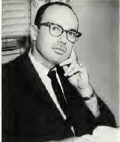
Epidemiology @ UNC – Bert Kaplan
Berton H. Kaplan, Ph.D.
1951 – B.S. in Business Administration from Virginia Polytechnic Institute
1952 – M.S. in Personnel Administration from UNC
U.S. Air Force. First Lt., Base Information and Education Officer; Base Adjutant to the Base Commander
1954-55 – Studied Social Anthropology at University of Edinburgh
1956 – Research Assistant to John Cassel
1956-1959 – Fellowships with Harvey L. Smith
1959-1968 – Preceptor in Departments of Psychiatry and Sociology, UNC
1962 – PhD in Sociology from UNC
1960-1966 – Instructor and Assistant Professor, Department of Mental Health, UNC
1966 – Appointed Senior Associate, Department of Anthropology, UNC
1967 – Appointed Associate Professor, Department of Epidemiology (Full, 1972)
1974-1980 – Director, NIH Training Program on Psychosocial Factors in Mental Health and Disease
Notes:
Photo from Robert Korstad, Dreaming of a Time, p116

Slide 26
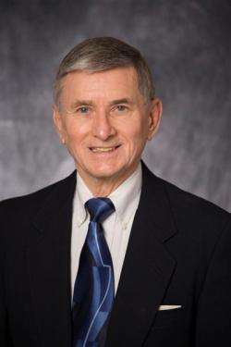
Epidemiology @ UNC – Stephen Zyzanski
Stephen J. Zyzanski, Ph.D.
1960 – B.S. Iowa State University, Ames, Iowa. Major: Industrial Psychology, Minors: Chemistry, Math
1962 – M.S., Iowa State University. Major: Psychology, Minor: Psychometrics
1968 – Ph.D., University of North Carolina at Chapel Hill. Major: Psychometrics. Minors: Math & BIOS.
Department of Epidemiology, UNC School of Public Health
1966-1968 – Research Associate
1968-1971 – Assistant Professor
1971-1972 – Associate Professor
1972-1979 – Associate Professor, Department of Behavioral Epidemiology, Boston University School of Medicine
Case Western Reserve University
1979-2008 – Director, Division of Research, 1979 – Associate Professor, 1986 – Professor, 2012 – Emeritus Professor, Department of Family Medicine, School of Medicine
1999-2008 – Director, Behavior Measurement Core Facility, Ireland Cancer Center

Slide 27
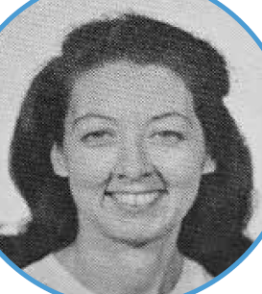
Epidemiology @ UNC – Joan Cornoni Huntley
Joan Cornoni, Ph.D.
1962 master’s degree from UNC Biostatistics
Worked at Yale school of public health
Recruited back to UNC into the EPID doctoral program; worked as a research assistant and instructor
On completing her PhD in 1970 she was appointed assistant professor
Married Robert Huntley and moved to D.C. in 1977
After retiring to Chapel Hill from the NIH National Institute on Aging, she worked with EPID students and taught [EPID160 / EPID600] one year

Slide 28
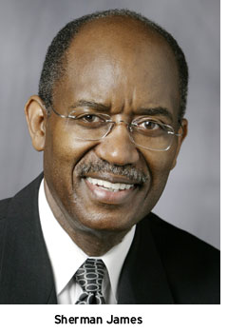
Social epidemiology @ UNC - James
Sherman A. James, Ph.D.
1964 – BA from Talladega College, Talladega, Alabama
1964-1969 – USAF, 2nd lieutenant to Captain
1973 – PhD in Social Psychology from Washington University, St. Louis
1973 – Appointed Assistant Professor, UNC Department of Epidemiology (Associate 1980, Full 1985)
1986-1987 – Visiting Professor of Preventive Medicine, School of Medicine, Federal University of Bahia
Sherman describes his recruitment to Chapel Hill in an interview with Bill Jenkins: https://youtu.be/vCSEAaT6kxw (6 min. excerpt) (Complete interview [30 min]: https://www.youtube.com/watch?v=1qALNhukprg)

Slide 29
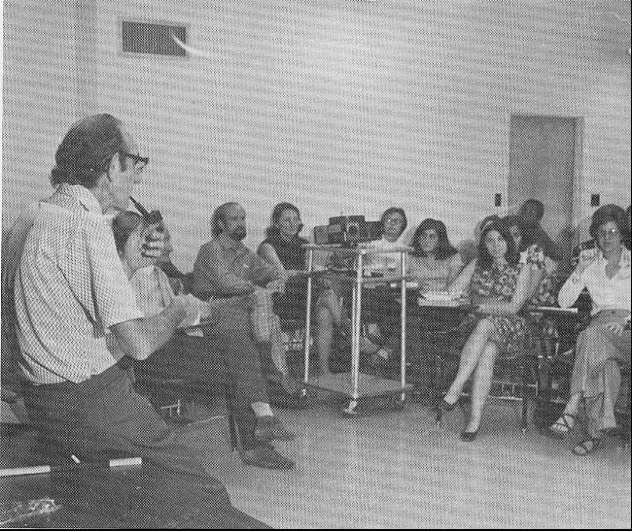
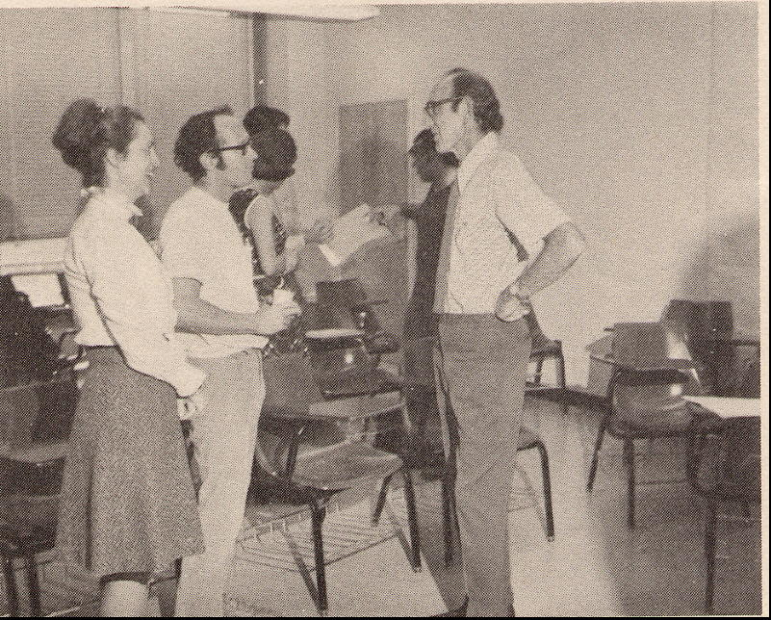
John Cassel (photo from 1972?)
John Cassel teaching a class in Rosenau Hall
After class with Bobbie Lupker(?) and Jeremy Kark (?)

Slide 30
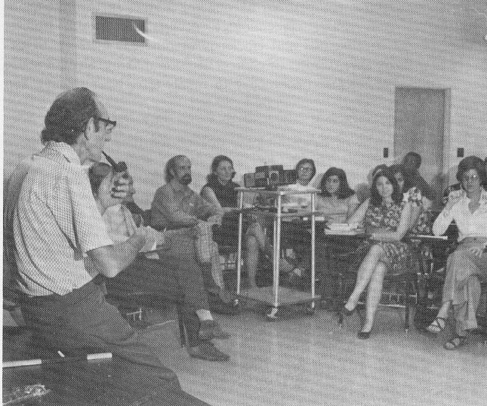
What was John Cassel’s epidemiology?
“Epidemiology is fundamentally engaged in the broader quest for social justice and equality.” (per Sherman James, 1/20/1999)
Notes:
“Epidemiology is fundamentally engaged in the broader quest for social justice and equality.” This is the way that John Cassel characterized epidemiology during the discussion in which he invited Sherman James to join the Epidemiology faculty at UNC. Dr. James recounted the incident when he presented the 1999 John Cassel Seminar (1/20/1999). John Cassel’s perspective is not always prominent in epidemiology discussions, but it defines a mission for our field that we should never lose sight of.
(To learn more about John Cassel, see Michel A. Ibrahim, Berton H. Kaplan, Ralph C. Patrick, Cecil Slome, Herman A. Tyroler and Robert N. Wilson. The legacy of John C. Cassel. Am J Epidemiol 1980(July);112(1):1-7 (http://aje.oxfordjournals.org/cgi/reprint/112/1/1.pdf)

Slide 31
What was John Cassel’s epidemiology?
“One of my father’s qualities and methods of investigation was that he cast a wide net over a problem, without preconceived notion of what he would find. He gathered all sorts of information whether it was potentially valuable or not. He dissected out the variables and discarded the ones that were the same. He took careful note of ones that were different. From there he would examine what it was about the different variable(s) that might influence the problem he was investigating. He gave my UNC nursing class commencement address and emphasized that searching for answers required critical and clear thinking without bias.” Gillian Cassel Wolfe, 1/22/2014

Slide 32
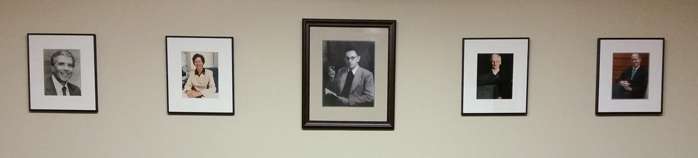
EPID chairs – John Cassel (center), Michel Ibrahim, Barbara Hulka, Carl Shy, David Savitz
Portraits on the wall in the John C. Cassel Conference Room, 2101G McGavran-Greenberg
Notes:
The original John C. Cassel Conference Room was room 204 Rosenau Hall. The John C. Cassel Conference Room in McGavran Greenberg was dedicated in 1998. The portraits were framed by Susanne Wolf.

Slide 33
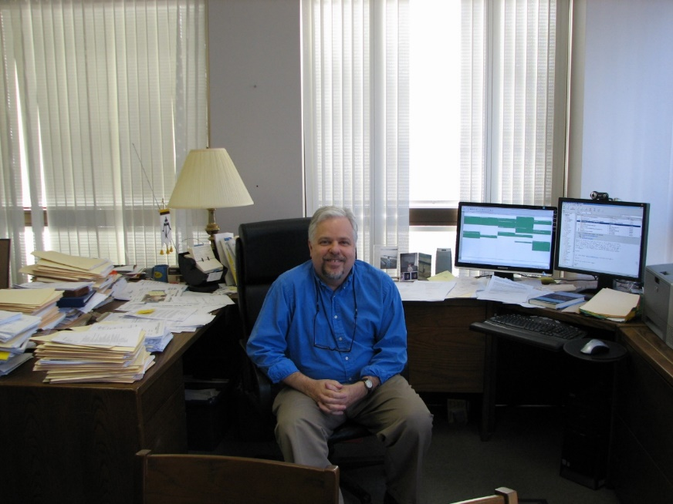
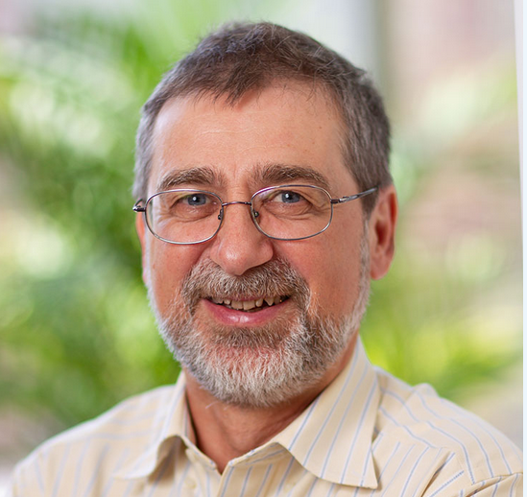
EPID chairs – Andrew Olshan, Til Stürmer
Andrew Olshan, PhD
Barbara Sorenson Hulka Distinguished Professor
Til Stürmer, MD, MPH, PhD
Nancy A. Dreyer Distinguished Professor

Slide 34
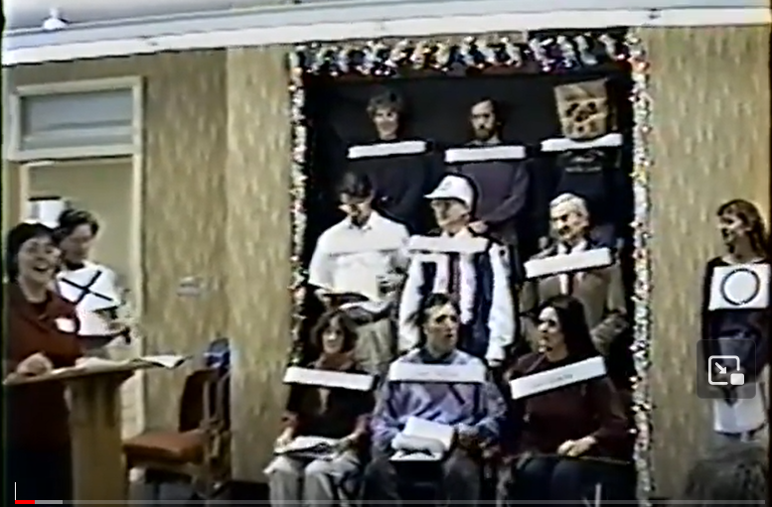
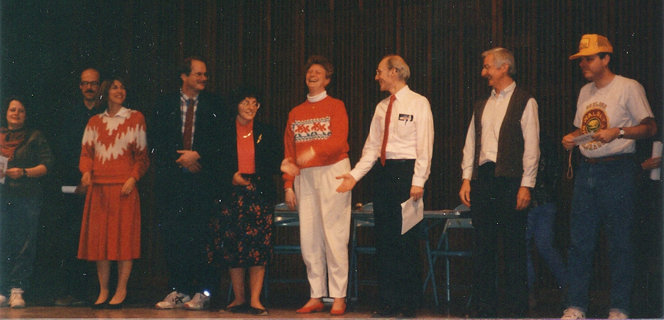
UNC Epidemiology holiday party skits
See also the Memory Books and one video recording at www.epidemiolog.net/sjae/publib/orgs/UNCCH/UNCSPH/EPID/History/PastEvents/Skits/

Slide 35
Working on the history of the Department of Epidemiology

Slide 36
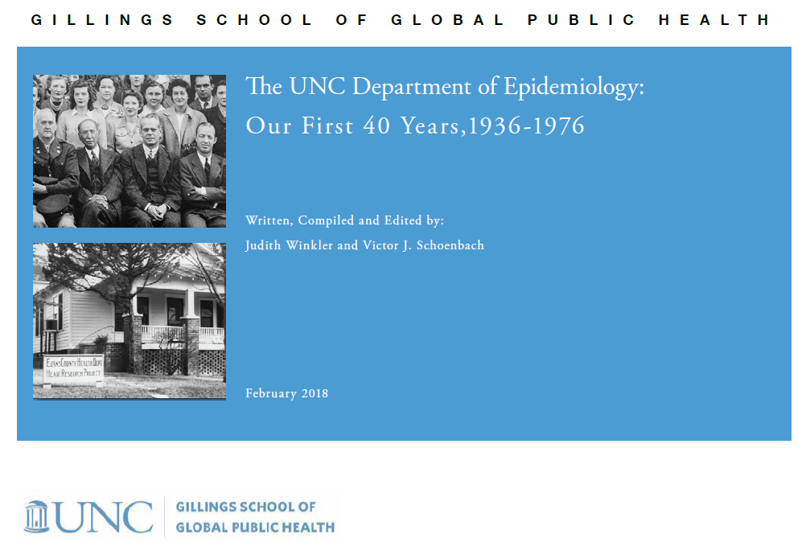
Whence this precious document?
https://www.epidemiolog.net/sjae/publib/orgs/UNCCH/UNCSPH/EPID/History/UNC_EPID_history_2018.pdf

Slide 37
Sept. 28, 2006 email from Andy Olshan
Bert and Vic, Can you help with these questions?
[Linda Kastleman wrote] “I am finalizing copy for the next /Carolina Public Health. . . . The Dean has asked that this issue include a "timeline" of our School's activities related to health disparities. . . . Specifically, I am interested in finding out:
* Who was the first chair of your department and what year was he appointed? (There seems to be some discrepancy as to whether it was Sidney Kark or John Cassel)
* What year was John Cassel appointed Epi chair?
* What year was Sidney Kark appointed Epi chair?
* What year (or decade if year is not available) was Sherman James appointed to the Epi faculty? Also was James African American?
* What year (or decade if year is not available) was Cecil [Slome] appointed to the Epi faculty?
* What year (or decade if year is not available) was Ralph Patrick appointed to the Epi faculty?
Notes:
Looking back through emails from Andy Olshan after he became chair, I found multiple question to Bert Kaplan and me
The questions generally originated with the Dean’s office or its communications unit

Slide 38
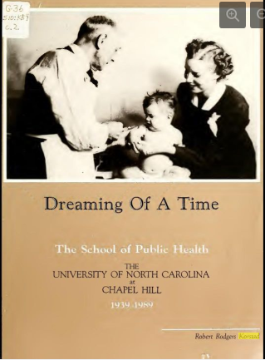
The history of the School’s first half-century was published in 1990
Robert Rodgers Korstad, Dreaming of a time: the School of Public Health: the University of North Carolina at Chapel Hill, 1939-1989
  https://www.epidemiolog.net/sjae/publib/orgs/UNCCH/UNCSPH/EPID/History/Robert%20Korstad%2C%20Dreaming%20of%20a%20Time.html
Commissioned by Dean Michel Ibrahim; Harriett Barr was a key facilitator

Slide 39
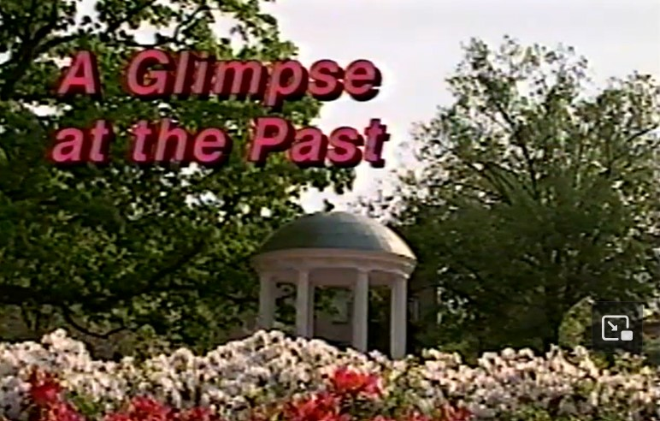
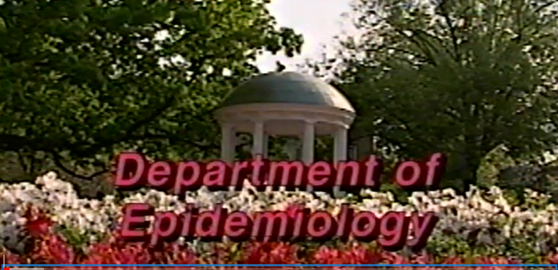
Previous compilations of the Department’s history had been created
A Glimpse at the Past - A Pictorial History of the Department of Epidemiology at the School of Public Health at the University of North Carolina. Created and produced by Sue Wolf. Narrated by Marilyn Vine.
  https://www.epidemiolog.net/sjae/publib/orgs/UNCCH/UNCSPH/EPID/History/PastEvents/Glimpse/
Developed for a celebration honoring the distinguished careers of Professors Berton H. Kaplan, Carl M. Shy, and H. A. (Al) Tyroler
Developed by a History Committee created by chair David Savitz in the mid-1990s

Slide 40

Catching up to BIOS
The School was becoming interested in its history again, but looking to the departments
BIOS published a book chapter!
  https://sph.unc.edu/wp-content/uploads/sites/112/2014/02/bios_2013-HISTORY-DEPT-BIOS-UNC-CH-CHAPTER.pdf
  (We learned later that the Department of Biostatistics had a file cabinet where they had retained all of their documents over the decades!)
Andy Olshan wanted EPID to match them. He asked Vic-the-collector. Then he heard about Judith Winkler, the communicator.

Slide 41
Judith Winkler:
Mine the historical data/write it up
Read/listen to everything: archives, recorded interviews, transcripts
Corroborate the facts: first-person and contemporaneous reports, CVs, obituaries, annual reports, tales in the department
Photos: NC Collection, department, internet, publications (Gigapixel)
Identify focus areas: people, departmental change, social and cultural environment at UNC

Slide 42
Judith Winkler:
Mine the historical data/write it up - 2
Research->write->read->revise->read->revise->revise, copy edit
List resources for future researchers
Graphic design to show interrelationships of the focus areas
Document design in InDesign and final format is PDF

Slide 43
Acknowledgements
Great debt to Robert Korstad’s Dreaming of a Time, an invaluable resource on the history of the UNC Gillings School of Global Public Health, and to Michel Ibrahim, then dean of the school, for commissioning the work.
Susanne Wolf compiled a department scrapbook, preserving booklets, letters, stories and photographs not available elsewhere. Faculty and staff joined that effort, with encouragement from then-chair, David Savitz.
An unpublished booklet printed around 1979 supplied unique information about the programs and faculty members of the department in late 1970s.
Additional key resources: annual reports for the Gillings School and the department archived in the UNC Health Sciences Library; unpublished documents, digital collections and interviews held in UNC’s University Archives, North Carolina Collection and Southern Historical Collection.
Notes:
Joanna Smith, Marilyn Knowles, Jo Heiss
From Judith Winkler to Elizabeth French, 1/12/2016
Hi Elizabeth—I am working with Vic to put together a history of the Department of Epidemiology. He has many resources, but we would like to sit down and talk about other sources you may know. We have done a little work to narrow down the scope of the history. We can tell you about that.
We know we need to find data about faculty, students, degrees earned, and similar information. We know that Gillings, General Alumni Association, libraries, university administration will likely have some of this info. However, we think talking with you before we go looking for data would help us be most effient.
From Judith to Linda Kastleman, 1/12/2016:
Hi Linda, I am going to be working on a history of the Department of Epidemiology with Vick and with Andy Olshan.
I would love to meet with you to see what photos and other resources you have and pick your brain about sources of info.

Slide 44
Acknowledgements - 2
Victor Schoenbach contributed documents and memories, contacted former faculty members and alumni to check facts and collect resources, drafted sections of the document and edited many drafts.
Schoenbach and Bill Jenkins interviewed many former faculty members.
Judith Winkler, lead writer, editor and graphic designer, also conducted archival research.
Linda Kastleman provided editorial assistance.
Department Chair Andrew Olshan provided critical vision, leadership, encouragement and support.
Notes:
Joanna Smith, Marilyn Knowles, Jo Heiss
From Judith Winkler to Elizabeth French, 1/12/2016
Hi Elizabeth—I am working with Vic to put together a history of the Department of Epidemiology. He has many resources, but we would like to sit down and talk about other sources you may know. We have done a little work to narrow down the scope of the history. We can tell you about that.
We know we need to find data about faculty, students, degrees earned, and similar information. We know that Gillings, General Alumni Association, libraries, university administration will likely have some of this info. However, we think talking with you before we go looking for data would help us be most effient.
From Judith to Linda Kastleman, 1/12/2016:
Hi Linda, I am going to be working on a history of the Department of Epidemiology with Vick and with Andy Olshan.
I would love to meet with you to see what photos and other resources you have and pick your brain about sources of info.

Slide 45
Sources of historical data

Slide 46
Sources of historical data
Traditional
Documents
Reports – annual, special
Meeting minutes
Newsletters
Interviews
Photos
Correspondence, incl. email
Memory
Digital / Internet
Webpages
Event programs and recordings
North Carolina Digital Collections
Social media posts
Notes:
From Judith Winkler to Elizabeth French, 1/12/2016
Hi Elizabeth—I am working with Vic to put together a history of the Department of Epidemiology. He has many resources, but we would like to sit down and talk about other sources you may know. We have done a little work to narrow down the scope of the history. We can tell you about that.
We know we need to find data about faculty, students, degrees earned, and similar information. We know that Gillings, General Alumni Association, libraries, university administration will likely have some of this info. However, we think talking with you before we go looking for data would help us be most effient.
From Judith to Linda Kastleman, 1/12/2016:
Hi Linda, I am going to be working on a history of the Department of Epidemiology with Vick and with Andy Olshan.
I would love to meet with you to see what photos and other resources you have and pick your brain about sources of info.

Slide 47
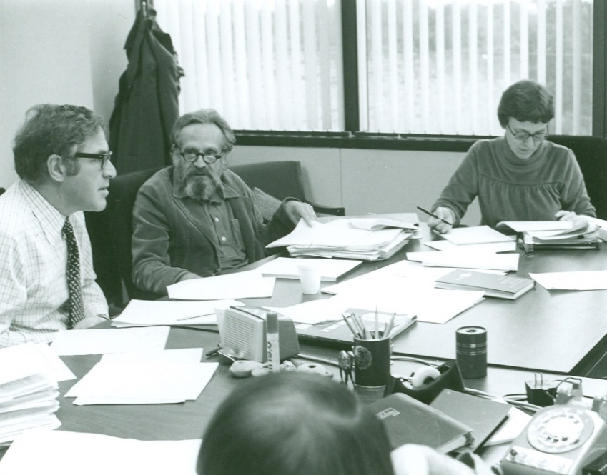
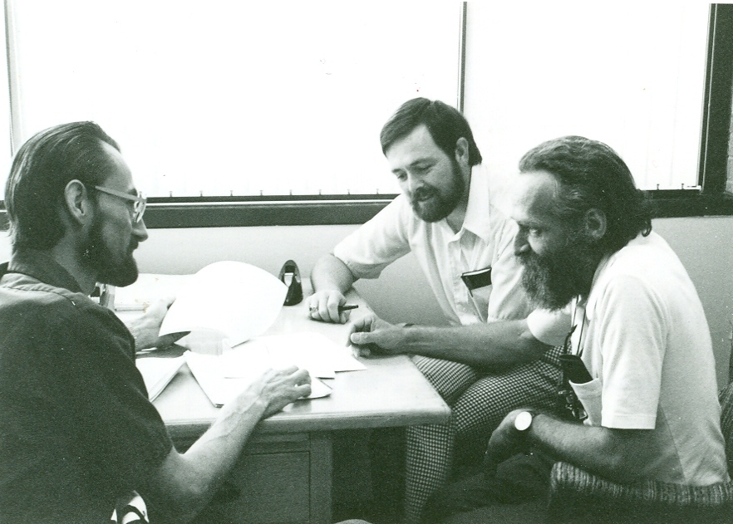
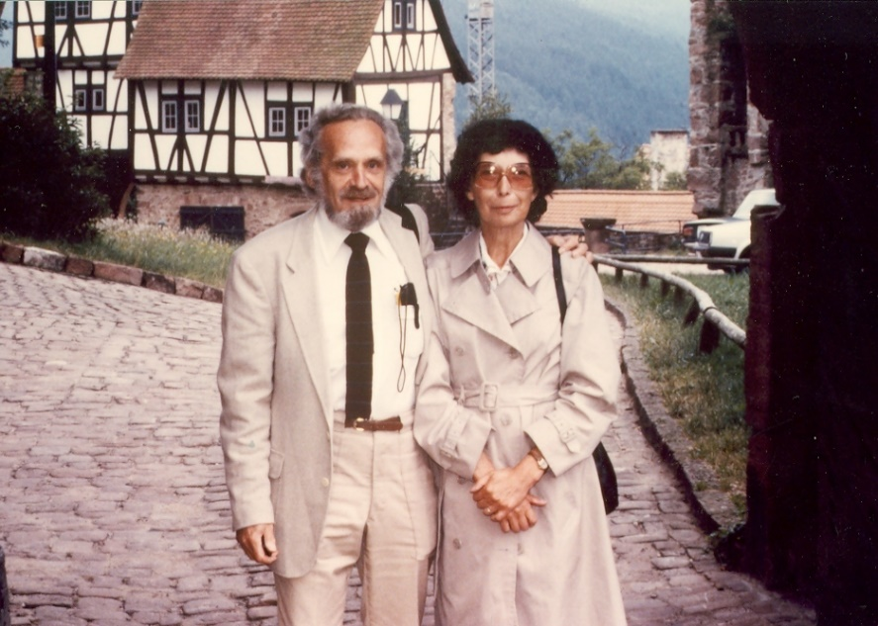
Photos are precious – but they need captions
Al Tyroler (center) - with whom?
Gerardo Heiss, Ed Davis, Al Tyroler
Al and Marilyn Tyroler
Notes:
But they are most meaningful when the people and context are identified.

Slide 48
Let’s take ten minutes to look for a precious gem in an interview
Epidemiology Department chairs following Sidney Kark and John C. Cassel (about) (order of appearance)
Epidemiology Department faculty
Epidemiology Department alumni
https://go.unc.edu/EpiVic
Then scroll down to Recorded interviews with UNC public health people
Notes:
From Judith Winkler to Elizabeth French, 1/12/2016
Hi Elizabeth—I am working with Vic to put together a history of the Department of Epidemiology. He has many resources, but we would like to sit down and talk about other sources you may know. We have done a little work to narrow down the scope of the history. We can tell you about that.
We know we need to find data about faculty, students, degrees earned, and similar information. We know that Gillings, General Alumni Association, libraries, university administration will likely have some of this info. However, we think talking with you before we go looking for data would help us be most effient.
From Judith to Linda Kastleman, 1/12/2016:
Hi Linda, I am going to be working on a history of the Department of Epidemiology with Vick and with Andy Olshan.
I would love to meet with you to see what photos and other resources you have and pick your brain about sources of info.

Slide 49
Many people have contributed to preserving our history but it remains a challenge – and there’s a lot more waiting to be written!

Slide 50
A partial list of people who have helped me discover, preserve, and disseminate history
Joyce Allen
Harriet Barr (Alumni Affairs)
Nancy Colvin
Spencer Gee
Chandra Ford
Joan Cornoni Huntley
Barbara Hulka
Michel Ibrahim
Bill Jenkins
Phyllis Johnson
Bert Kaplan
Robert Korstad (Dreaming of a Time)
Tom Laney (Instructional Media)
O.J. McGhee (Instructional Media)
Andy Olshan
David Savitz
Carl Shy
Matthew Turi (UNC Archives)
Steve Wing
Judith Winkler
Susan Wolf and her CVD colleagues*
Steve Zyzanski
Notes:
* Including Joanna Smith, Marilyn Knowles, Jo Heiss

Slide 51
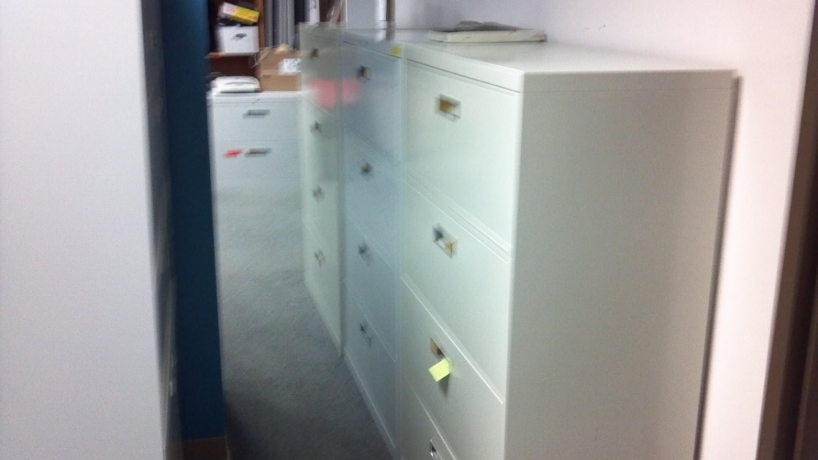
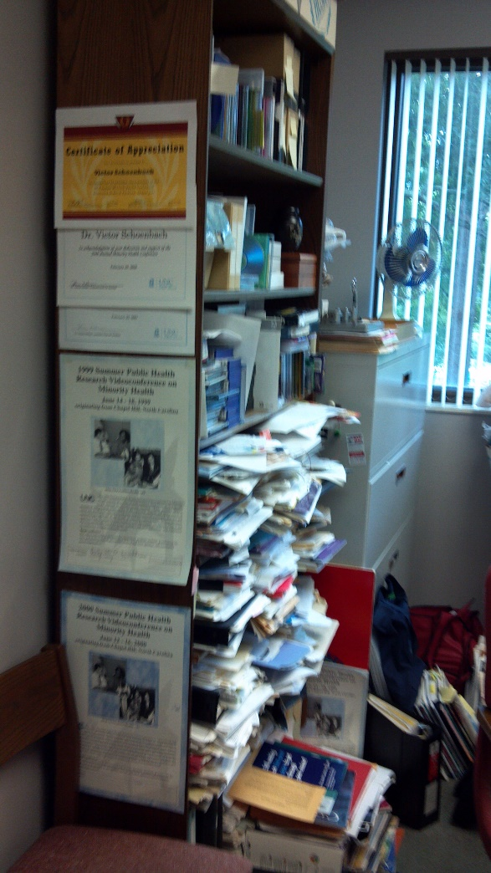
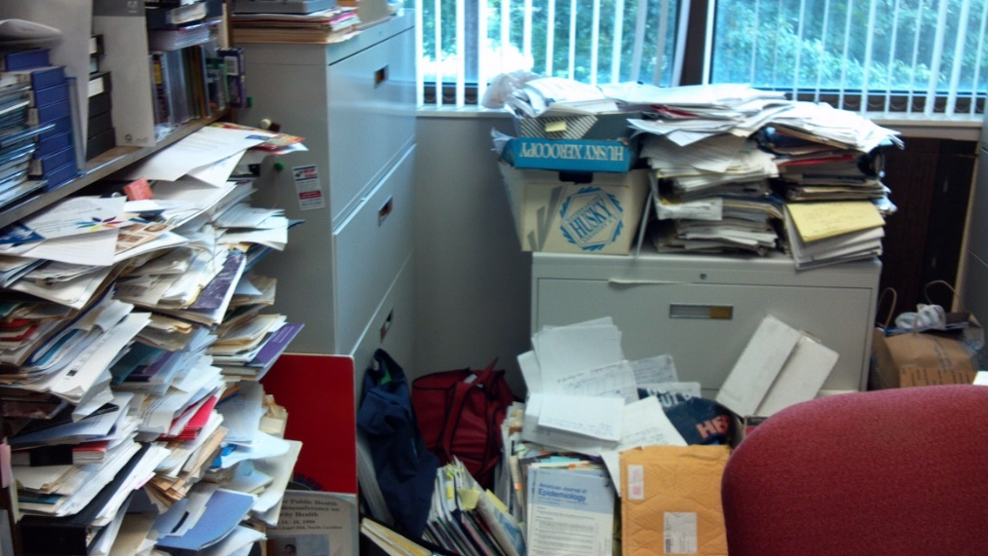
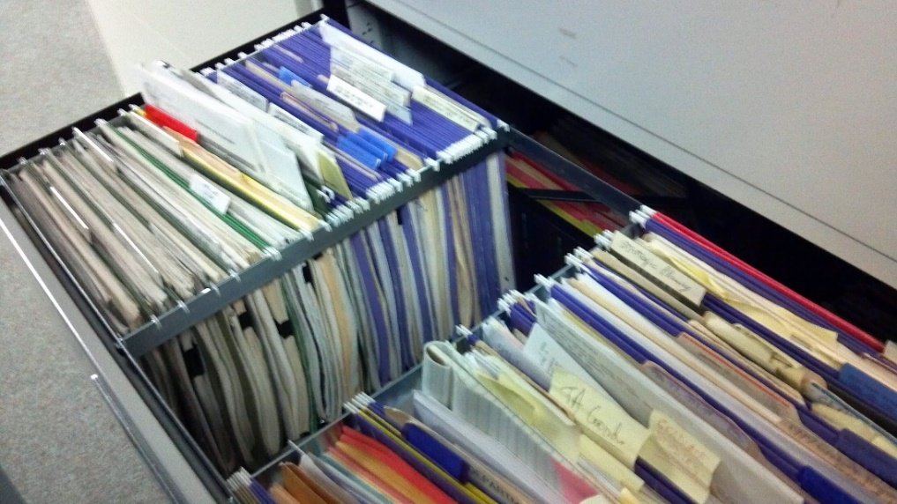
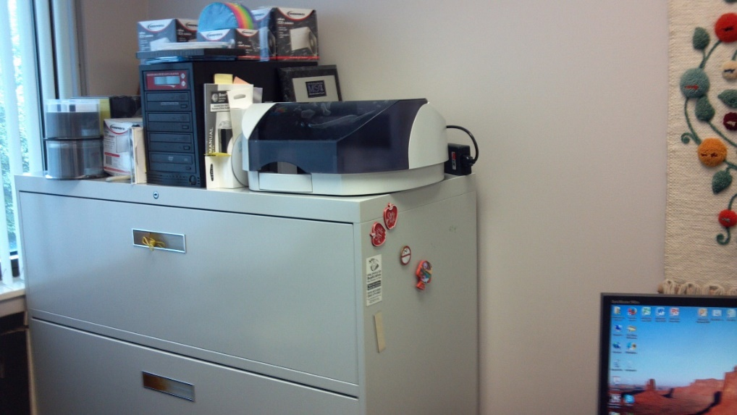
But how to preserve history – paper, digital?
Notes:
D:\2-Vic\VicsScansandImages\Vic\VicsOffice

Slide 52
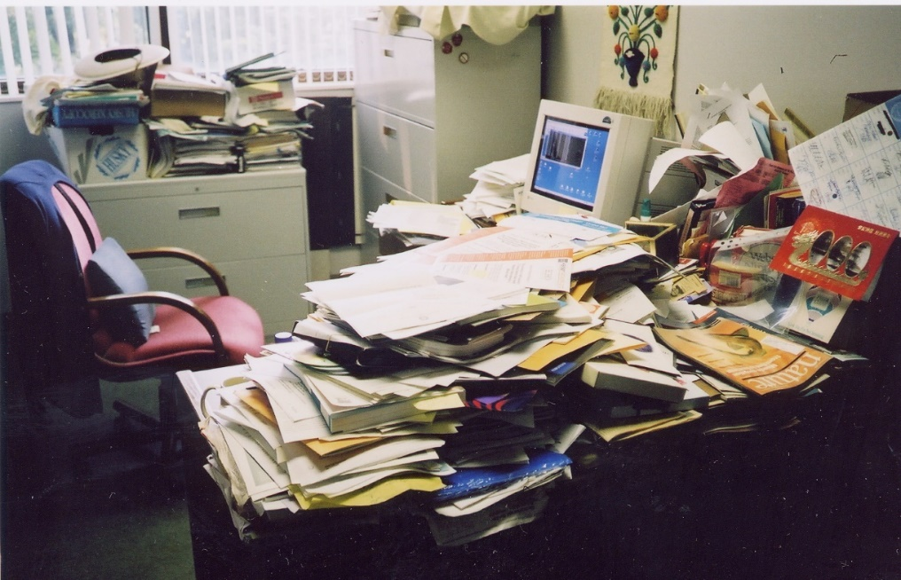
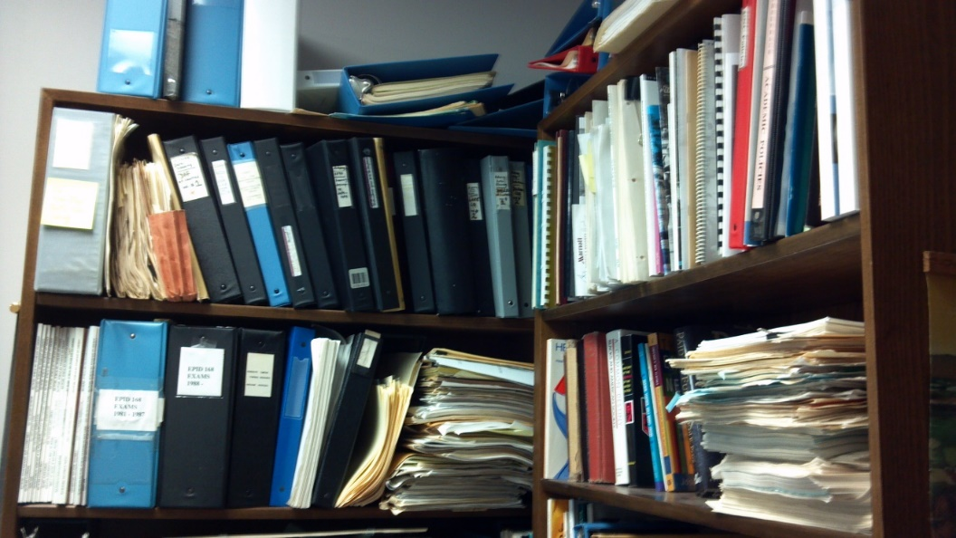
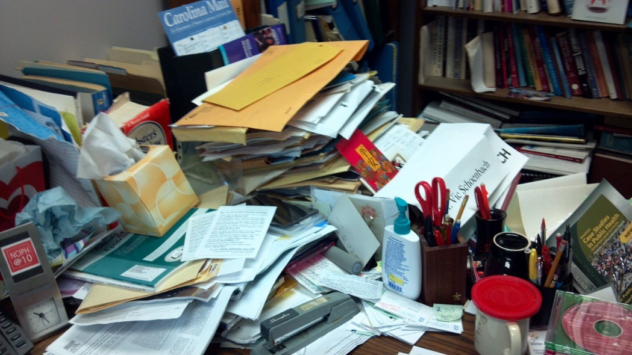
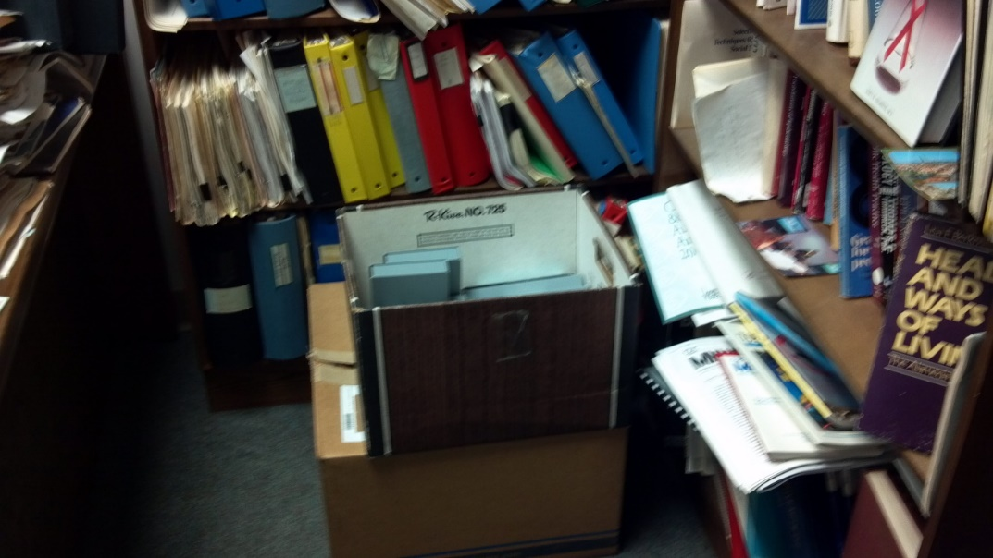
(It was painful to leave my office)

Slide 53
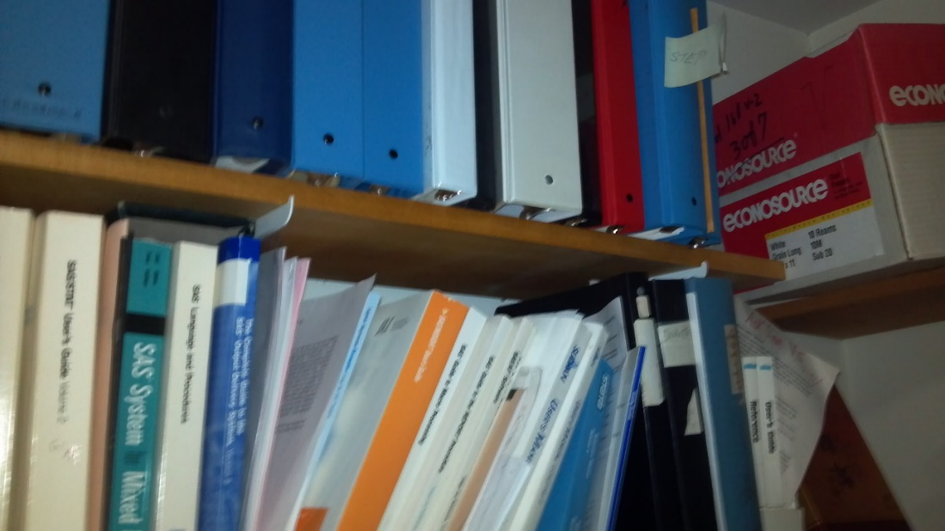
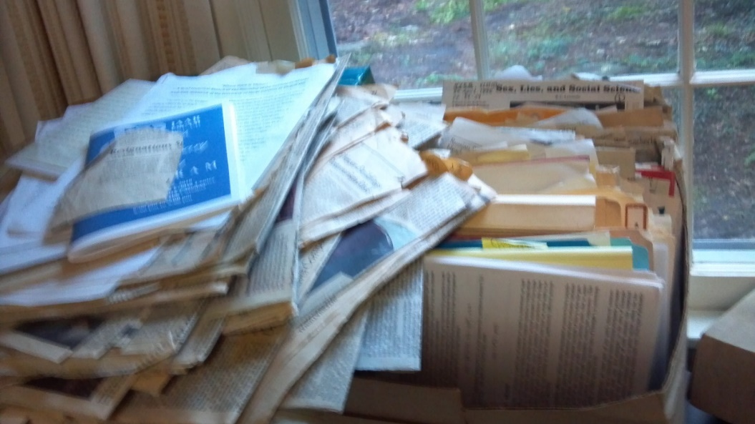
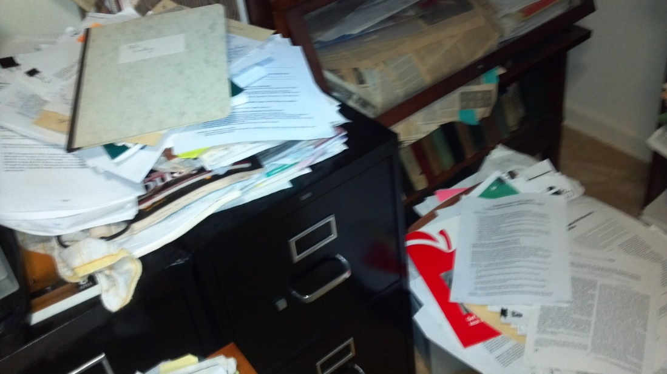
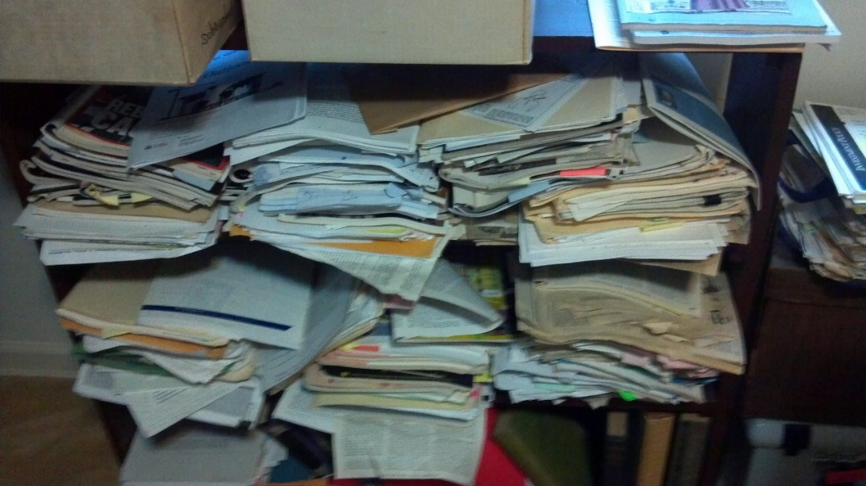
Because my house was already stuffed!

Slide 54
So I’m thinking digital archiving – but . . .
ColdFusion @SPH → Had to switch to ColdFusion @UNC
Cold Fusion@UNC → Had to switch to plain HTML
AFS (Andrew Files Space)@UNC → Had to switch to Epidemiolog.net
Sakai@UNC → Had to switch to Epidemiolog.net (in progress)
Various web platforms at UNC have been decommissioned – thank goodness for the Internet Archive and its Wayback Machine (archive.org)
How long will digital archives endure?
Notes:
Joanna Smith, Marilyn Knowles, Jo Heiss

Slide 55
Key resources about CVD epidemiology history
Heart Attack Prevention: A History of Cardiovascular Disease Epidemiology (http://www.epi.umn.edu/cvdepi/)
Community Health: A Model for the World
https://www.nlm.nih.gov/exhibition/againsttheodds/exhibit/community_health/model_world.html
Archives of Internal Medicine, December 1, 1971;128(6)
http://jamanetwork.com.libproxy.lib.unc.edu/journals/jamainternalmedicine/issue/128/6
https://jamanetwork.com/journals/jamainternalmedicine/issue/128/6

Slide 56
Thank you!
Key resources about UNC EPID history
https://go.unc.edu/EPIDhistory
UNC EPID people – including recorded interviews
https://www.epidemiolog.net/sjae/publib/orgs/UNCCH/UNCSPH/EPID/People/
UNC EPID events from our history
https://www.epidemiolog.net/sjae/publib/orgs/UNCCH/UNCSPH/EPID/History/PastEvents/

Slide 57
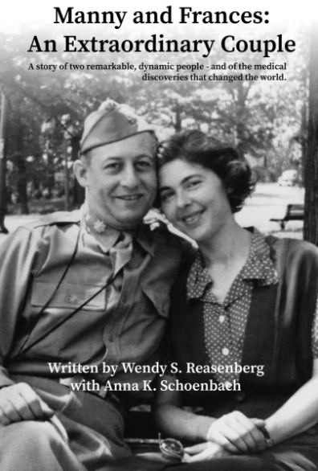

Two books by my big sister and niece
https://go.unc.edu/ReadBooks#wsr
Notes:
Wendy Schoenbach Reasenberg, with Anna Kade Schoenbach: Manny and Frances: An Extraordinary Couple and The Life Savers of World War II. Reading these books, which she published last year, led me to realize that I had actually heard of epidemiology many years before I was aware.

