Slide 1
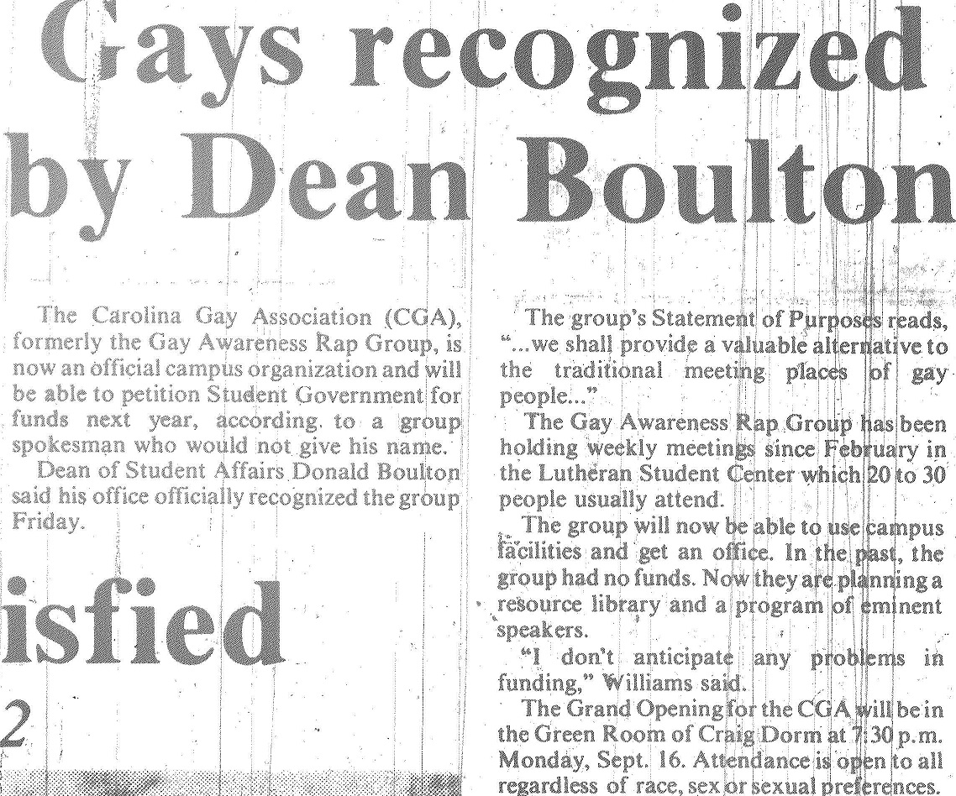

Slide 2
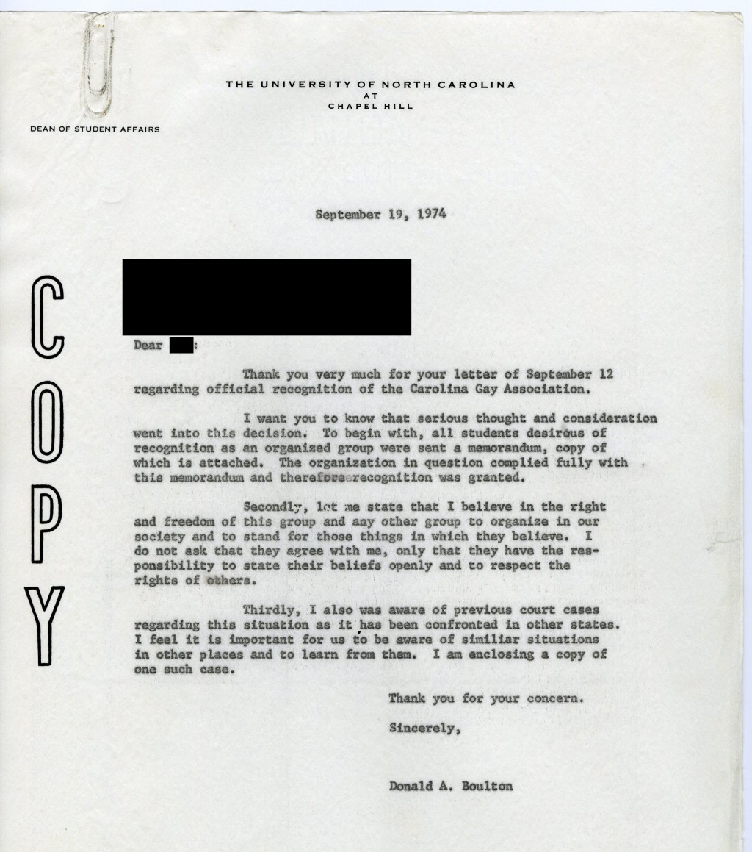
Dean Boulton’s response to a complaint about the Carolina Gay Association (Folder 305, Box 6, Records of the Student Union of the University of North Carolina at Chapel Hill Records #40128, University Archives).

Slide 3
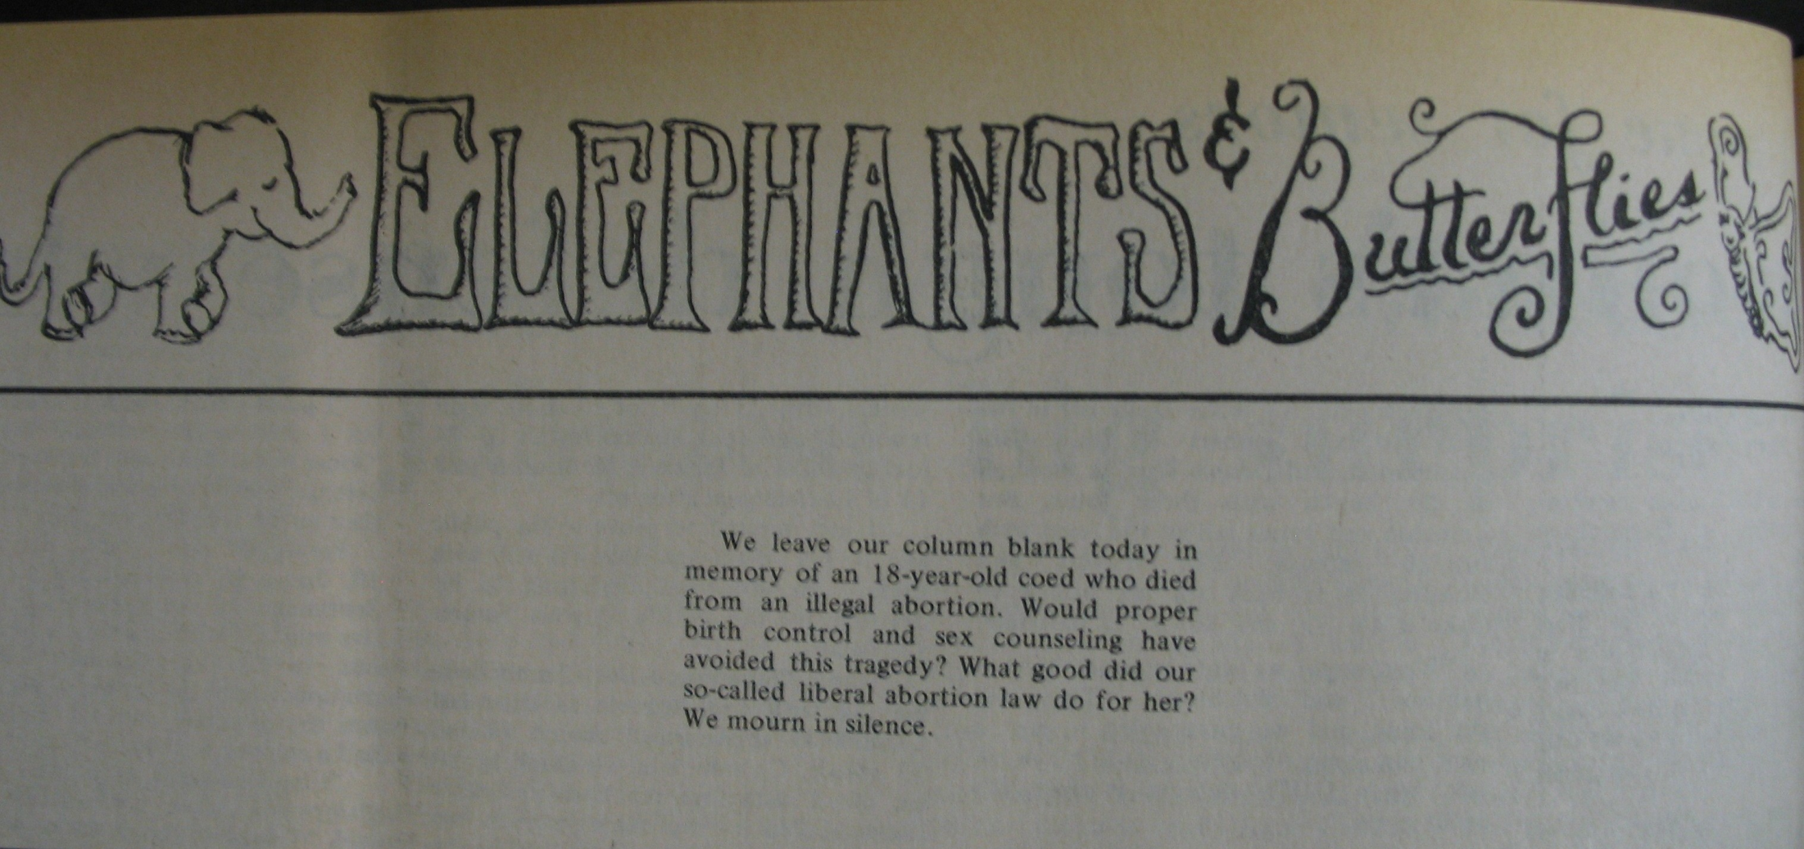
From the “Elephants and Butterflies” column in the Daily Tar Heel, 6 March 1972

Slide 4
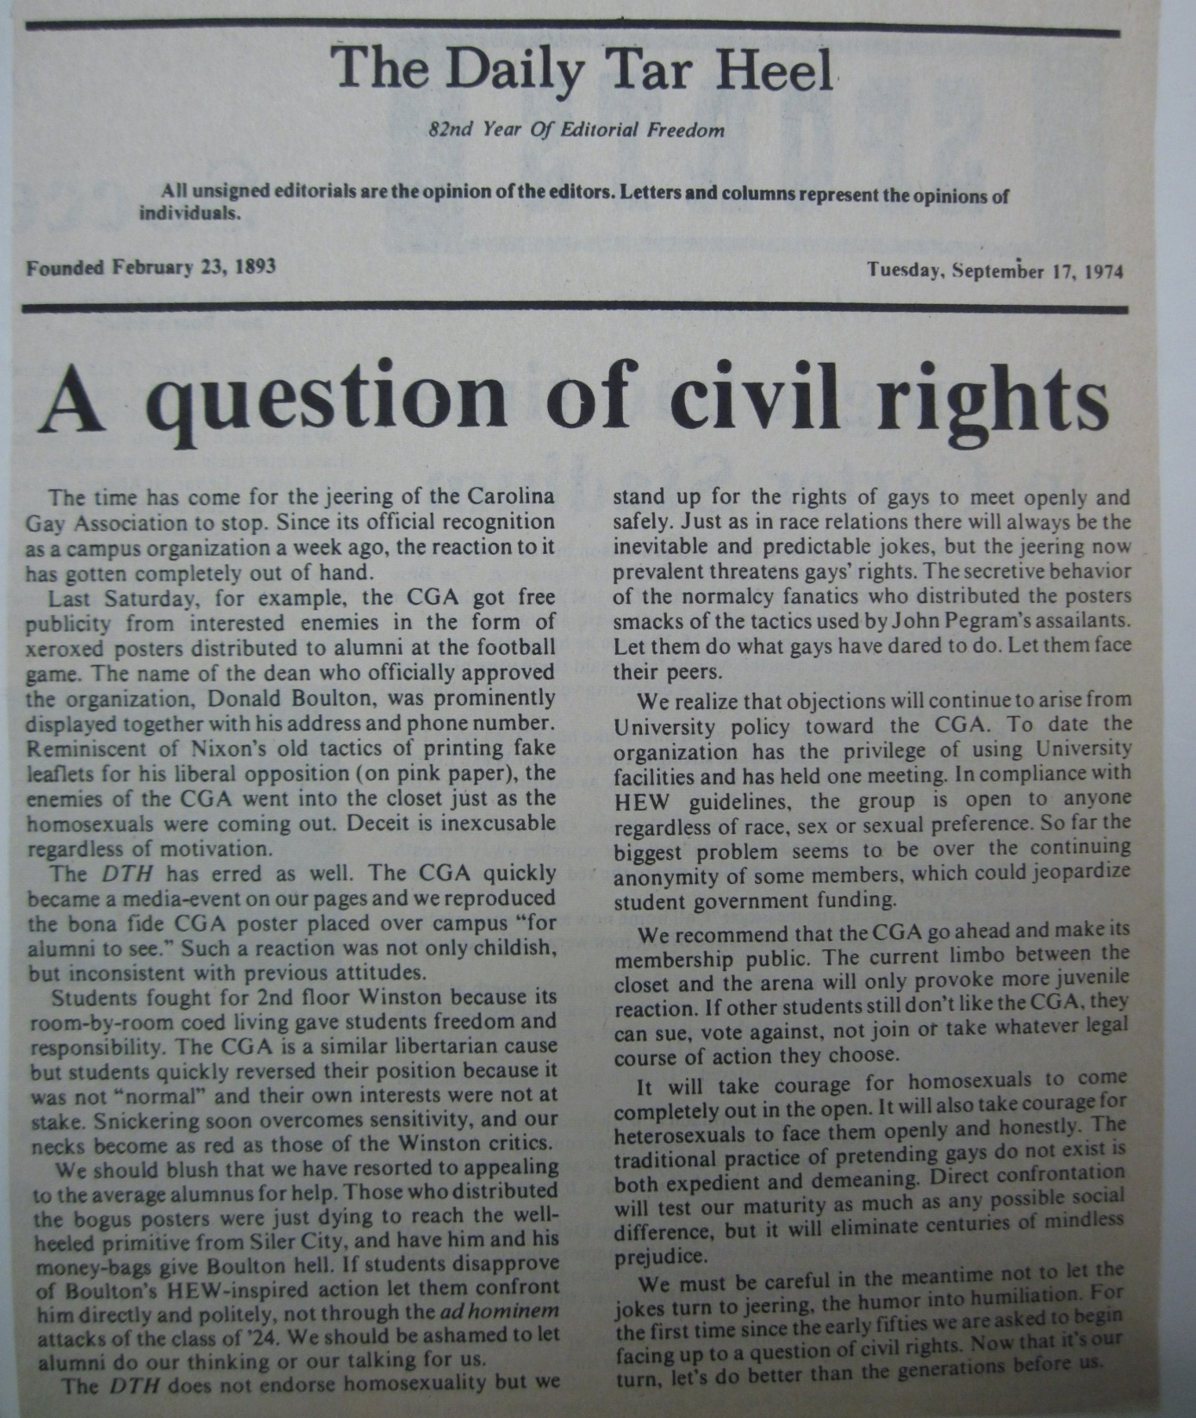
From the Records of the Vice Chancellor of Student Affairs, Box 34, #40124, University Archives

Slide 5
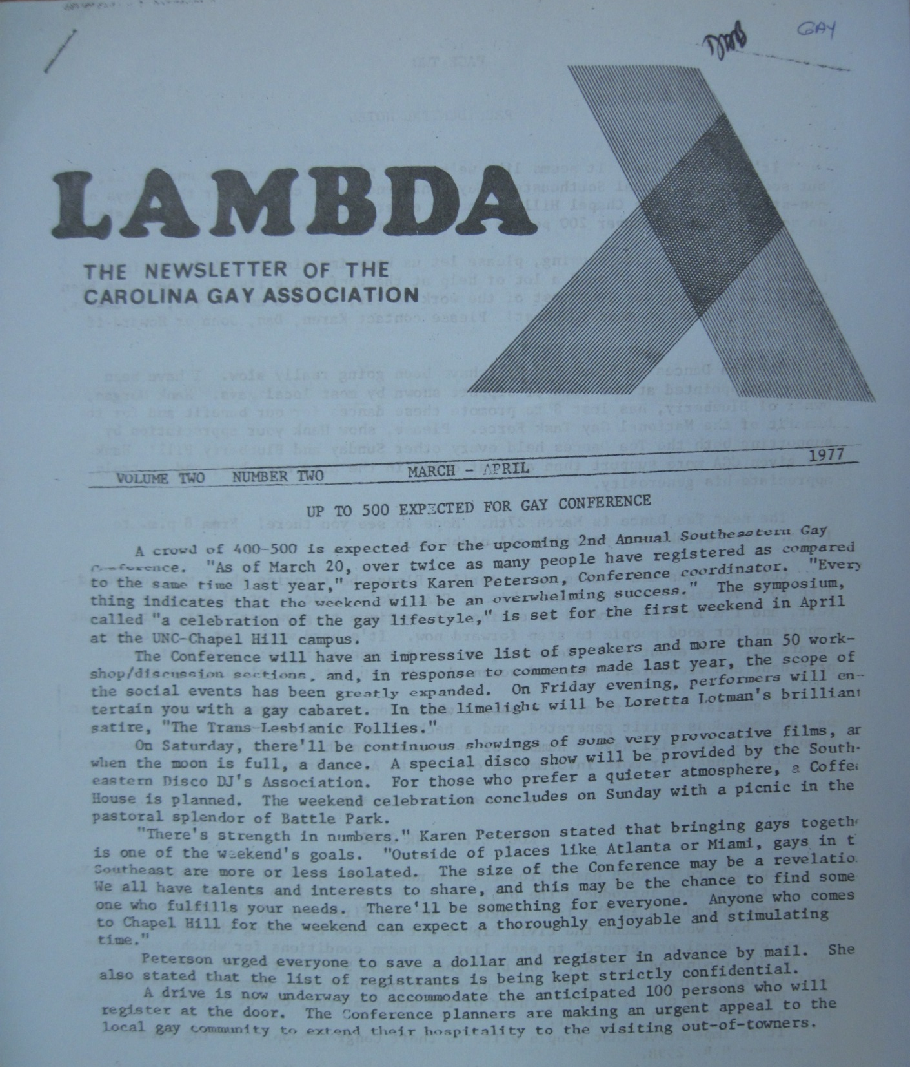
From the Records of the Vice Chancellor of Student Affairs, Box 34, #40124, University Archives

Slide 6
From the Records of the Vice Chancellor of Student Affairs, Box 35, #40124, University Archives

Slide 7
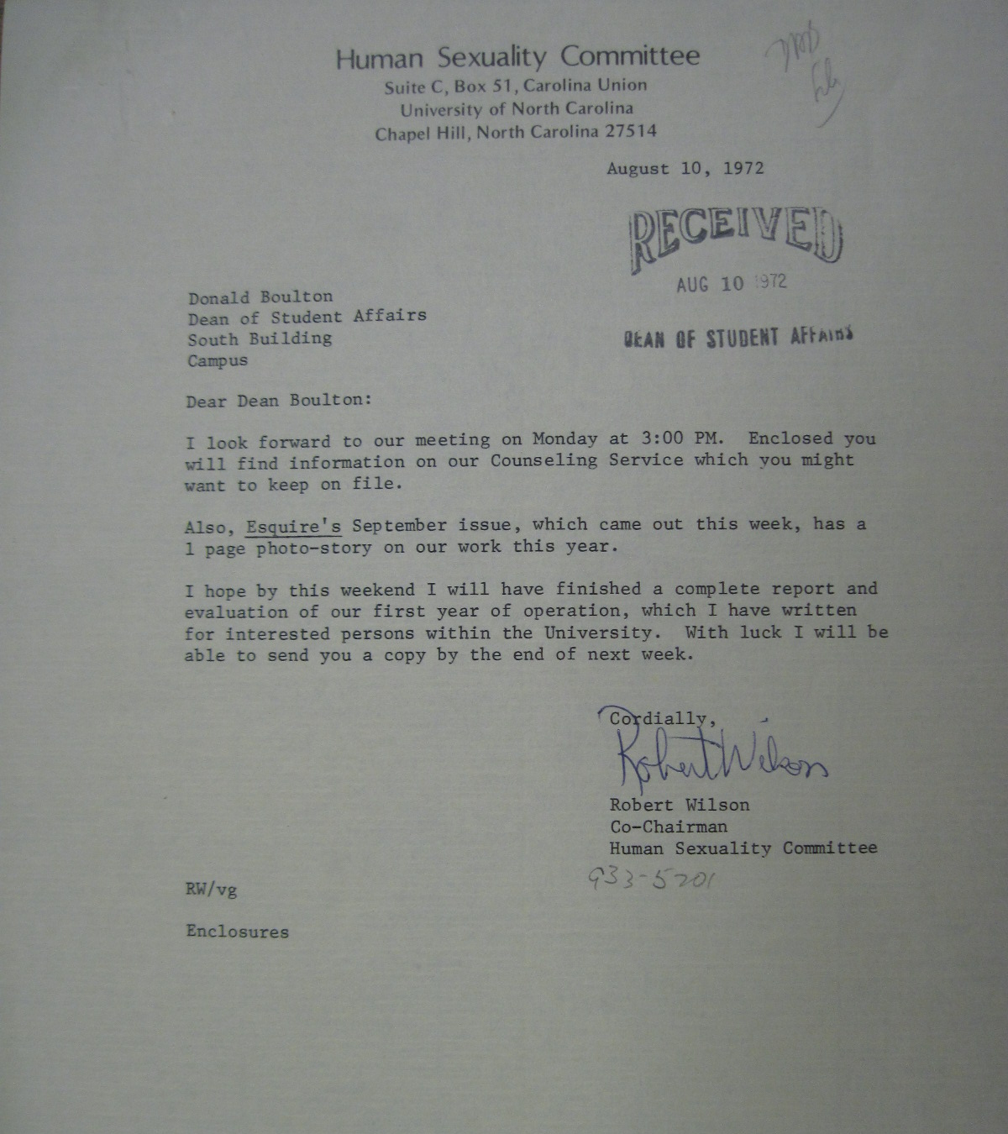
From the Records of the Vice Chancellor of Student Affairs, Box 35, #40124, University Archives

Slide 8
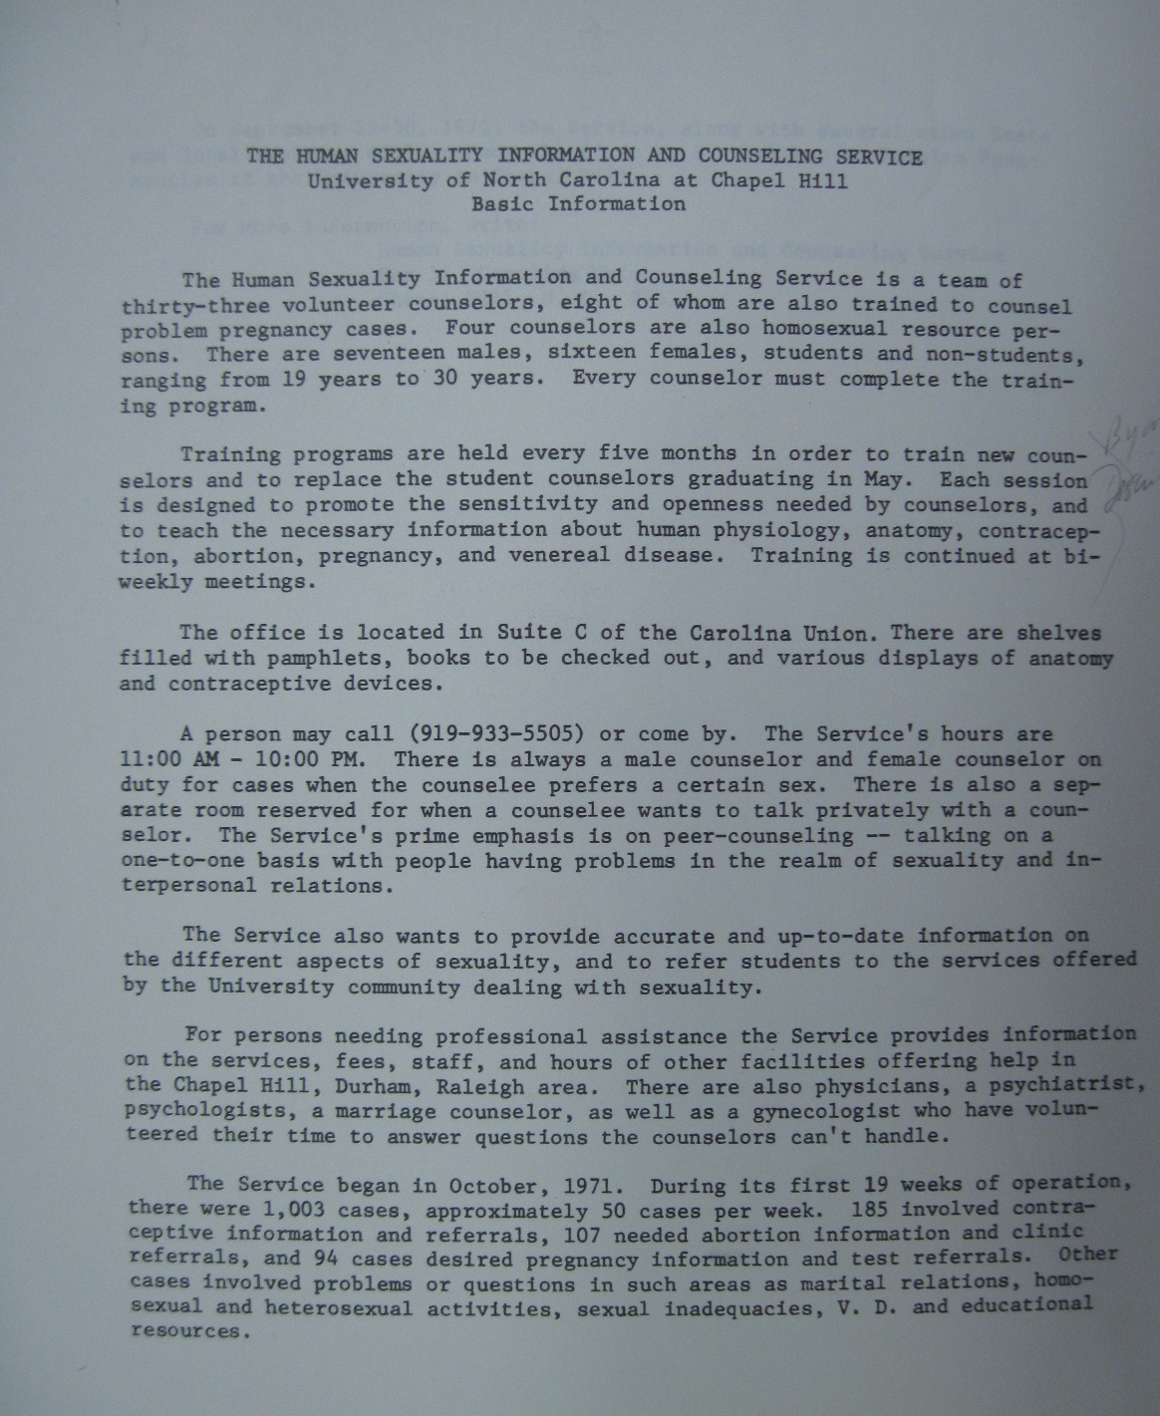
From the Records of the Vice Chancellor of Student Affairs, Box 35, #40124, University Archives

Slide 9
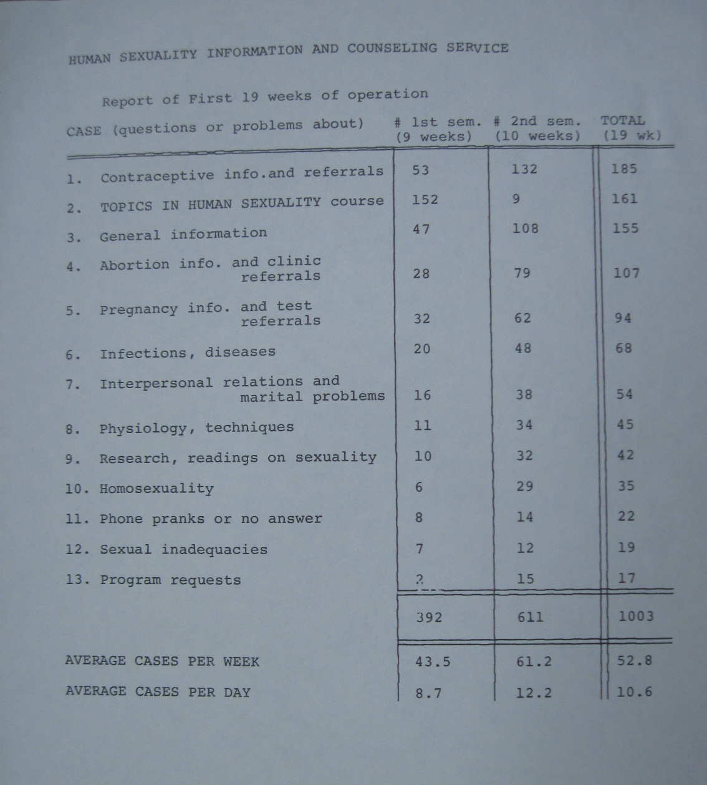
From the Records of the Vice Chancellor of Student Affairs, Box 35, #40124, University Archives

Slide 10
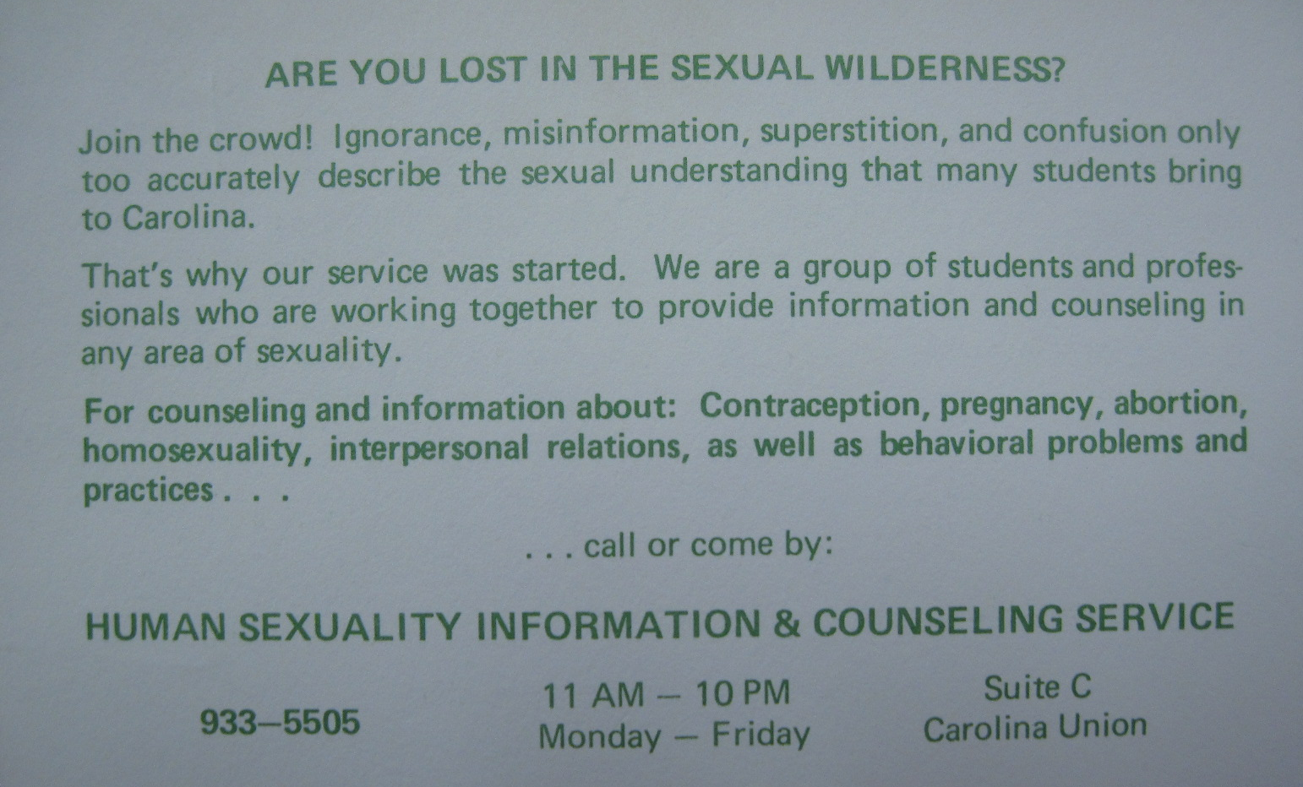
From the Records of the Vice Chancellor of Student Affairs, Box 35, #40124, University Archives

